Slide 1
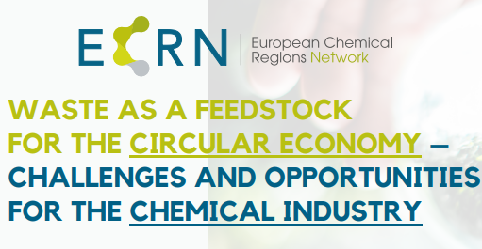
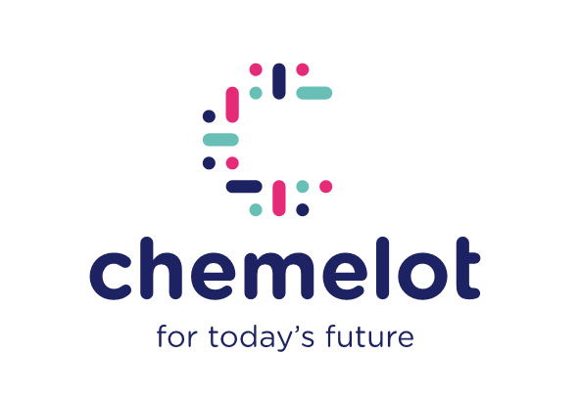

Welcome to
Frank Schaap
April 20, 2022

Slide 2
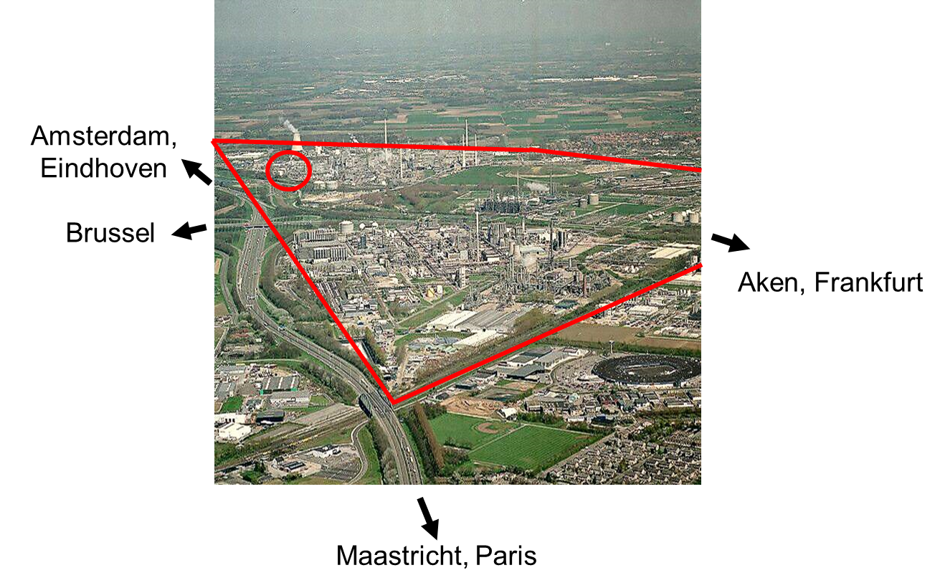
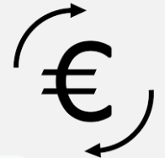

What is Chemelot?
One of the largest chemical and material communities in Europe (ca 8 km2)
Industrial Park + Campus
Number of companies on site > 150; strongly growing since 2005
> 10 billion €
7,5 billion kg
Notes:
60 plants
60 km rails
800 km pipelines
harbor

Slide 3
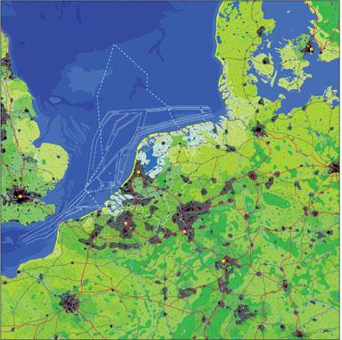

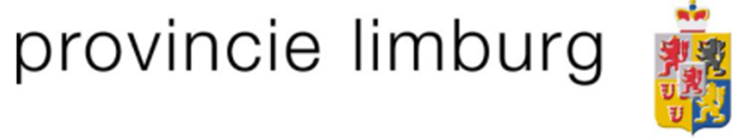
Center of ARRRA
40% of chemical production in EU
Rotterdam
Dusseldorf
Antwerp
Cologne
Frankfurt
Paris

Slide 4
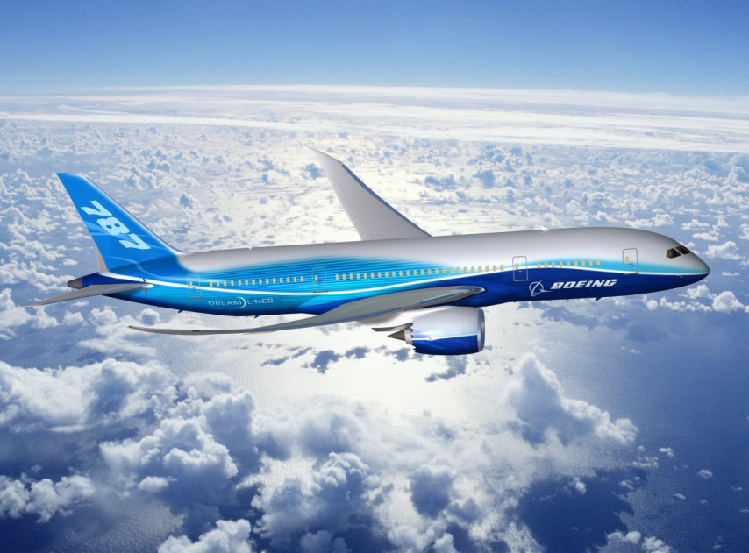

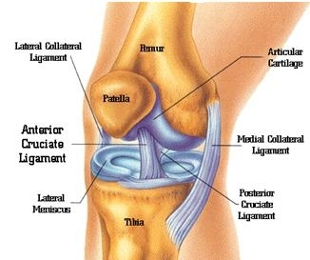
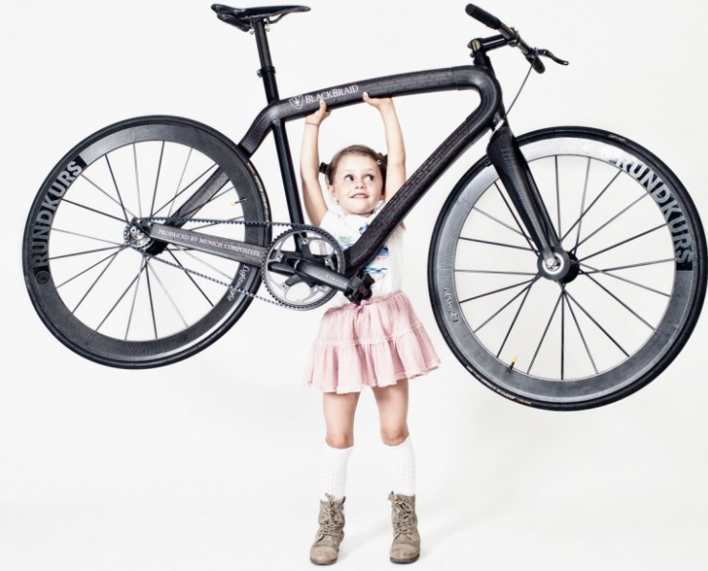

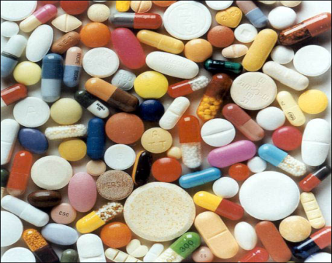


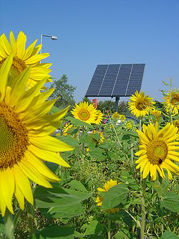


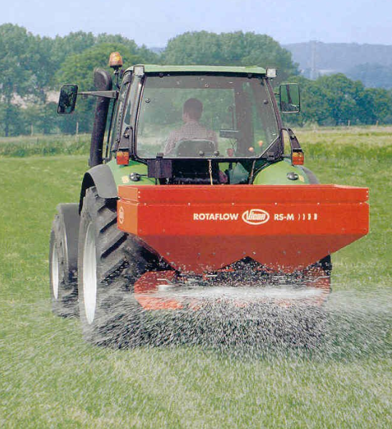


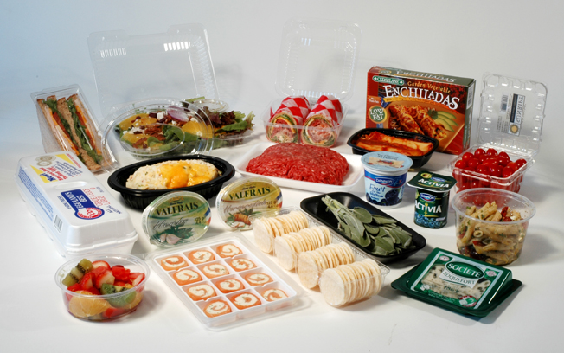
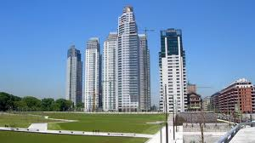
Global leading valuechains
4
Brightlands Chemelot Campus

Slide 5
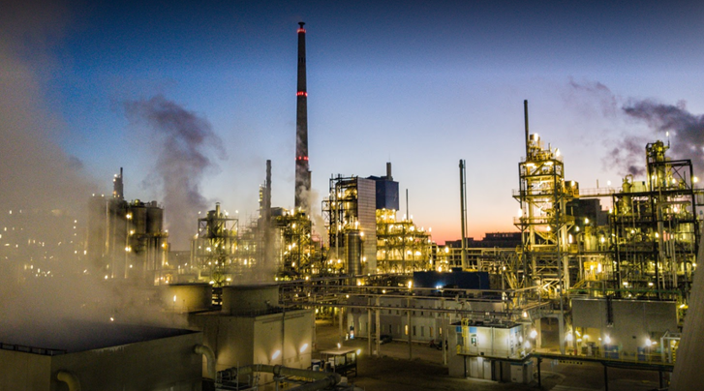
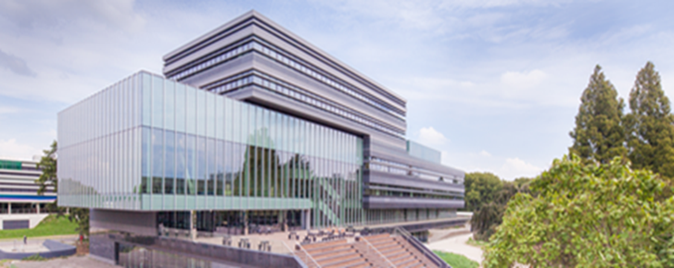
Chemelot vision 2025
“Most safe, sustainable and competitive chemical site in Europe”

Slide 6
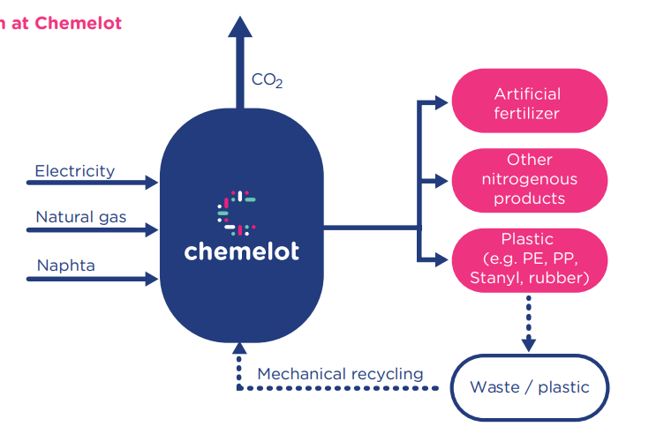
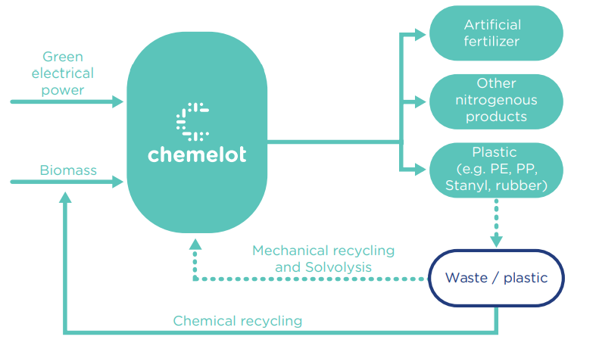
Chemelot’s development towards carbon neutrality
Chemelot 2018
Chemelot 2050

Slide 7
Status 1 januari 2022
108 leads linked to Chemelot 2050 transition
3
4
6
41
Chemelot 2018
Expansion site user
9
Extension value chain
10
New value chain
9
Proc. Inno., Site infra, Waste heat
26
Notes:
80% van de leads is gekoppeld aan Chemelot site users

Slide 8
Status 1 januari 2022
108 leads linked to Chemelot 2050 transition
TOTAL CAPEX: 5,4 billion € TOTAL NEW JOBS: 3800
3
4
6
41
Chemelot 2018
Expansion site user
9
Extension value chain
10
New value chain
9
Proc. Inno., Site infra, Waste heat
26
Notes:
80% van de leads is gekoppeld aan Chemelot site users

Slide 9
Status 1 januari 2022
108 leads linked to Chemelot 2050 transition
TOTAL CAPEX: 5,4 billion € TOTAL NEW JOBS: 3800
3
4
6
41
Chemelot 2018
Expansion site user
9
Extension value chain
10
New value chain
9
Proc. Inno., Site infra, Waste heat
26
Notes:
80% van de leads is gekoppeld aan Chemelot site users

Slide 10
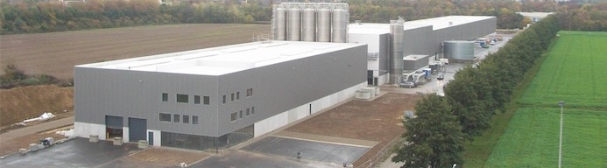

QUALITY CIRCULAR POLYMERS from post-consumer WASTE
2012: BUSINESS PLAN
2013: FUNDING
2014: QCP CREATION (FOUNDERS, SUEZ, LIOF, CV), ENGINEERING, PERMIT & STAFFING
2015: CONSTRUCTION
2016: 1st YEAR OF 24 x 7 PRODUCTION
2017: 1st VIRGIN REPLACEMEMT SUCCESS + ACCELERATED GROWTH TRANSACTION
2018: A 50/50 JV BETWEEN:

Slide 11


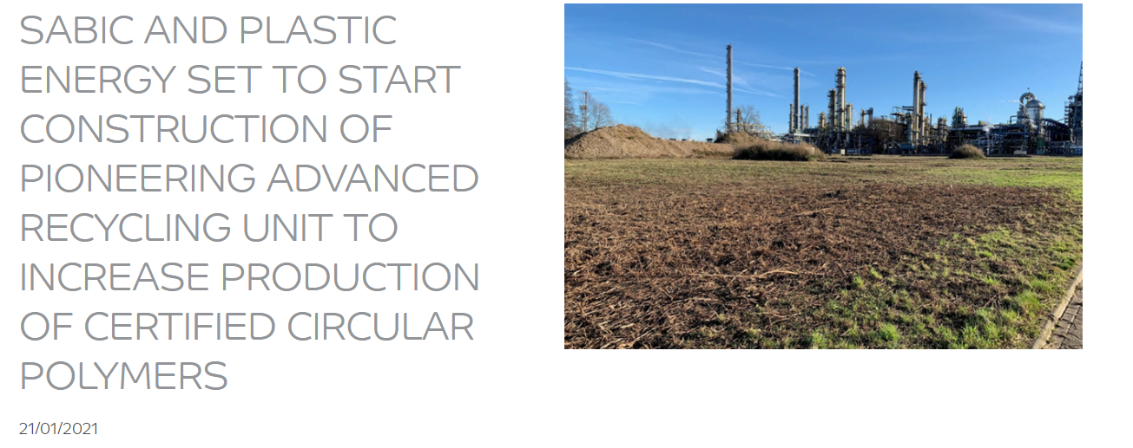
Notes:
SABIC and Plastic Energy are set to start construction of world’s first commercial unit to significantly upscale production of certified circular polymers derived from used plastic
The engineering and construction stage brings this pioneering project one step closer to beginning operations in Geleen, The Netherlands
Project demonstrates Plastic Energy and SABIC’s ongoing commitment to drive towards a circular economy for plastics by increasing the availability of more sustainable products
In another significant contribution towards the development of a circular economy for plastics, SABIC and Plastic Energy are set to commence construction on the first commercial unit to produce its flagship certified circular polymers, part of the TRUCIRCLE™ portfolio, which are made from the upcycling of mixed and used plastic.
SABIC, a global leader in diversified chemicals, along with partner Plastic Energy, a pioneer in chemical plastics recycling, are set to start the engineering and construction phase for the unit, which will be based in Geleen, the Netherlands and is expected to become operational in the second half of 2022. The project will be realized under a 50-50 joint venture called SPEAR (SABIC Plastic Energy Advanced Recycling BV) and is being executed with a Top Sector Energy Subsidy from the Ministry of Economic Affairs in the Netherlands.
As part of the project’s market foundation stage, SABIC has worked together with Plastic Energy and leading customers and converters to produce and commercialise certified circular polymers since early 2019. The new unit will enable SABIC to significantly upscale the production of certified circular polymers to provide customers with greater access to sustainable materials which have been recycled, repurposed and produced in a way that can help protect our planet’s natural resources, whilst acting as a drop-in solution.
‘Advancements in this pioneering project take us one step closer to driving the change needed to become a circular global industry,’ said Fahad Al Swailem, Vice President, PE & Sales at SABIC. ‘We have overcome significant external, global challenges to reach this important milestone and remain fully committed to closing the loop on used plastic. We are continuing to collaborate on an unprecedented level with our partners upstream and downstream to achieve this.’
‘It has been an exciting journey in making our vision of building advanced recycling plants come to life, and we are delighted to announce the construction of this new facility with SABIC,’ said Carlos Monreal, Founder and CEO of Plastic Energy. ‘We have worked jointly with SABIC towards our common goal of making plastics more sustainable and moving towards a more circular economy for plastics.”
SABIC’s certified circular polymers are produced using Plastic Energy’s advanced recycling technology to convert low quality, mixed, and used plastic, otherwise destined for incineration or landfill, into TACOIL. The TACOIL produced in the new commercial unit will be used by SABIC in their production process as an alternative to traditional fossil materials to create new circular polymers.
The circular polymers form part of SABIC’s TRUCIRCLE portfolio and services for circular innovations. Launched in 2019, the TRUCIRCLE portfolio is a considerable milestone on the journey towards closing the loop and creating a circular economy for plastics and intends to provide manufacturers with access to more sustainable materials. The TRUCIRCLE portfolio spans design for recyclability, mechanically recycled products, certified circular products from feedstock recycling of used plastic and certified renewables products from bio-based feedstock.

Slide 12
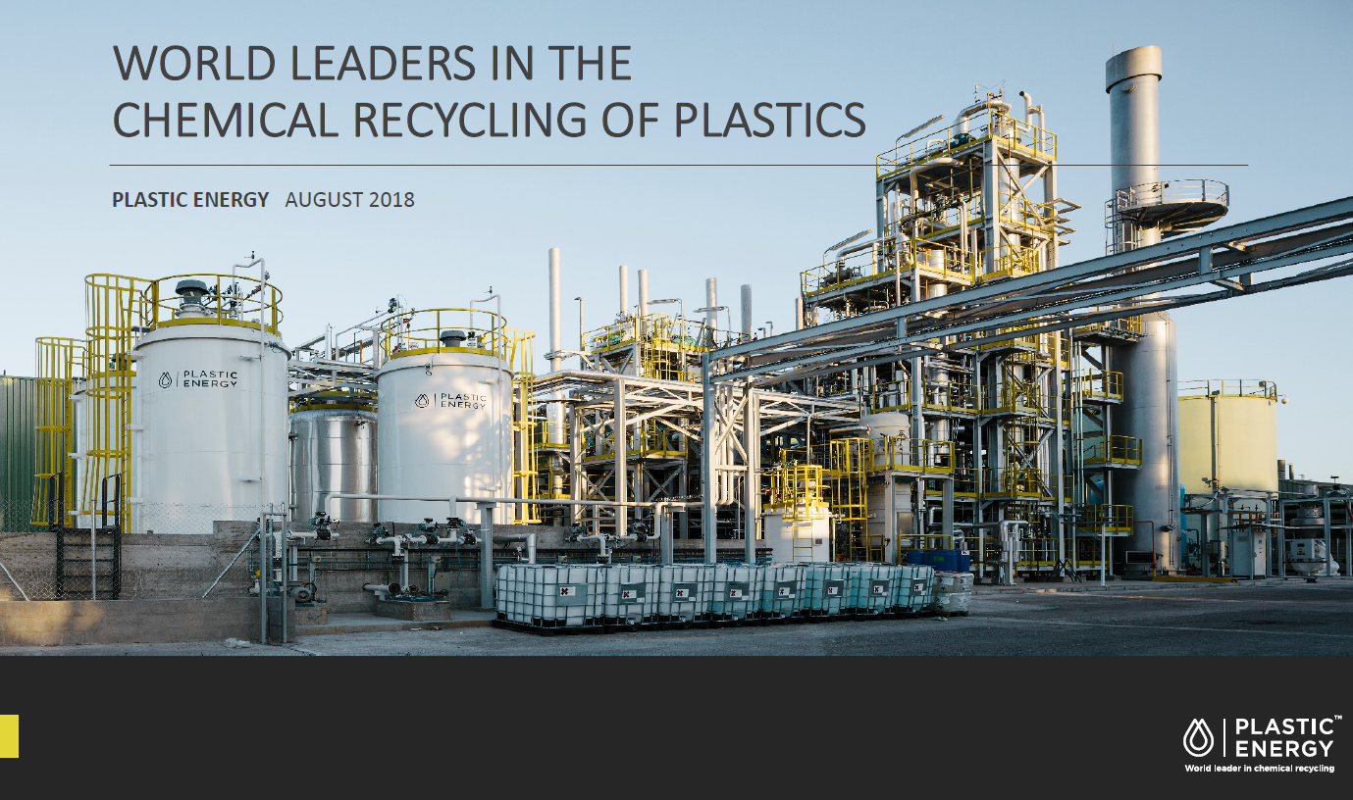

Slide 13

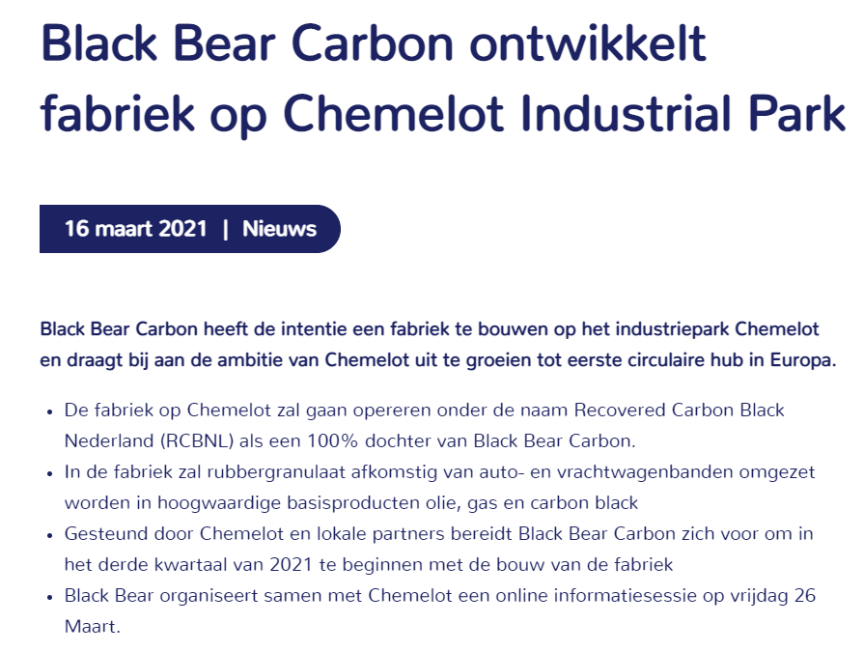
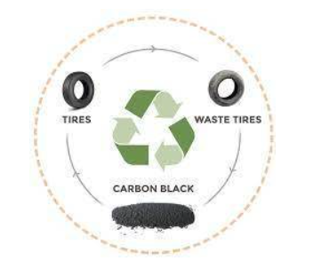

Slide 14
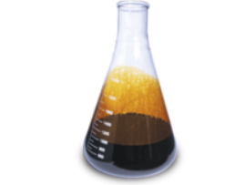
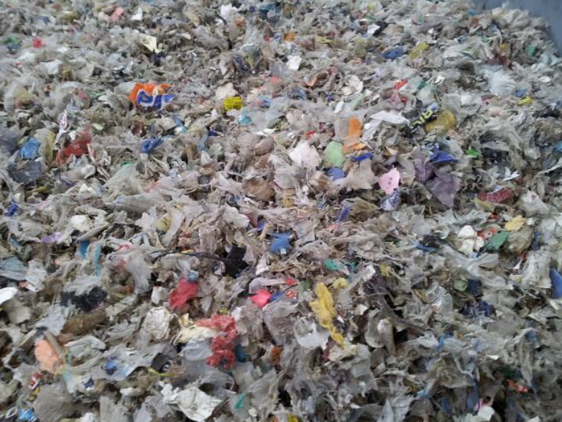
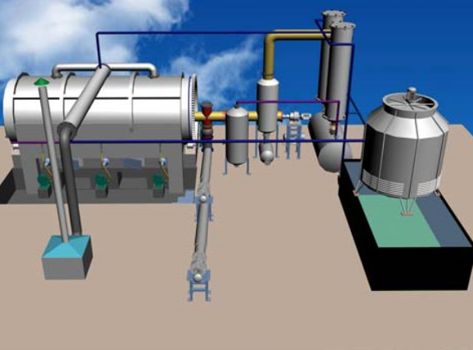
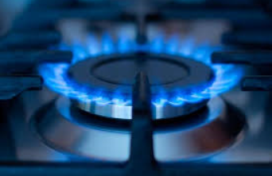
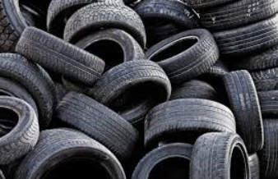
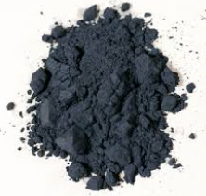
Pyrolysis of waste mixed plastic or tyres 1
Pyrolysis oil
Hydrocarbon gas
Pyrolysis plant
Carbon Black

Slide 15
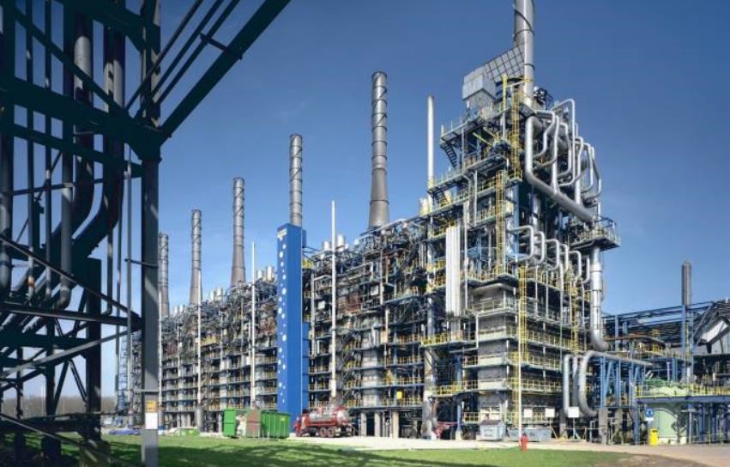
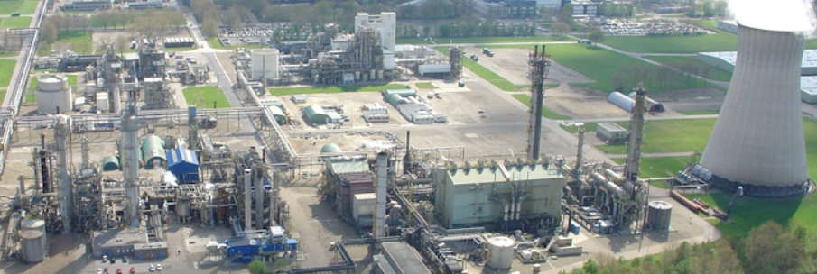
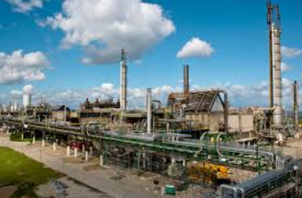
Pyrolysis of waste mixed plastic or tyres 2
Upgrading to
renewable crackerfeed
Naphta cracker
Pyrolysis oil
Decarbonisation to renewable hydrogen
Ammonia plant
Hydrocarbon gas
Direct carbon fuel cell
Methanol plant
Carbon Black

Slide 16

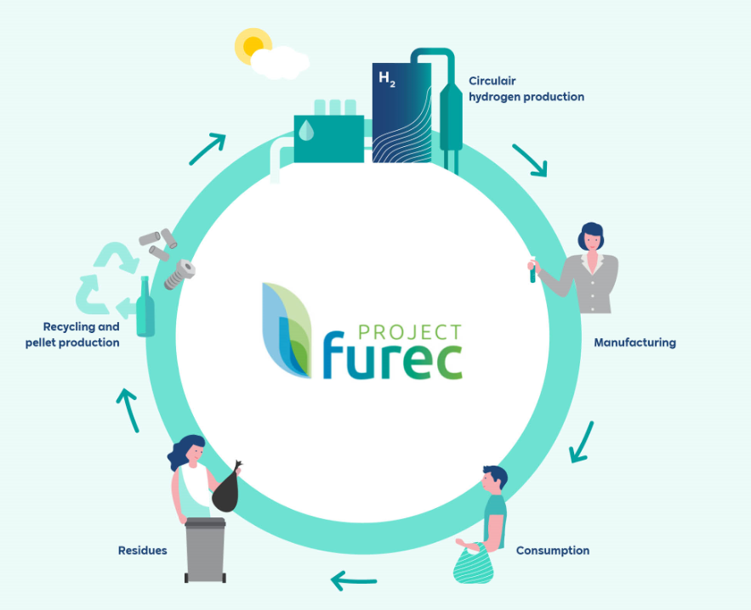
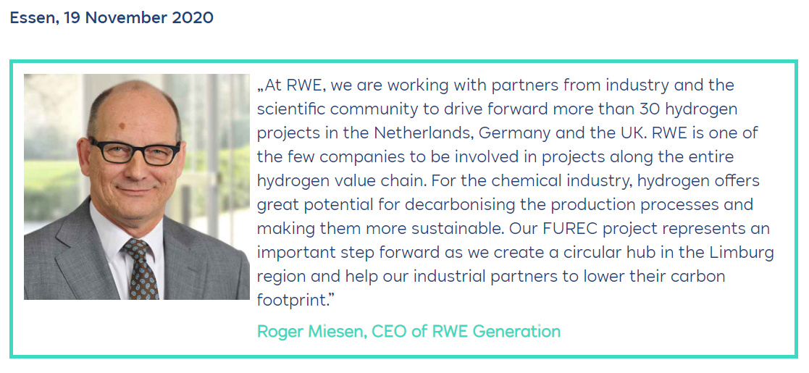
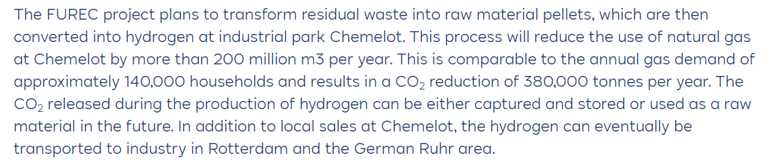
Circular hydrogen production

Slide 17






Plastic recycling
High quality
Mechanical recycling
Medium quality
several leads
Quality requirements of input
Low quality
Solvolyse
Hydrolysis
Chemical recycling
Pyrolysis
Gasification
Notes:
Renewi → Plastic Energy → SABIC → Unilever, Vinventions, Walki Group
Urban Mining Corp
ER Plastics
Surity
APK
Innovation Team
EuroEco Fuels
Fuenix
Indaver
Plastic Energy
Pyroil
SABIC Karma
Gr3n
Polygenta

Slide 18

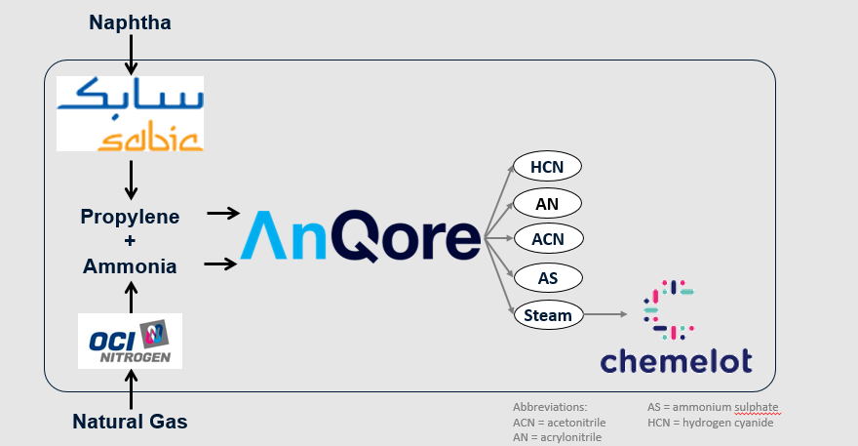


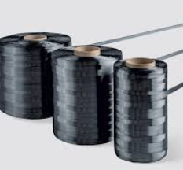
AnQore
Benefitting from strong integration synergies

Slide 19
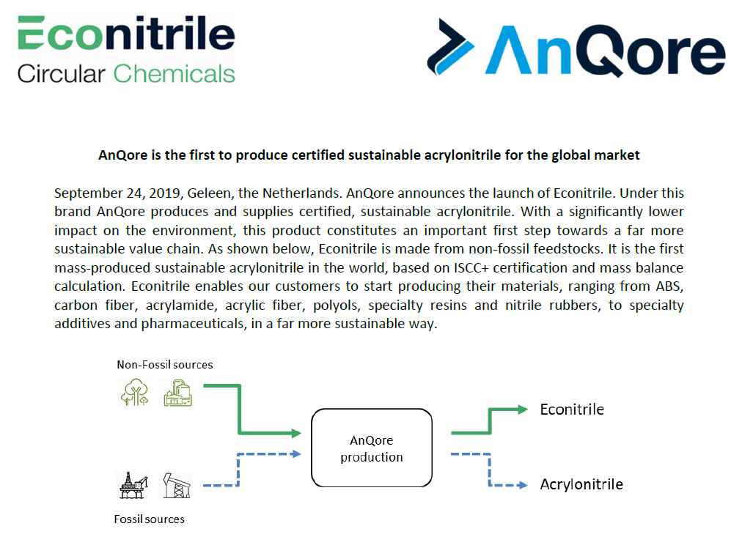

Slide 20
Waste as a feedstock
Challenges Chemelot is facing
Europe is not a uniform landscape with respect to waste → no level playing field for circular feedstock
It becomes increasingly difficult to transport plastic waste from one country to another country within the EU due to detailed (national) regulations which are not attuned to eachother → recycling becomes a regional activity instead of a European activity
Recycling policies need to be consistent with other objectives to reduce CO2-emissions and use of fossil raw materials / energy
  RED II and Fit for 55 need to take recycling into account and need to be attuned with circular objectives
  Equal policies and regulations for H2 from RWE/FUREC as H2 from electrolyzers
Knowledge level of goverments and citizens
Acceptation of transport and processing of large quantities of waste (NIMBY)
Qualification: waste processes need to be evaluated and ranked on efficiency and cost effectiveness on an equal basis and a similar scope (from waste-source until final processing including all intermediate logistics and handling)

Slide 21
On the way to 2025!

Slide 22
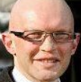
frank.schaap@chemelot.nl
+31 6 20446762

