Slide 1
Workshop 3: Implementation of REACH in the regions:
Guidance for enterprises on REACH
Jean-Pierre FEYAERTS – Head of Belgian National Helpdesk
Ústí nad Labem – 17 April 2009

Slide 2

Guidance for enterprises on REACH: Why?
One of the main change of REACH, regarding previous legislation is that responsibility is put on enterprises
There is therefore a need to provide sufficient support to enterprises through various means:
Two provisions were included in REACH: Article 124 (2) [Helpdesks] and Article 77 (2) [ECHA Secretariat]
> Sherper Project (SME Helpdesk Expert Roundtable – Planning their Establishment for REACH)

Slide 3
Guidance for enterprises – How? and Who?
Information from the ECHA and the European Commission
Technical support from the Member States authorities (National helpdesks – Article 124 (2)
Support from European federations and others
Experts (Consultancy)
Others

Slide 4
Main topics
Services: who can help enterprises?
Information: Where to find interesting information?
Procedures: organisation of information and consultations

Slide 5
Services: National Helpdesks & European Networks
National helpdesks aim to provide information of REACH Regulation (« what ? ») in national languages > presentation of Mr Jan Kolář
In addition a European network of National Helpdesk (REHCORN) was established on 15 February 2007, aiming, among others to identify Frequently Asked Questions, harmonising answers at European level and promoting mutual assistance as well as any other activities useful on communication on REACH
Further information:
http://echa.europa.eu/reach/helpdesk/nationalhelp_en.asp

Slide 6
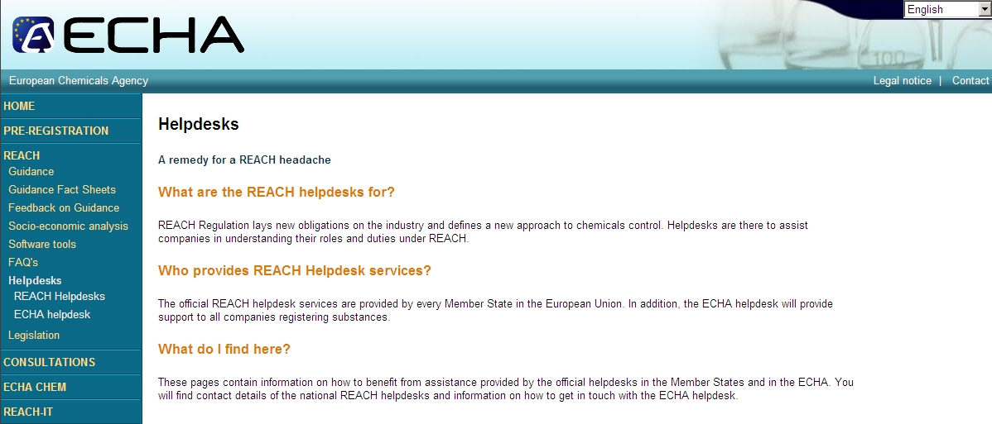

Slide 7
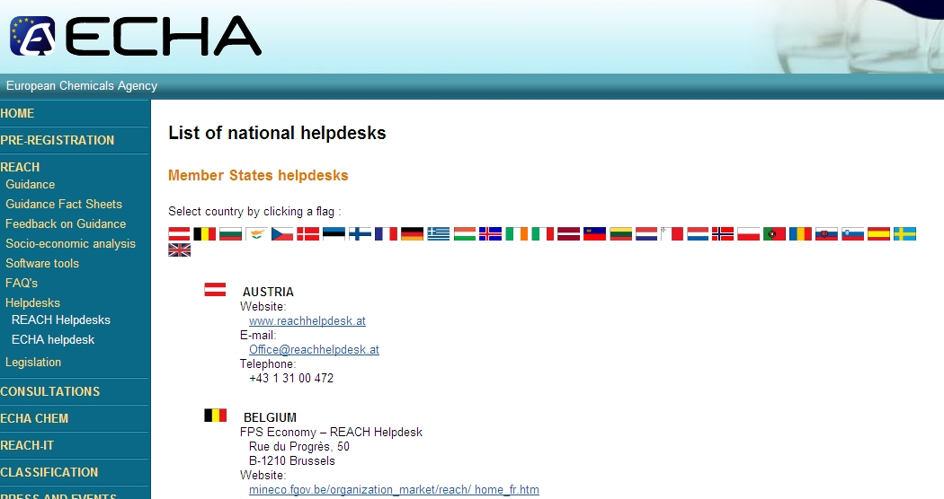

Slide 8
Services: ECHA Helpdesks
ECHA, in principle does not answer to question of European individual companies > National Helpdesk except on REACH-IT / IUCLID 5
ECHA helpdesk is also the helpdesk of the national Helpdesks
European federation as well as third country enterprises can also address their questions to ECHA
Individual companies that didn’t receive an answer from their national helpdesk or have doubts on the answer received can also address questions to ECHA:
Further information:
http://echa.europa.eu/reach/helpdesk/echahelp_en.asp

Slide 9
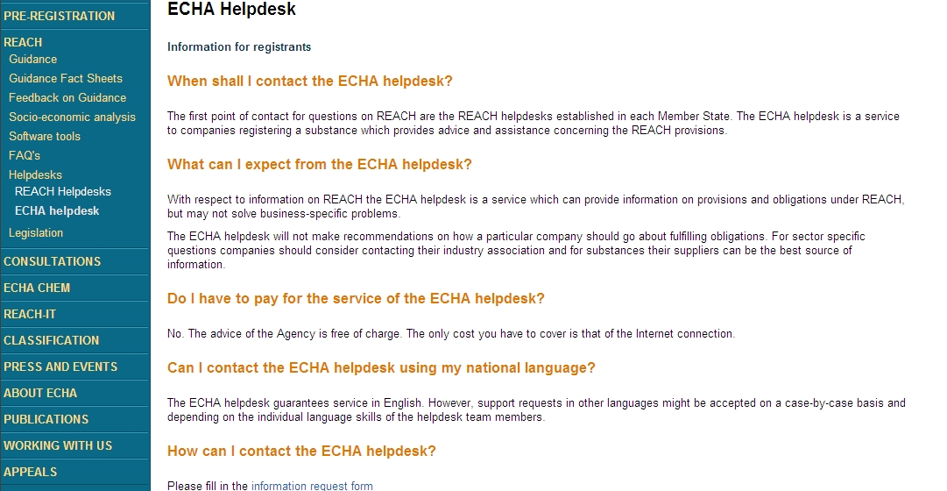

Slide 10
Services: Sectorial helpdesks (European and national federations)
National helpdesks or ECHA helpdesks will not answer on the ‘how to implement REACH’. Sectorials helpdesks can be another source of information.
Several European federations took initiatives, including CEFIC, AISE, EuPC, IMA-Europe, CEPE, CONCAWE and Euroalliages (observers in REHCORN) and others like Eurométaux (REACH Metal Gateway) or Eurofer…
Many national or regional federations ensure different forms of support (See presentations of Tine Cattoor and Alejandra Sánchez)

Slide 11
Services: Other initiatives and Consultancy
Other forms of support exist, including support from chambers of Commerce in several member States (Enterprise Europe Network), the ECRN, and private initiative like the ORO (Only Representative Organisation) or the ESCAPE Forum initiative (Excellence in SIEF and Consortium Administration and Practice in Europe of Hunton & Williams and Penman Consulting)
Many consultants support SIEF formation

Slide 12
Information: Legal texts
EC Regulation No 1907/2006 concerning the Registration, Evaluation, Authorisation and Restriction of Chemicals (REACH), + Corrigendum and amendments (Annexes) (Available on ECHA Web-site:
http://echa.europa.eu/reach/legislation_en.asp)
EC Regulation 1272/2008 on classification, labelling and packaging of substances and mixtures,
Implementation: fee Regulation (No 340/2008); Board of Appeal (Regs 1238/2007 and 771/2008); Test methods (No 440/2008)

Slide 13
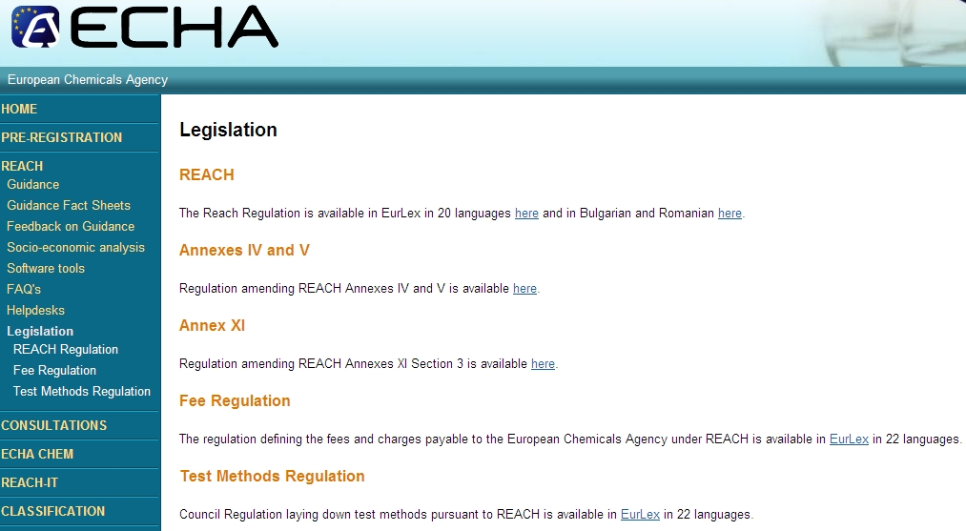

Slide 14
Information: Guidance and other tools on ECHA web-pages
The guidance documents are the main secondary source on how to implement REACH. One may find them at the following address:
  http://guidance.echa.europa.eu/
On the same web-page one may find also other tools/information including ‘About REACH’ (general introduction on REACH and several process), the REACH Navigator (to find your way through REACH a very good starting point), the Glossary and the Search engine which includes an interesting keyword list.
An introduction on guidance’s is provided as well in the fact sheets:
  http://echa.europa.eu/reach/fact_sheet_en.asp
Several FAQs are also available on this site (See next slide)
NB! The web-site of ECHA will be revamp soon!

Slide 15
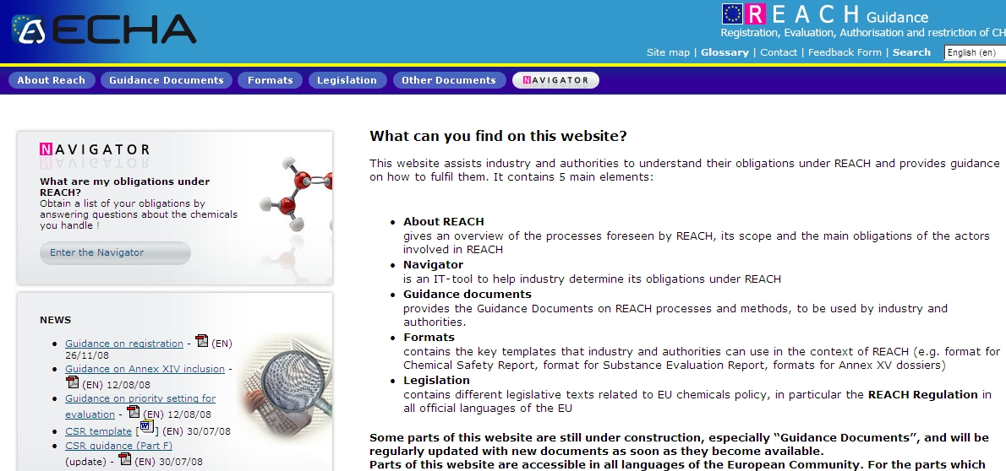

Slide 16
Information: (Frequently Asked) Questions (ECHA)
There are several FAQs/Q&A on the ECHA Web-site:
The main FAQ (harmonised by the REHCORN):
  http://echa.europa.eu/doc/reach/reach_faq.pdf (last version (2.4) of 20 March 2009- New issue (2.5) in June
FAQ on REACH IT: http://echa.europa.eu/reachit/reachit_faq_en.asp (+ other documents on http://echa.europa.eu/reachit/supp_docs_en.asp
Q&A on previously notified substances: http://echa.europa.eu/doc/reachit/prev_not_sub_registrants_qa.pdf
Q&A on pre-registration:
http://echa.europa.eu/doc/pre-registration/pre_reg_qa_en.pdf

Slide 17
Information: Guidance documents (ECHA)
Several guidance's are available on the ECHA web-site divided in 3 categories:
  Guidance on the different process mainly for industry
  Guidance on the different process mainly for authorities
  Guidance on the different methods under REACH

Slide 18
Information: Guidance on the different process mainly for industry use
Guidance on registration
Guidance on data sharing
Guidance for intermediates
Guidance for monomers and polymers
Guidance on requirements for substances in articles
Guidance for downstream users
Guidance on PPORD
To come: guidance on CLP and on Authorisation (preparation for application and on socio-economic analysis) + Annex V substances and Waste and recovered substances (amendments of Guidance on registration)

Slide 19
Information: Guidance on the different process mainly for authorities use
Guidance on Dossier and Substance Evaluation
Guidance for the preparation of an Annex XV Dossier on Harmonised Classification and Labelling
Guidance for the preparation of an Annex XV dossier on the identification of substances of very high concern
Guidance on inclusion of substances in Annex XIV (substances subject to Authorisation)
Guidance for the preparation of an Annex XV dossier for restrictions
Guidance on Socio-Economic Analysis - Restrictions

Slide 20
Information: Guidance on the different methods under REACH
Guidance for identification and naming of substances in REACH
Guidance on how to comply with the provisions of the new Regulation on Classification, Packaging and Labelling of substances and mixtures [To come]
Guidance on information requirements and chemical safety assessment
Guidance on priority setting for evaluation
Guidance on IUCLID

Slide 21
Information: Guidance on information requirements
Quite complex Guidance: needs a ‘Pathfinder’!
2 major parts: Concise guidance (Parts A to G) and supporting reference guidance (Chapters R.2 to R.20)
Part A: Introduction to the guidance for conducting the CSA and preparing CSR (Q ≥ 10 tonnes)
…
Part G: Guidance on preparing the extensions to the safety data sheet

Slide 22
Information: SIEF & Consortia
No specific guidance from ECHA – only few references in other guidance’s, in particular in G. on data sharing.
Basically SIEF and Consortia must be managed by the private sector but there is a need for some guidance’s
ECHA provided an important communication on the 13 February 2009 (‘Clarification in relation to Pre-SIEFs and SIEFs ‘) available in the ‘Press office’ section
ECHA will publish around 1 June a new version of its FAQs (2.5) with a section related to SIEFs including few new FAQs in relation to SIEFs and Consortia + more FAQ in release 3.0
There are other initiatives to provide guidance on SIEFs formation, in particular from CEFIC (or the ESCAPE Forum initiative)

Slide 23
Information: Revision programme of guidance (1)
Information requirements and CSA:
  Updating the use descriptor system (PEG: May 2009)
  Updating the sections on tier 1 exposure estimates and corresponding ES building (PEG: June 2009)
  Updating format of ESs based on the lessons learnt in the CSA Tool project and progress made with ES building in industry (PEG: May 2009)
  Further development of ES building and exposure estimates for the waste life stage (PEG: early 2010)
  Exposure scenarios describing strictly controlled conditions (PEG: December 2009)
  Further developing guidance on the scope of exposure assessment (PEG: July 2009)

Slide 24
Information: Revision programme of guidance (2)
Requirements for substances in article:
  Two rounds: first: PEG in June 2009, second October 2009 with a PEG meeting in October 2009
Risk communication:
  Selection of a service provider September 2009
  PEG’s meeting in Helsinki: January 2010 (back to back to the RCN) and April 2010
  Written consultation on the final draft: July 2010
Others: Registration : Annex V substances: CARACAL September 2009
    Wastes and recovered substances: CARACAL December 2009
  SDS guidance (stand alone): PEG: December 2010

Slide 25
Other information (ECHA)
The present Web pages of ECHA provide a lot of other information: Among other one may mention:
Information related to substances on ‘ECHA-CHEM’ (including the list of pre-registered substances and the candidate list + later information on registered substances)
Information on consultations (many are foreseen by REACH!) under ‘Consultations’
Information on ECHA, under ‘About ECHA’ its structures and its strategy papers (including documents from its committees). Other documents under ‘Publication’
Access to the REACH IT portal and IUCLID-5 (not so evident:
  http://echa.europa.eu/reach/software/iuclid5_en.asp or http://iuclid.echa.europa.eu/

Slide 26
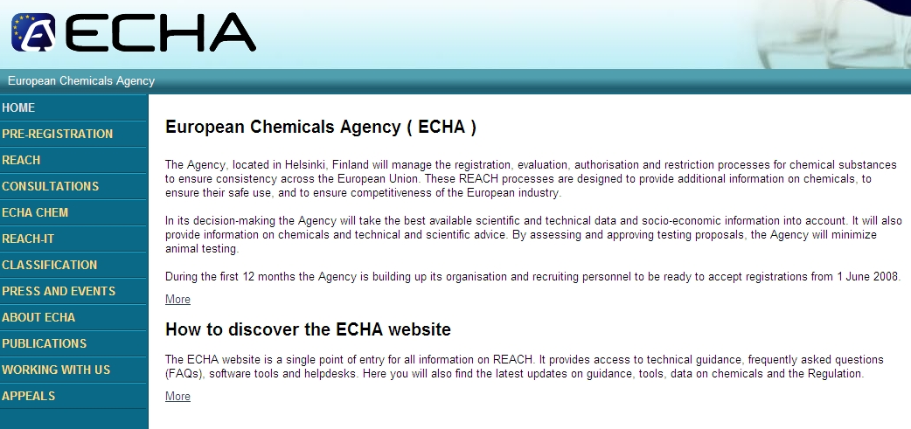
Information: ECHA Main page

Slide 27
Information: other sources
National helpdesk web sites
Several federations, in particular CEFIC: http://www.cefic.be/ (see REACH portal)
The European Commission (DG Enterprise and Industry: http://ec.europa.eu/enterprise/reach/index_en.htm
  and DG Environment:
  http://ec.europa.eu/environment/chemicals/reach/reach_intro.htm
Internet (various, … but…) including Chemical Watch
  http://chemicalwatch.com/home

Slide 28
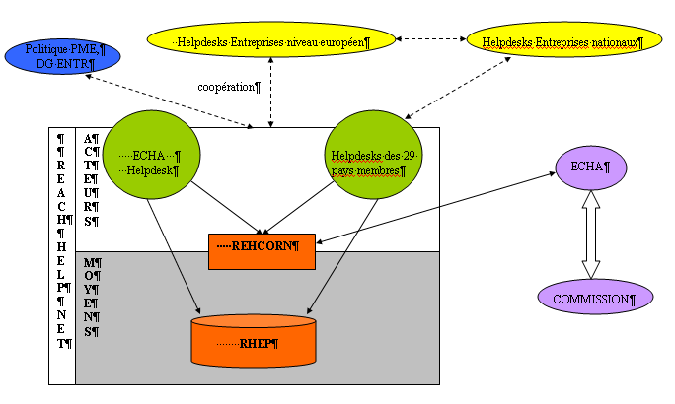
Procedures: The REACH Helpnet

Slide 29
Procedures: Stakeholders participation/consultations
REACH foresees many different consultations during the different steps before adoption of any decisions. Furthermore participation of stakeholders is also foreseen within the different committees, (MSC, RAC, SEAC, Forum, REHCORN (6), CARACAL) see also Articles 108 and 109
See also « ECHA Stakeholder policy » under ‘About ECHA / Strategy paper -> 16 general ‘stakeholders’ on first list + 3 on second list + 21 sectoral stakeholders
See also: « Consultation procedure on guidance » (same page)

Slide 30
Procedures: PEGs –Partner Expert Groups
Members are experts, nominated by the MSCA, Stakeholders Organisation (SO) or ECHA and selected by ECHA + Commission and MSCA observers
Functioning: Established by ECHA from its expert roster in function of expertise and availability, balancing MSCAs and Sos.
  PEG is request to comment in writing on ECHA draft
  PEG meeting (with observers) if no consensus by written route
Output: Opinion on ECHA text +, if necessary, majority and minority opinion
  ECHA revise its draft text in light of the opinion

Slide 31
Procedures: Revision of guidance
Origin: Various, including REHCORN
First step: ECHA drafts a text, with experts + consultation of legal service of Commission
Type of revision: Corrigendum; fast track (either ‘normal with shorten deadlines or limited consultation) or ‘normal’ amendment
Normal Procedure: - Step 2: PEG reviews ECHA’s draft
  Step 3: ECHA revises draft
  Step 3a Consultation of C’ttees/Forum + next revision
  Step 4 Consultation of MSCA’s (via CARACAL
  Step 5 ECHA finalises the text and publish it on its Website

Slide 32
Conclusions : REACH in the regions
Information needed at all levels, in particular information for individual companies
Type of support: various
Time frame -> Priorities
Challenges: Various, in particular for new substances and Socio-economic analysis (regional content vs European wide actions)

Slide 33
Thank you for your Attention!

