Slide 1
BEST PRACTICES HOW TO CONNECT BUSINESS AND EDUCATION TO SUPPORT THE CHEMICAL INDUSTRY
@PolskaChemia

Slide 2
Main objectives:
About PIPC
The Polish Chamber of Chemical Industry (PIPC) is an organization representing
the chemical industry before public administration bodies, both domestic and foreign, as well as international organizations. The Polish Chamber of Chemical Industry was established in 1988.
The Polish Chamber of Chemical Industry is a member of key business and scientific associations in Poland and as the only organization has the right to represent the
Polish chemical industry on the international arena.
To influence the shape of economic and social legislation that supports the sustainable development of the chemical industry and takes into account the rights and interests
of its Members;
The Members of the Polish Chamber of Chemical Industry include, among others:
the largest manufacturers of chemicals;
refining and petrochemical companies;
transport and distribution companies;
branches of foreign companies;
design studios and technology companies;
consulting companies;
scientific and research institutes;
law firms;
suppliers of apparatus and equipment;
To protect the rights and represent the interests of its Members
in relation to state authorities and administration bodies, local government bodies and other authorities, trade unions
of employees;
To represent the economic and social interests of the Members at the national and international level;
To support activities for the development of the chemical industry;

Slide 3
Key areas of PIPC activity
Cooperation
with the administration
of Poland and the EU
Advocacy
Innovation
Environmental protection
Promotion
of competitiveness
Image
and communication
Climate policy
New energy sources
Safety
Market protection mechanisms
Sustainable development
Reports
and publications

Slide 4
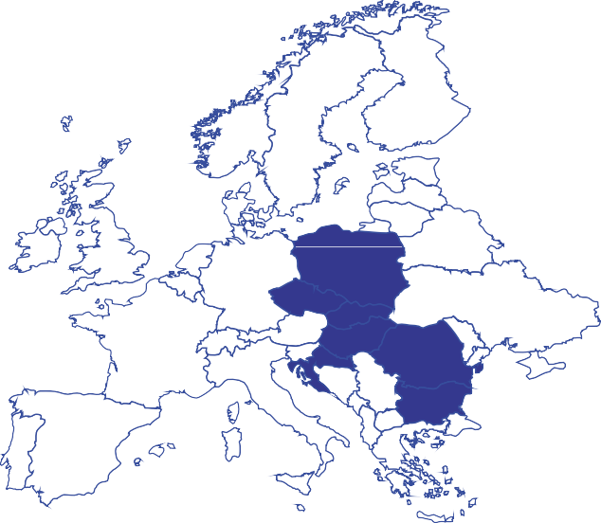
The Polish Chamber of Chemical Industry (PIPC)
within the framework of
the National Association Board
in the European Chemical Industry Council (CEFIC)
leader of the Central Europe Cluster
and
represents
7 Central European countries
(Poland, Czech Republic, Slovakia, Hungary, Bulgaria, Croatia, Romania)

Slide 5
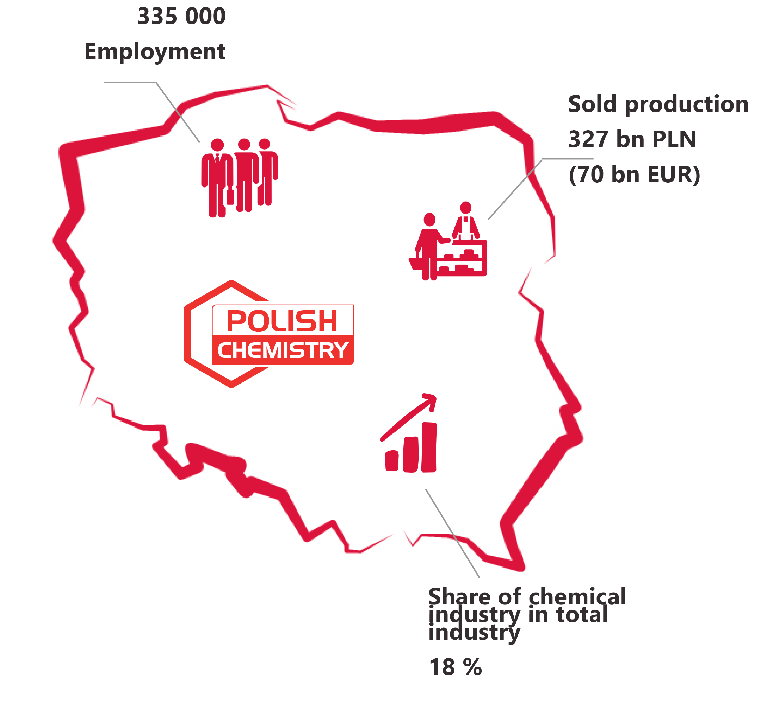
The situation of the chemical industry
The chemical industry occupies one of the key positions in the development of Polish industry and the Polish economy - the production sold in 2021 is over PLN 327 billion, which gives almost 18% share in the Polish industry.
It provides almost all branches of the economy with access to the commodity base necessary at every stage of the value chain.
Polish chemistry is also one of the leading employers, ranking third from all industrial sectors - it accounts for about 335,000 jobs.

Slide 6
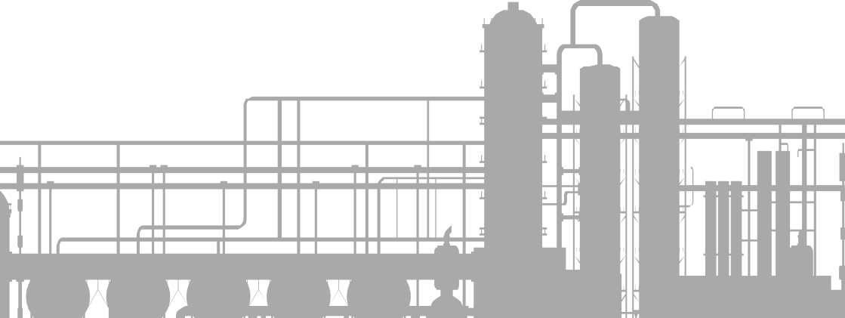
Challenges for the industry - employee skills
Along with the changes taking place in the industry as a result of technological and organizational progress, the education system must also undergo appropriate changes so that potential future employees have the knowledge, features, and skills desired by employers.
Industry representatives have repeatedly emphasized the need for employees to have the following skills:
Soft and cross-cutting skills,
Focused on the ability to work and cooperate in a group,
Willingness to acquire knowledge, training and to show initiative;
Finding oneself in various complex situations;
Ability to solve unexpected problems and have basic engineering knowledge.

Slide 7
PIPC initiatives
PIPC observing the changing situation in the chemical industry, sees the need for cooperation between industry and science.
PIPC has been implementing the original project ChemHR.
The diversity of the program partners in terms of the industry, the way the business is organized, as well as the requirements.
ChemHR will allow students and later graduates to make informed decisions about their professional career.

Slide 8
PIPC initiatives
The implementation of the idea of industry 4.0 will require changes in the method and system of education so that future employees can meet the requirements and achieve the goals and tasks of the employer.
Part of PIPC’s projects: the Chemistry 4.0, Safe Chemistry, and Scientific and Technical Conferences "Innovations in the Chemical Industry" talk about the needs of the industry in terms of competencies, gaps, and methods of obtaining them.
As part of its activities, PIPC analyzes and discusses the subject of competence gaps and the need for changes in the way of education.
PIPC experts participated, among others, in the work on the creation of the Sectoral Qualifications Framework for the Chemical Industry.

Slide 9
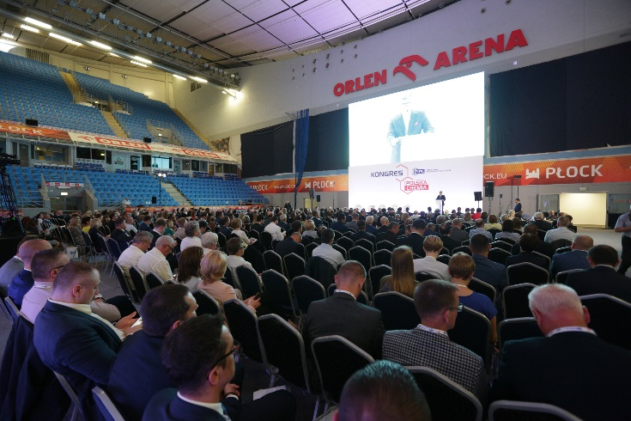
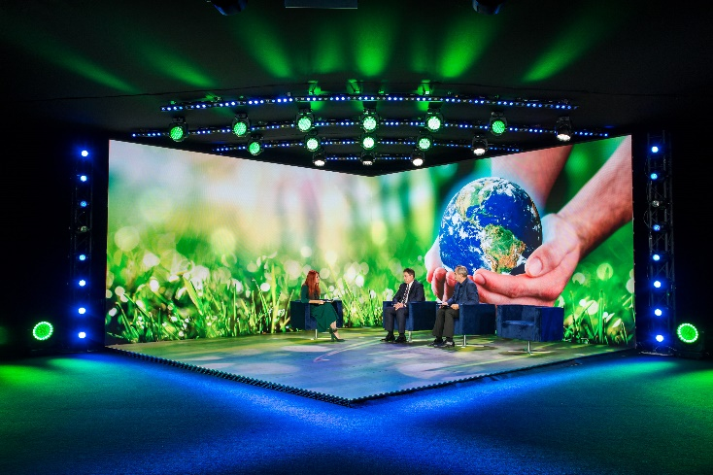
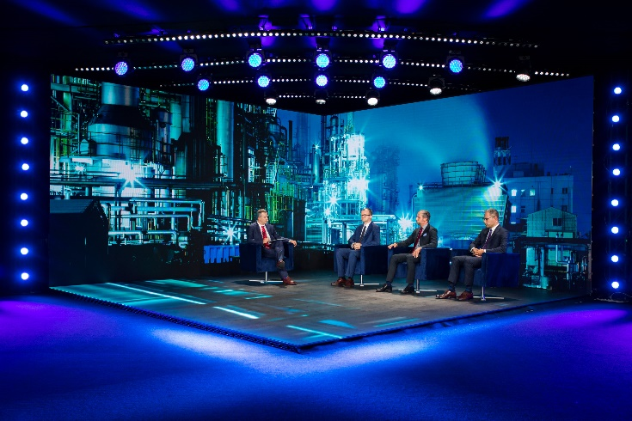
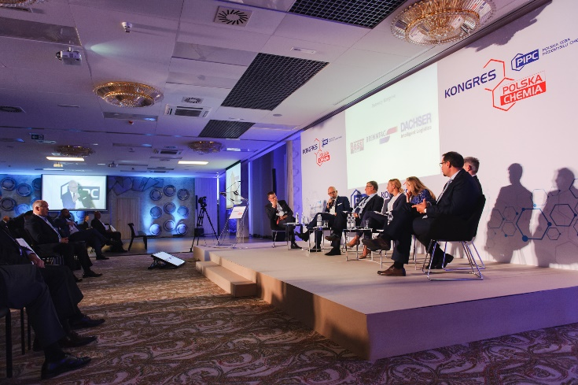
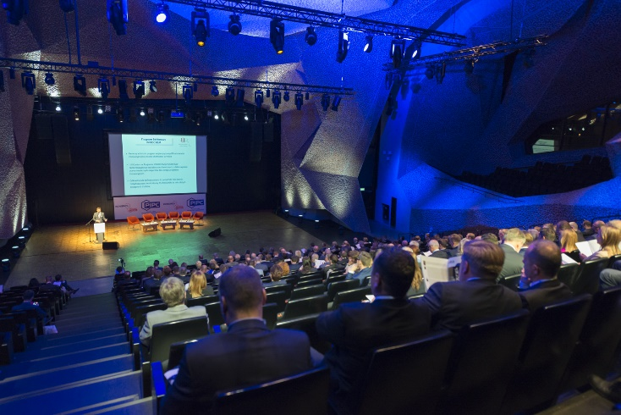
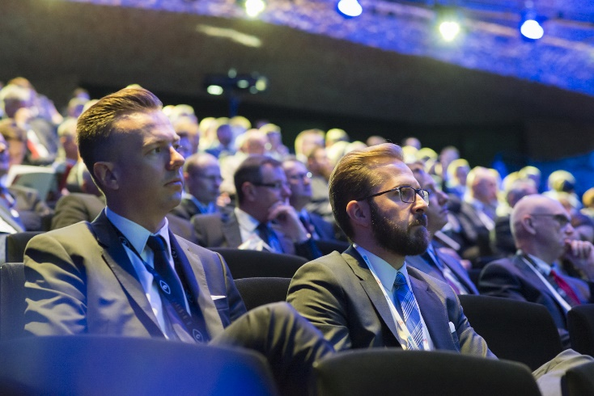
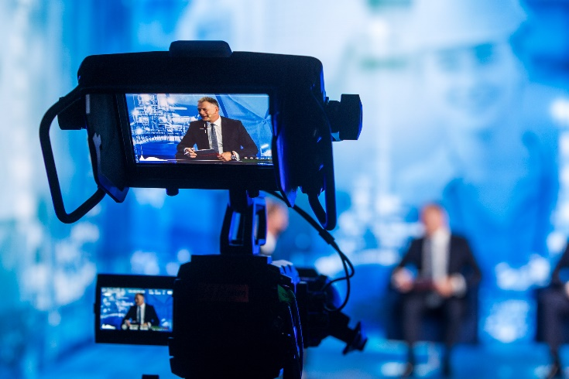
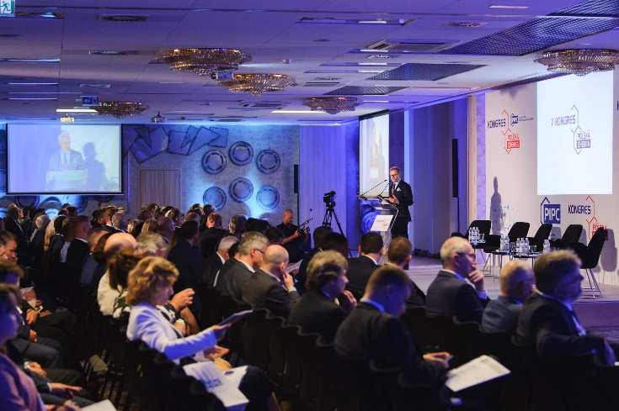
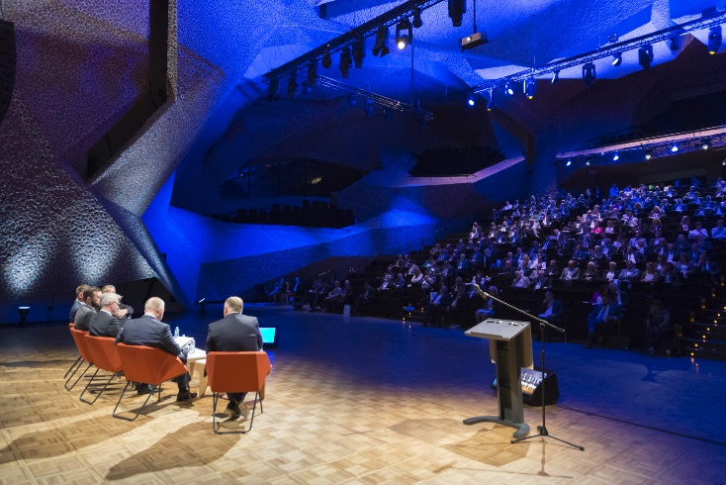
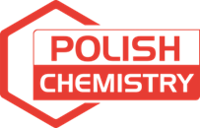
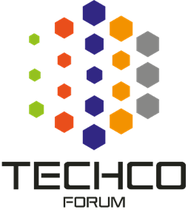
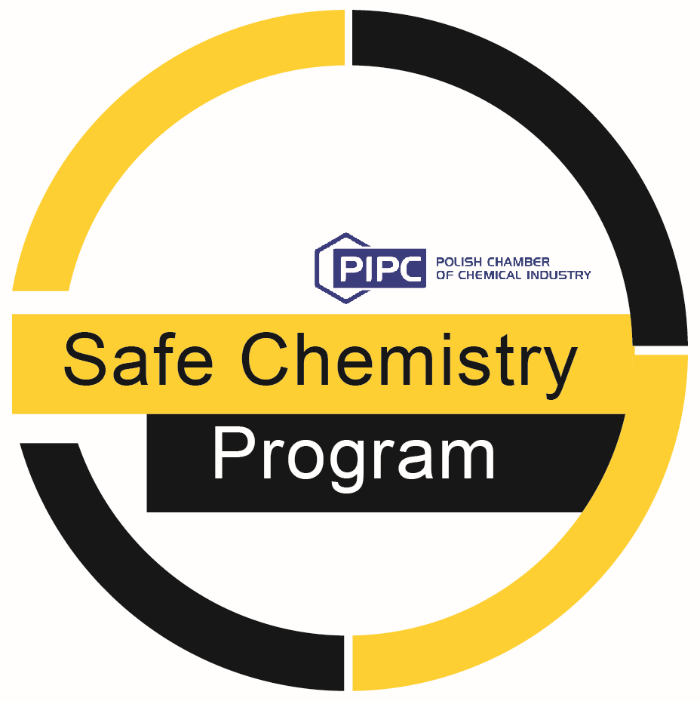
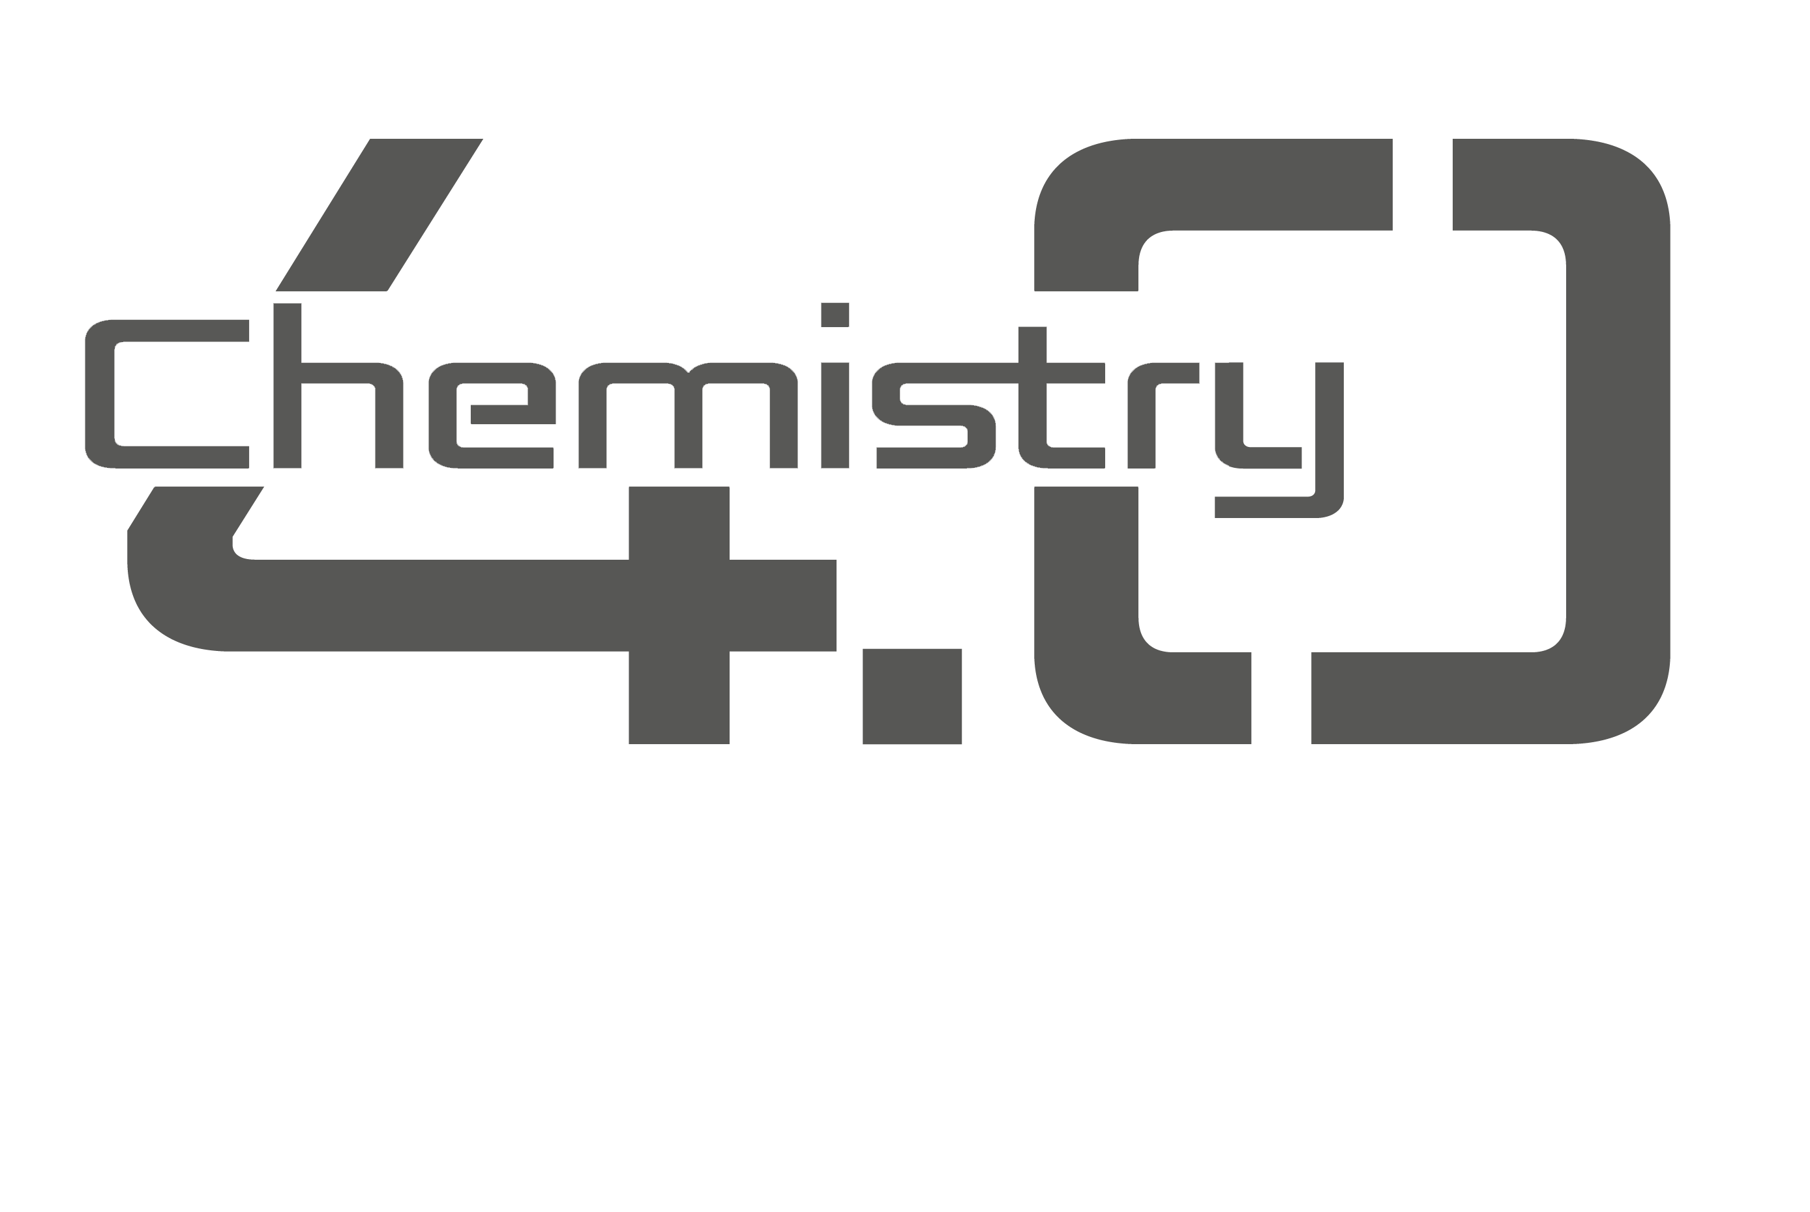
Why do we realize projects?
We create a relationship building platform
We create a strong voice of the entire sector
We integrate the chemical industry with representatives of other industries - we facilitate potential cooperation

Slide 10
PIPC’s proprietary program - initiated in 2013 under the patronage of the then Ministry of Economy (today the Ministry of Economic Development and Technology) and the Ministry of Science and Higher Education.
ChemHR
The aims of the program:
Strengthening the education system for the sector of chemistry through direct cooperation between industry and universities
Improving the qualifications of future graduates and preparing them to enter the market
As part of the program, about 10 master's and engineering theses and 50 internships in partner companies were completed
Supporting companies in the preparation of qualified employees from the group of students
In addition, PIPC experts took an active part in the work on the projects of core curricula for future employees of chemical industry education
Since the beginning of the program several dozen seminars have been organized in which over 600 students and university staff participated
Partners over the years: PCC Rokita S.A., Grupa Azoty S.A., BASF Polska, FLUOR, ANWIL S.A., PKN ORLEN, I2 Analytical
Scientific Partners of the program are 8 Polish universities, including Warsaw University of Technology, AGH University of Science and Technology, the University of Wroclaw, Lazarski University, the Silesian University of Technology, Rzeszow University of Technology, Poznan School of Logistics, Military University of Technology
To enable students to get acquainted with the functioning of companies in the chemical industry with various business profiles, needs, and requirements for potential candidates for employees, as well as with the scientific and research activities of partner universities

Slide 11
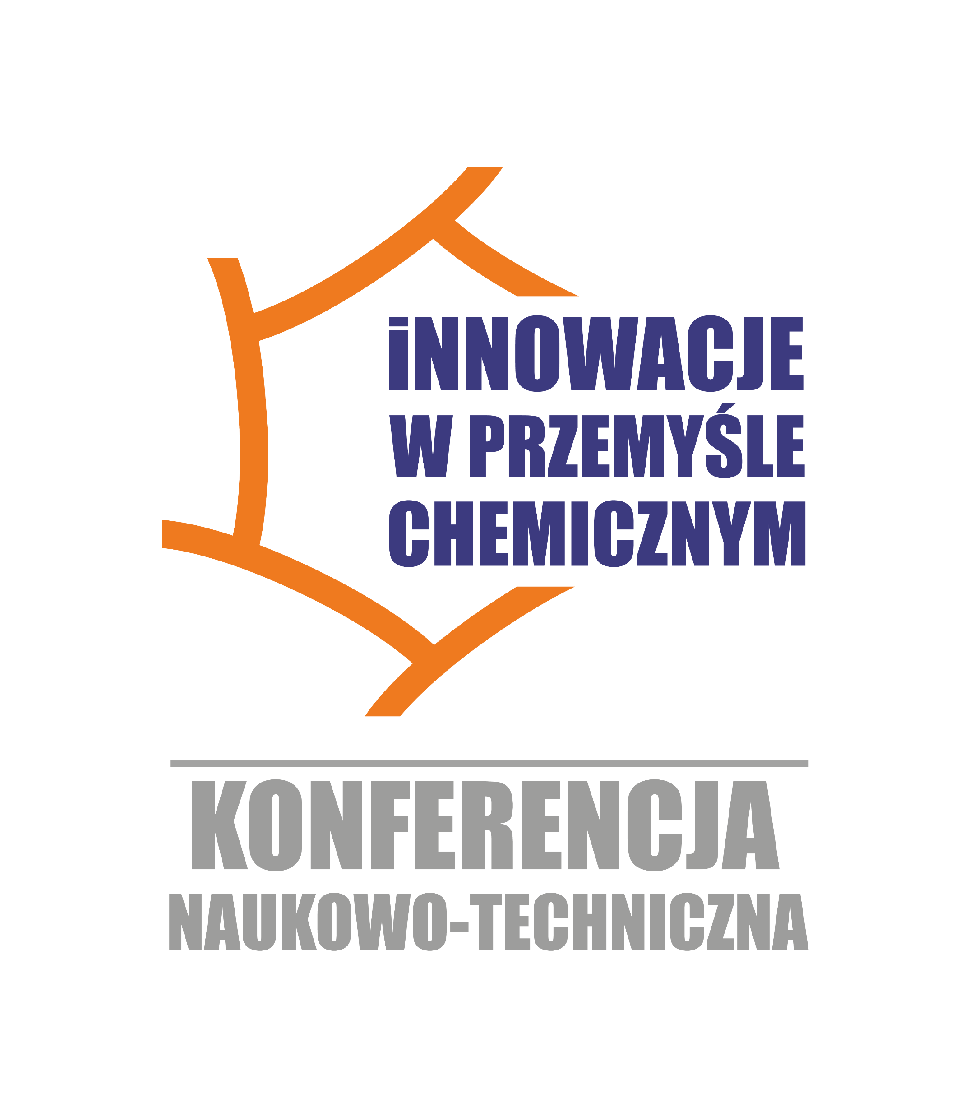
Scientific and Technical Conference
Scientific and Technical Conferences "Innovations in the Chemical Industry" is a space to discuss the needs of employers, students' skills, and the possibilities of universities.
In the years 2017-2019, 3 conferences were held, each time attended by over 100 participants
During the conference, the issues of competency gaps, the need to change the way of educating future employees, and the research and technological potential of universities were discussed

Slide 12
Chemistry 4.0
PIPC’s project was created in 2018 in response to changes and new directions of development resulting from the implementation of solutions of the fourth industrial revolution
The project aims to create a platform connecting manufacturers, suppliers, and recipients of products and services and exchanging practitioners' experiences in technical areas.
As part of the project, meetings, debates, and conferences are organized. In addition, a bulletin is published on issues in the field of broadly understood digitalization, digitization, and 4.0 solutions important for the chemical industry
So far, there have been 8 events attended by 550 participants

Slide 13
Safe Chemistry Program
The program has been running since March 1, 2014.
The program aims to increase the awareness of the importance of occupational safety in PIPC member companies and to promote the highest standards of safety activities in the entire chemical industry.
As part of the program, training and workshops are conducted to promote the best available practices related to occupational safety and health issues, as well as to raise awareness of OSH, fire protection, and process safety.
Since the beginning of the program, 9 events have been held with a total of almost 1500 participants, and 23 bulletins have been issued

Slide 14
@PolskaChemia

