Slide 1
Connecting innovation of SMEs
with education of students

Slide 2
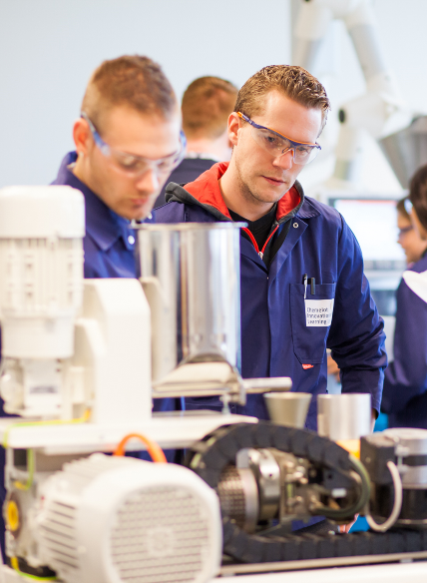
Ambition
CHILL connects the education of students
and R&D questions from business

Slide 3
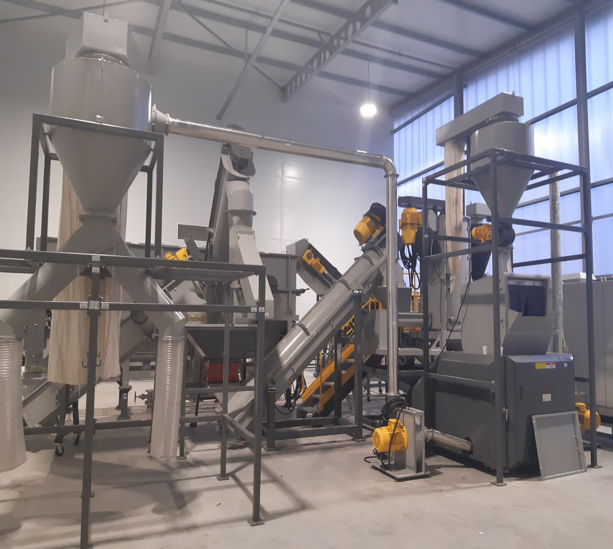
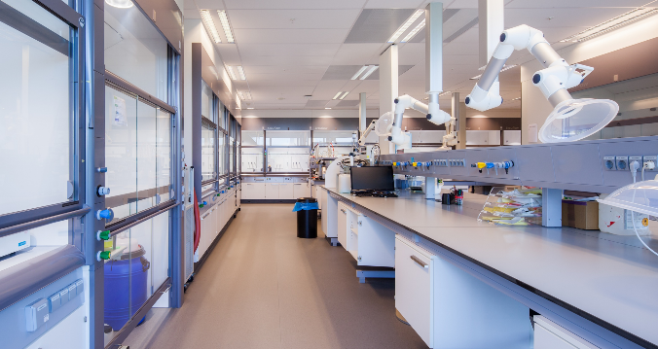
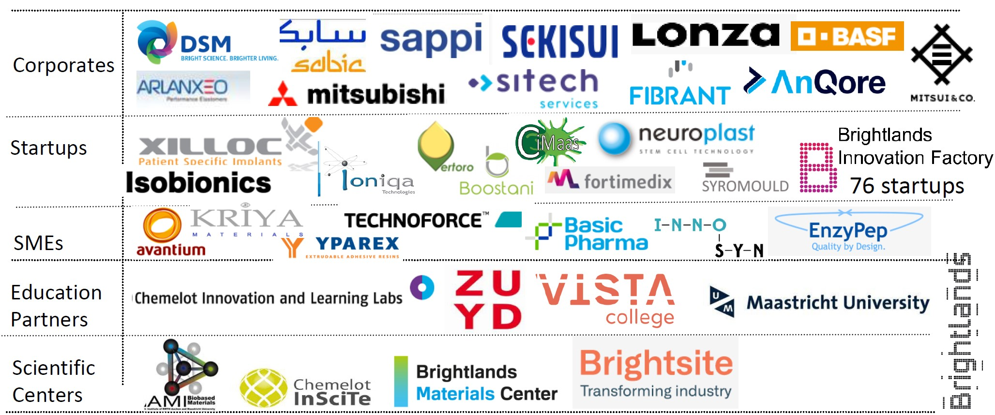
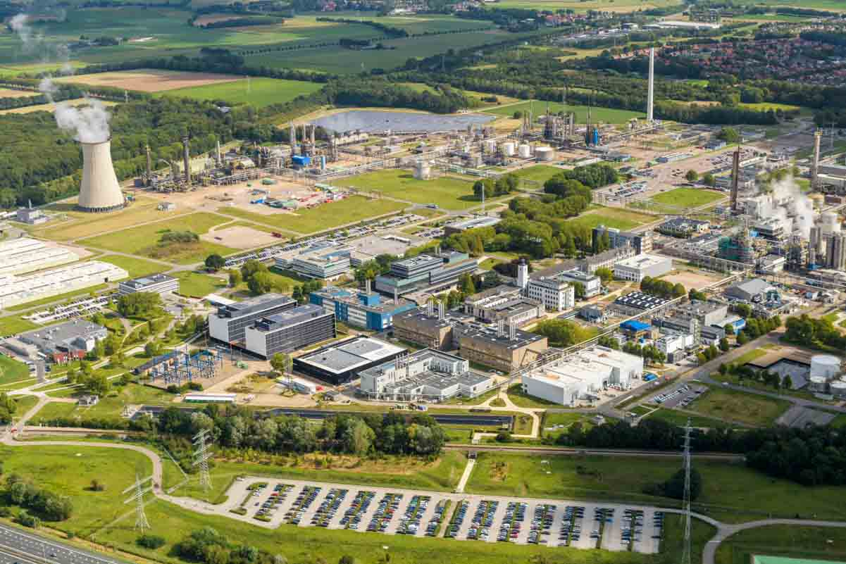
How: Innovative surroundings
Innovative learning, work and research environment
Brightlands Chemelot Campus
State-of-the-art Facilities
Part of large ecosystem
Notes:
Design Note: Line underneath title to be moved to correlate with where the title ends

Slide 4
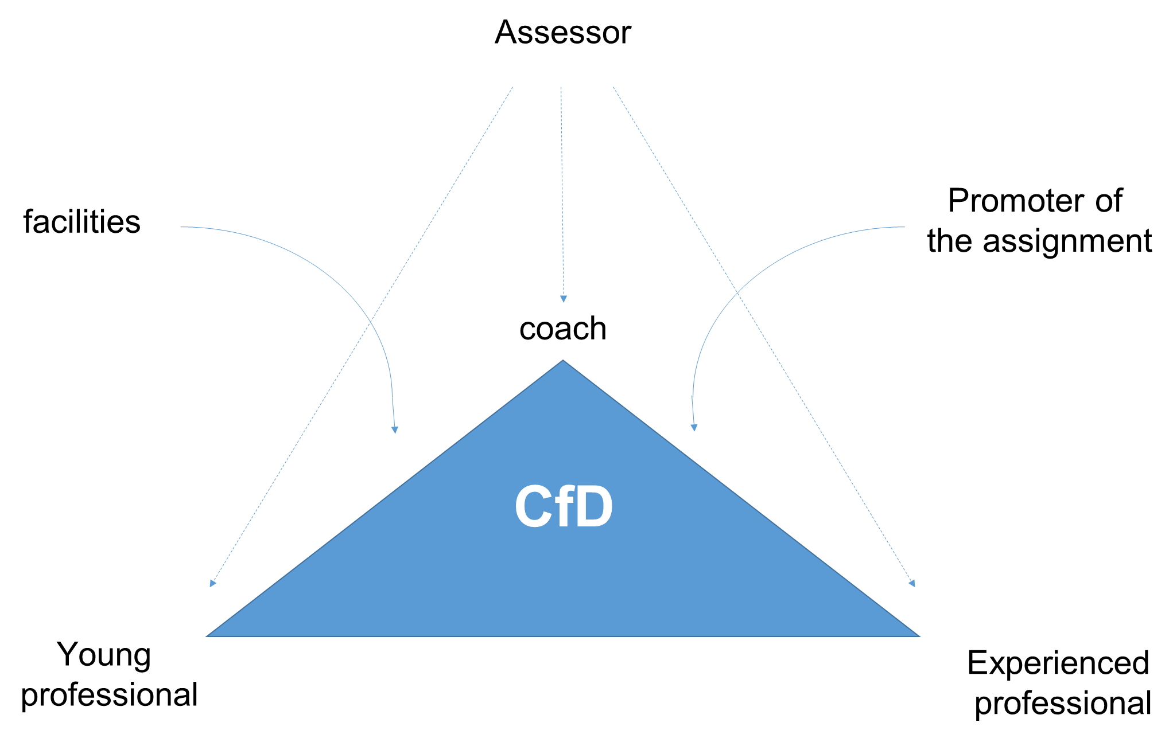
How: Community for Development (CfD)

Slide 5
How: Community for Development (CfD)
Real-life case (contract research and development)
Guaranteed Result
Expert/Technician as back-up (students are in a learning process)
Elaborate account management and Business Development

