Slide 1
#SocialRights
#PactforSkills
Pact for Skills
European Chemical Regions Network
Miguel Fernández – DG EMPL
17 May 2022

Slide 2
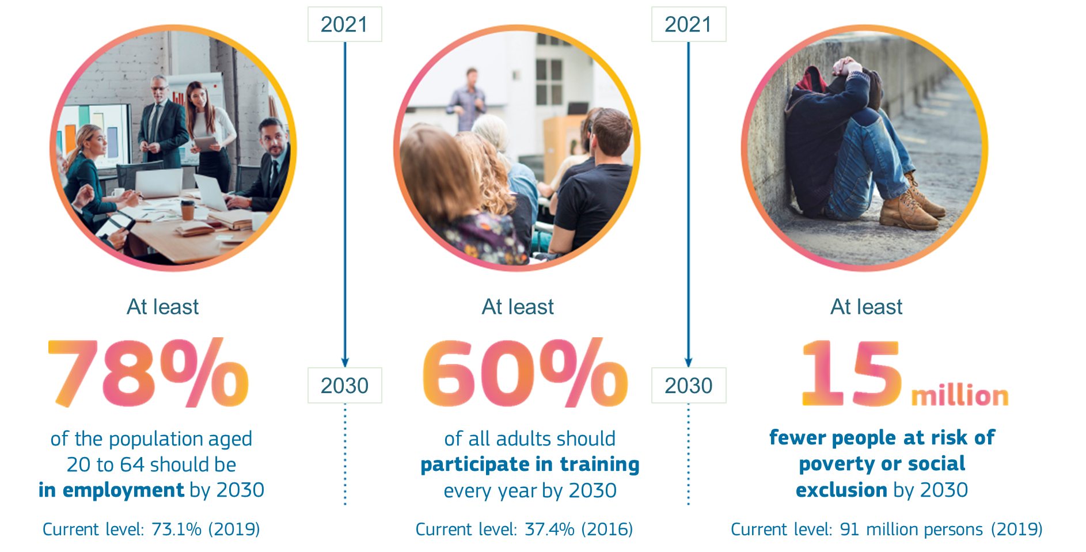
Why?
Why a Pact for Skills
European Pillar of Social Rights
Action Plan – EU headline targets
Endorsed in the
Porto Social Summit
60 million low-qualified adults
70% of companies report that lack of skills hampers their investment
Notes:
There is a strong need to boosting joint action to increase and maximise the impact of public and private skills investment.
We experience rapid changes on EU labour markets that shift skills policy to the centre of today‘s labour market policies.
Facing skills shortages and mismatches, as well as the twin digital and green transitions, require a shift in the skills set of the working population.
Lifelong learning for all is not only a European social and fundamental right, but also a smart economic investment. And yet, while EU Member States on average invest 4,6% of GDP in education and training overall, they only invest 0,5% of their GDP in developing adults’ skills.
Collectively we need to invest more in education and training of the working age population.
We need to create a culture where the norm is for people to continuously upskill or reskill.
To build a skilled workforce and inclusive society we need ambitious targets. The European Pillar of Social Rights’ Action Plan sets out that by 2030, 60% of all adults should participate in training every year. This was welcomed by EU Leaders, including social partners and civil society, at the Porto Social Summit in May 2021 and endorsed by the European Council on 25 June 2021.

Slide 3
Joining forces under the Pact
Businesses (large and small), social partners, education and training providers, associations, cluster organisations, national, regional and local authorities, chambers of commerce and employment services etc.
Upskilling & reskilling of people of working age
© European Union
Notes:
The Pact starts by acknowledging that skills policies and actions are shared between many actors. We need to work together.
Public authorities (ministries, regional authorities, public employment services…), but also education and training providers, businesses, social partners, chambers of commerce and employment agencies are can and need contribute to making up- and reskilling a reality.
There are many advantages of joining forces: A shared vision, pooling expertise and resources and concerted efforts can bring clarity to individuals and companies throughout the value chain, deliver impactful results, achieve economy of scale and reduce costs and very importantly focus on key priorities.
Also, Joint action in skills partnerships, particularly in large-scale partnerships will increase the return on skills investment.
Finally, the Pact aims to mobilise private and public stakeholders to take concrete action for the upskilling and reskilling of people of working age. The Pact is not merely a general declaration of good will, but seeks to materialise in specific public commitments for tangible activities with real impact.
The Pact has a strong political backing. Since its launch in November of 2020, Commissioners Schmit and Breton have engaged repeatedly with the Pact and met with all key industrial ecosystems.

Slide 4
Building blocks
Joining forces under the Pact
Large scale partnerships
Major players in industrial ecosystems
Partnerships based on Blueprints
Public authorities
Concrete investments in upskilling opportunities for employees in the company and in a whole value or supply chain
Erasmus+ Sector Skills Alliances Blueprint Projects
National, regional or local partnerships
Employers
Public authorities
Stakeholders e.g. VET providers, PES, social partners
Building on the work of Eurocities and Intelligence Cities Challange, Centres of Vocational Excellence, Clusters
Community of members of the European Alliance for Apprenticeships
© European Union
Social Partners agreements on upskilling and reskilling
Individual commitments
Stakeholders Commit to provide quality upskilling opportunities. Basis for
Notes:
The Pact is a framework, an umbrella, in which very different initiatives by stakeholders fit. It takes the shape that stakeholders want to give it. There are many different ways to participate.
At EU level, the Pact has a strong focus on industrial ecosystems and regions, Large-scale European public-private multi-stakeholder partnerships, where major players in industrial ecosystems and value or supply chains, including associations and relevant public authorities, commit to cooperate and invest to provide up-/re-skilling opportunities for employees in the whole industrial ecosystem (including SMEs).
National/regional/local partnerships based on cluster and territorial skills strategies. Here relevant stakeholders (e.g. social partners and education and VET providers, including Centres of Vocational Excellence) and public authorities (e.g. public employment services) together with employers, can commit to up-skill/re-skill the workforce (both employed and unemployed people and potential jobseekers among the inactive). The partnerships can have a horizontal or sectoral dimension (including clusters).
Finally, Individual commitments from individual companies or stakeholders, are also possible with the commitment to sign a Charter. This is the basis for networking to either form new partnerships, strengthen the existing ones or build other cooperation arrangements.
There are solid building blocks for this:
Sector Skills Alliances Blueprint projects financed by the Erasmus + Programme already bring together relevant stakeholders at sectoral level to identify skills needs, design training contents and formats and outline skills strategies. This has proven a good basis to develop cooperation further into skills partnerships.
Social partners agreements and/or tripartite agreements at EU, national regional or local level focusing on upskilling and reskilling of the workforce.
Pledges under the renewed European Alliance of Apprenticeships and the Digital Skills and Jobs Coalition are also included under the umbrella of the Pact.

Slide 5
Already with the Pact
11 Large Scale Skills Partnerships (LSP) now launched in key ecosystems. Together, committed to provide up- and reskilling opportunities to close to 6 million people in the coming years.
Over 600 signatories of the Charter from all Member States and sectors, including close to a third with concrete commitments.
Very different types of stakeholders: large multinational companies, SMEs, local training providers, chambers of commerce, social partners, regional authorities, sectoral clusters, national authorities and diverse kinds of networks and associations.
Notes:
The first partnerships were launched in November 2020 in few major industrial ecosystems, building on the results of their Blueprints for sectoral cooperation on skills. Progressively, these partnerships will be extended further to other industrial ecosystems.
Today, there are 11 Large Scale Skills Partnerships: automotive; microelectronics; aerospace & defence; shipbuilding; offshore renewable energy; textiles; tourism; construction; agri-food; creative and cultural industries and proximity and social economy
The Pact for Skills is gaining mometum. With the new launches in the last few months, now more than two thirds of the key industrial ecosystems (as defined by the renewed EU industrial Strategy) have at least one large-scale skills partnership. These bring together all relevant players along the value chain and are essential to facilitate the joint effort for up- and reskilling.
The objective of the Commission is to end the year with at least one large-scale partnership in each of the ecosystems to articulate work by stakeholders for concrete skilling actions. Work is now intesifying in the remaining ecosystems. Digital, Retail, Health and Energy Intensive Industries.
All LSP sign a Declaration describing their vision of their ecosystem and spelling out their specific ommitments to face the skilling challenges. There are ambitious commitments for up- and reskilling.
The base of individual members of the Pact is also growing steadly, with now over 600 individual members. These include a wide range of different stakeholders, including public authorities in the area of Vocational Education and Training, training platforms, networks of training centers and local VET centers. Also committed to the Pact as signatories of the Pact Charter there are sectoral organisations and clusters. All of them are a solid basis to form new skills partnerships or strengthen the existing ones.
The Commission (through a contractor) will facilitate networking opportunities for these stakeholders to come together and work jointly in projects for up- and reskilling.
The focus will be on the regional dimension. Regions share skills needs and cooperation at that level can be more fruitful. The Pact will seek to strenghten the regional dimension in the coming months: new regional partnerships, more regional playes in large-scale partnerships, more regional members.

Slide 6
Enablers
Key role for regions
Members of large-scale partnerships
Support services
National Recovery and Resilience Plans
Mobilizing stakeholders
Regional authorities
Strengthening networks
© European Union
CoVEs, Blueprint projects…
Promoting regional partnerships
EU funding for up- and reskilling
Notes:
Regional and local authorities can play an important role as facilitators, promoters or active players of the Pact by :
Identifying key large-scale partnerships in key ecosystems particularly relevant for their regional or local specialization
Mobilizing a broad coalition of stakeholders, including key regional (or local) developing or innovation agencies, universities and training providers, chambers of commerce, business clusters and social partners.
Promoting regional (or local) partnerships that help individual firms, specially SMEs to pool resources and access information and networks that help them deliver concrete up and reskilling actions. The partnerships could possibly have a sectoral (including clusters) dimension and cooperate with the multi-stakeholder partnerships mentioned above and facilitate the mobility of workers (both geographically and sectoral).
Multiplying access to the information and knowledge hubs that the Commission will be providing.
Sharing good practices of members of the partnerships or of signatories of the Pact in their area and showcasing the benefits of the Pact to individual stakeholders.

Slide 7
Regions members of the Pact, directly or as members of larger partnerships
Regions’ participation
Notes:
Regional and local partners of the Automotive Alliance
Moravian-Silesian Region (Czechia)
Stuttgart Region (Germany)
Le Grand Est (France)
Municipalities of Mangualde (Portugal) and of Cluj-Napoca (Romania)
Silicon Saxony, in Germany, is a regional cluster of microelectronics partnership

Slide 8
Regions members of the Pact, directly or as members of larger partnerships
Regions’ participation
Notes:
Regions in the Tourism and in the Textiles, Clothing, Leather and Footwear large-scale skills partnerships.

Slide 9
Final remarks
There is a strong need to increase public and private skills investment, maximise its impact and to do it rapidly.
Investment in skills needs a joint effort. Key players have to contribute to making up- and reskilling a reality. The Pact for Skills aims to mobilise private and public stakeholders to take concrete action.
Regional authorities can play an active role. They are in a unique position to get involved with the Pact and also engage relevant actors, e.g. economic development agencies, chambers of commerce, Public Employment Services, managing authorities of the ESF+, social partners, sectoral clusters,….
Skills partnerships are the best way to pool expertise and resources and make concerted efforts for up- and reskilling actions. They can achieve economies of scale and deliver impactful results.

Slide 10
https://ec.europa.eu/social/PactforSkills
EC-PACT-FOR-SKILLS@ec.europa.eu

