Slide 1
How to bridge the skills gap to enable the green and digital transformation of the Chemical industry Shaping the EU Policy
Eleonora Isopo
Policy Executive at the
European Chemical Employers Group (ECEG)
e.isopo@eceg.org

Slide 2
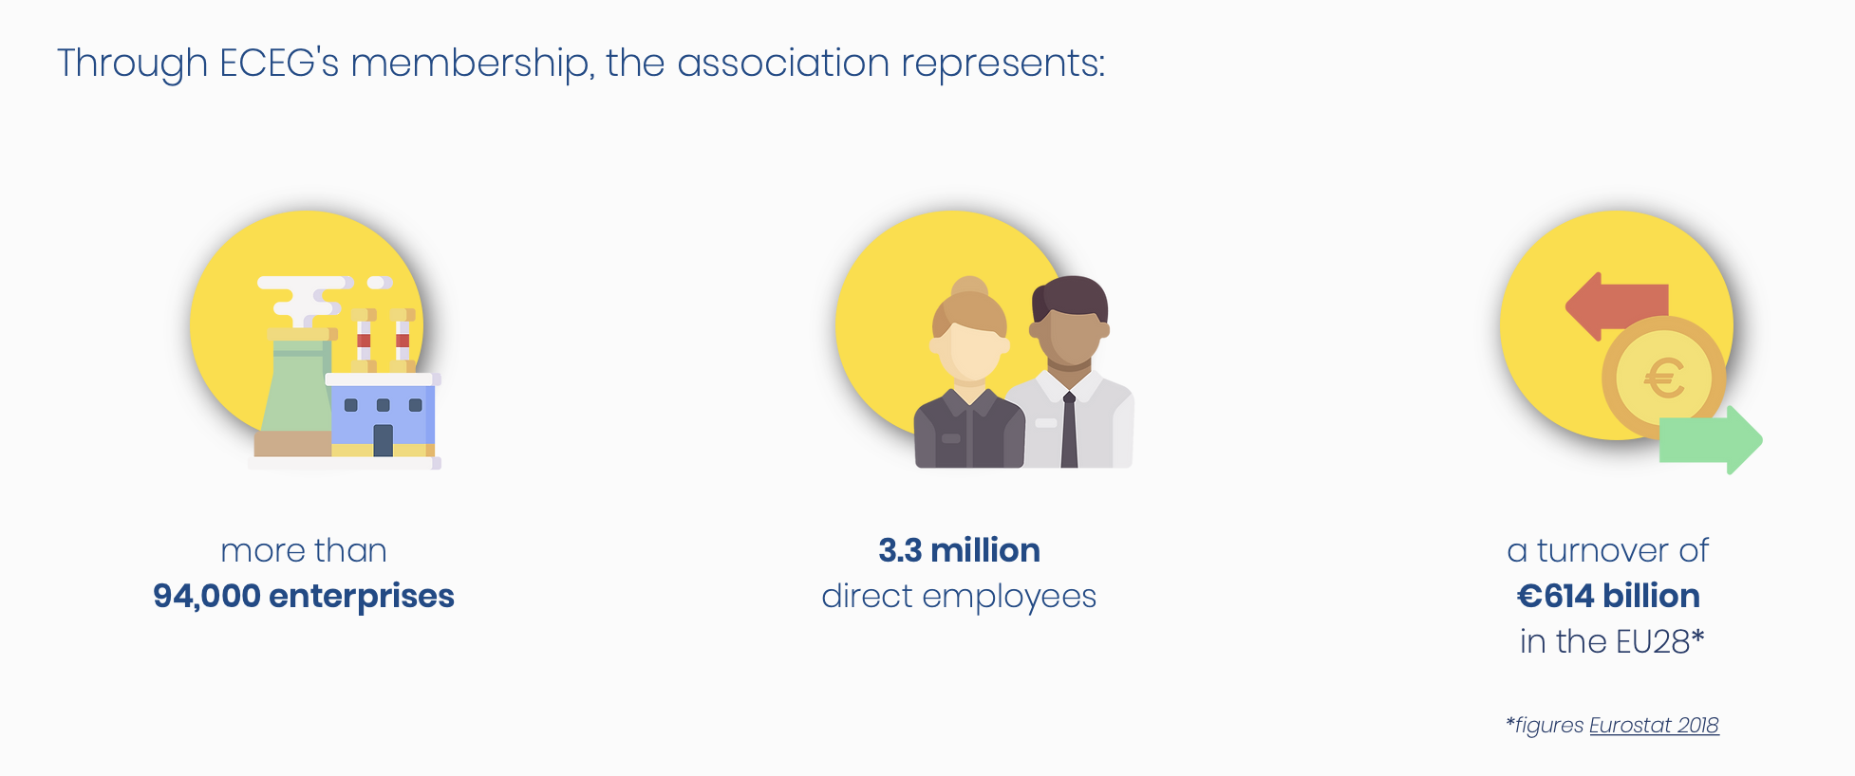
Who we are? The European Chemical Employers Group (ECEG)…
…represents the Employers’ interests from the chemical, pharmaceutical, rubber and plastics industries in Europe.
…is a recognised social partner and a consultation body of the European Institutions.

Slide 3
What we do & how to shape the EU Policy
Since 2004 with the then EMCEF
May 2012: the EMCEF dissolved
and merged into
Stakeholders’ Partnerships

Slide 4
Current challenges and opportunities for the chemical industry
Climate neutrality
The “Quadruple Transition”
Digitalisation
Circular economy
Implementation of the CSS

Slide 5
The impact on skills
Change in job profiles and emergence of new ones, requiring new skills and competences.
→ Increased demand for cross-cutting competences, e.g. problem-solving and communications
Lack of understanding and definition of skills needed in the future.
Need to secure skilled workers.

Slide 6
How to successfully respond to these challenges? ECEG’s engagement
To increase attractiveness of the sector
To modernize teaching methods and training programmes
Specific focus on SMEs
Involvement of Social Partners and
Promotion of Social Dialogue
Stakeholders’s and Skills Partnerships
Joint position papers.
Joint projects.
Toolbox of good practices in the European chemical, pharmaceutical, rubber and plastics industries.
Just Transition Platform Working Group.
Transition Pathway for the chemical industry.
Blueprint for sectoral cooperation on skills.
EU Year of Youth 2022.

Slide 7
Thank you for your attention
The European Chemical Employers Group
Eleonora Isopo e.isopo@eceg.org

