Slide 1
Fostering interregional cooperation
Monika Zsigri, REGIO G1 Smart and sustainable growth
10 November 2021

Slide 2
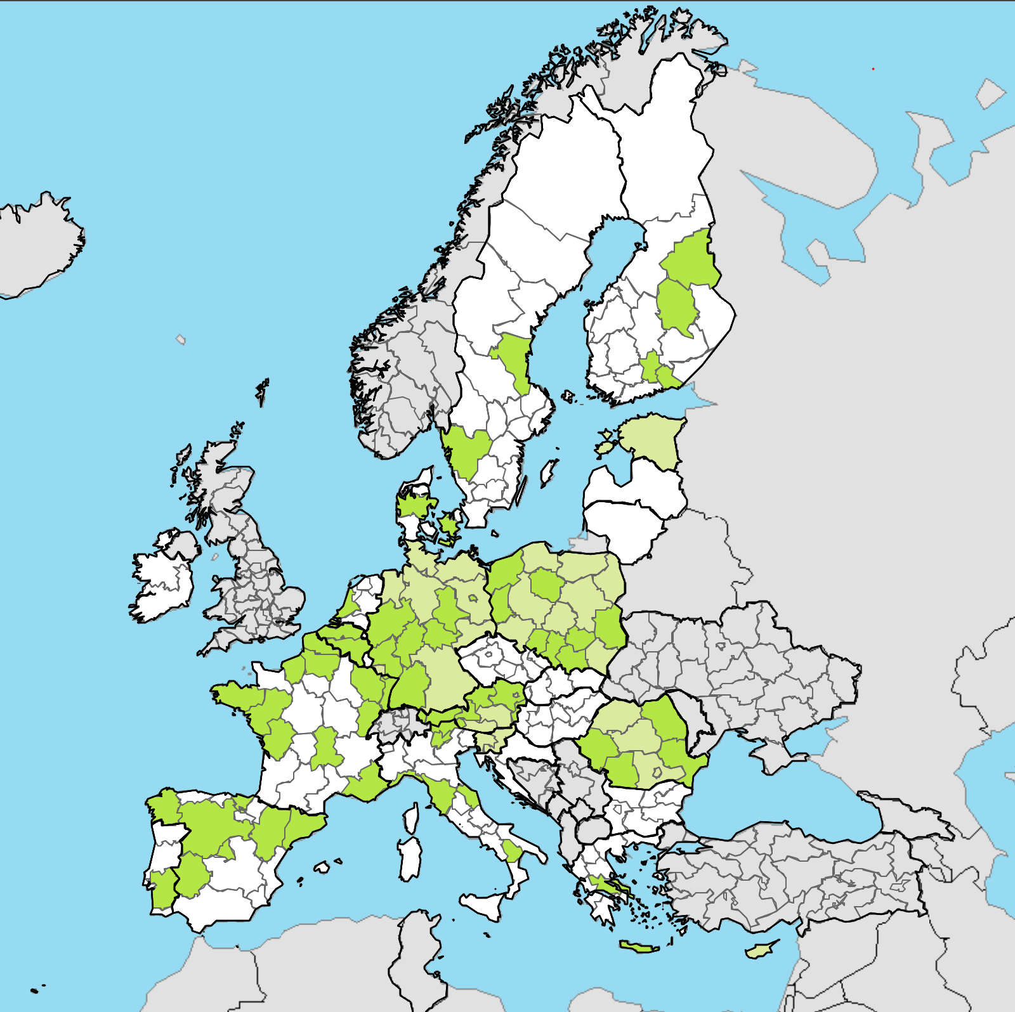
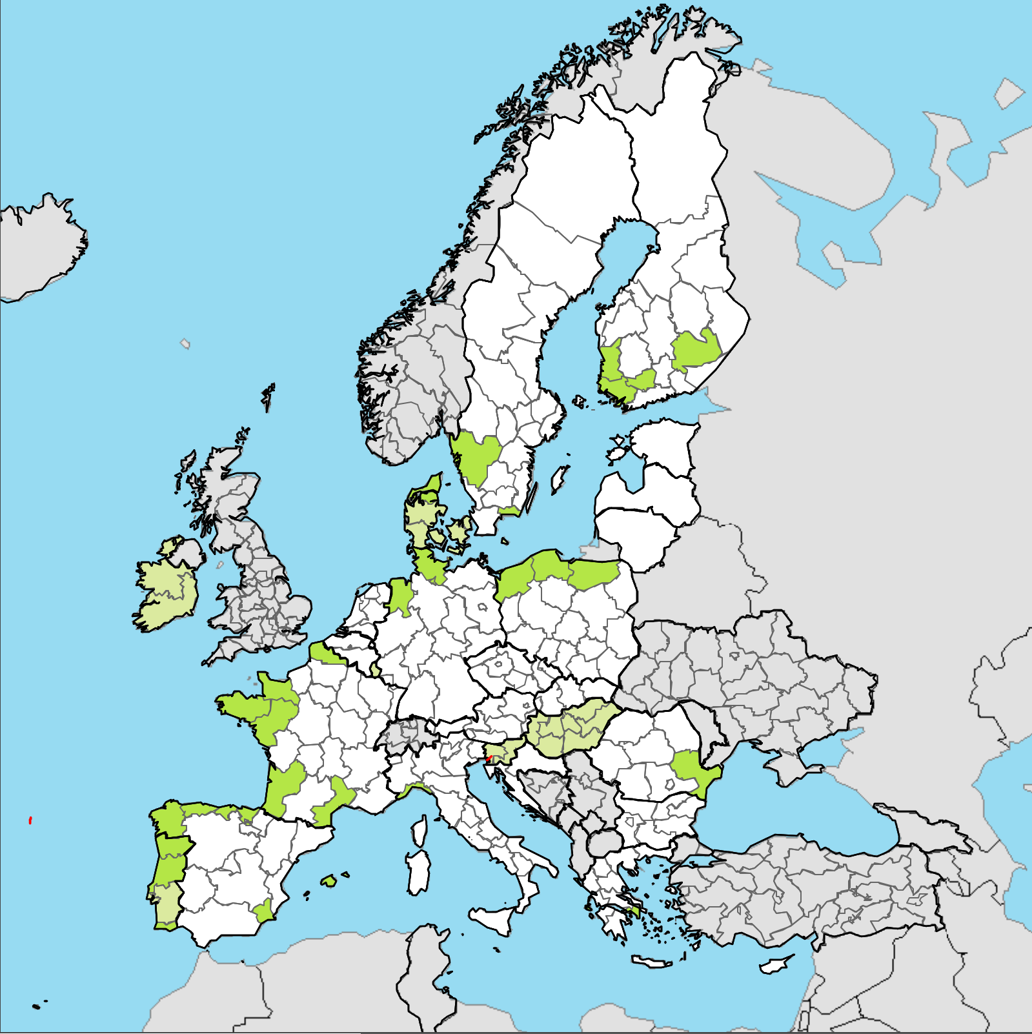
Guiding principle for R&I: Smart specialisation
Resource Efficiency
Blue Renewables

Slide 3
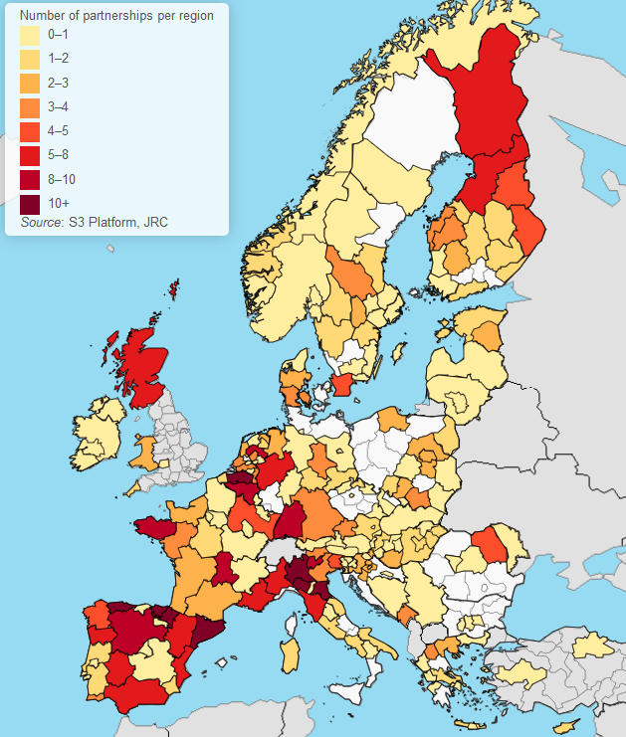
3 Thematic Platforms – 33 S3 Partnerships
S3P Agri-Food - S3P Energy - S3P Industrial Modernisation
Connect regional innovation ecosystems(Q-helix)
Provide interactive & participatory environment for S3 implementation through transnational / interregional cooperation (outward looking process of S3)
Host around 33 Interregional S3 Partnerships:
Currently S3 partnerships involve 189 regions from 33 EU + non EU countries

Slide 4
Thematic smart specialisation platforms

Slide 5
Interregional Innovation Instrument
I3
WHAT
Commercialisation and scaling up of innovation projects for the development of European value chains
FOR WHOM
Interregional Q-Helix ecosystems: researchers, businesses, civil society and public administrations involved in smart specialisation strategies established at national or regional levels
HOW
Implemented under direct management.
HOW MUCH
ERDF (Art. 10 bis)
EUR 570 Million
(current prices)
EC supported by an executive agency

Slide 6
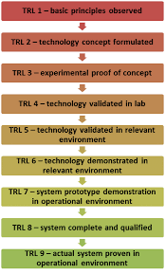
Investment
Maturity of Innovation Project
Knowledge Development
I3
Technology development & demonstration
I3
Close to market
At least TRL 6
Business & Investment Development

Slide 7
Innovation cycle: I3 position
ERDF
Thematic Platforms
Interregional Innovation Investments
Learn
Connect
Demonstrate
Commercialise
Scale-up
Pilot Projects and experimentation
Testing approaches to commercialise and scale-up interregional investment projects
Developing bankable projects for support from financial instruments
Developing new value chains
Portfolio of complementary value chain investment projects
I3 de risking component in private investments
Investment in new value chains

Slide 8
Supporting Interregional Innovation
Possible scenario for the future support to Thematic S3 Platforms and Interregional investments
Dedicated S3
partnerships
database
Self-assessment toolkit to evaluate key
ingredients for a well performing partnership
and investment projects
Methodological manual
I3
I3
1- Learn Phase
Facilitated by Interreg or by appointed experts (for partnerships working on EC strategic priorities)
2- Connect Phase
Facilitated by Interreg, EEN & European Cluster Collaboration Platfom
3- Demonstration Phase
Facilitated by TAF experts (mature investment projects),
supported by ERDF (I3, mainstream programmes) & Horizon Europe (IA) and Innovation ecosystems
4- Commercialisation & scale-up phase
Supported by I3 and Horizon Europe (EIC),
InvestEU Fund (ESIF and financial instruments),
InvestEU Advisory Hub (technical advise on investment projects) &
InvestEU Portal (database matching projects with potential investors worldwide)

Slide 9
Outline of the I3 programme
I3
Thematic areas
Digital transition
Green transition including climate neutrality, resource efficiency and circular economy
Smart manufacturing
Strand 1: Mature partnerships
(49%) EUR 279,3 M
Strand 2a: Less developed regions
(44%) EUR 250,8 M
Strand 2b: Capacity building for less developed regions
(5%) EUR 28,5 M
Strand 3: Technical assistance, capitalisation and experimentation
(2%) EUR 11,4
Grants
Direct management or service
procurement
Grants

Slide 10
Objectives of the public What next
January 2021
Results of the public consultation
2nd quarter 2021
Finalisation of I3 Work Programme
Q4 2021
Launch of the first call for proposals (strand 1 and 2a)
May 2021
Setting up an expert group
Q1 2022
Evaluation of projects proposal (strand 1 and 2a)
Timeline
Mid-2022
Projects implementation
(strand 1 and 2a)

