Slide 1
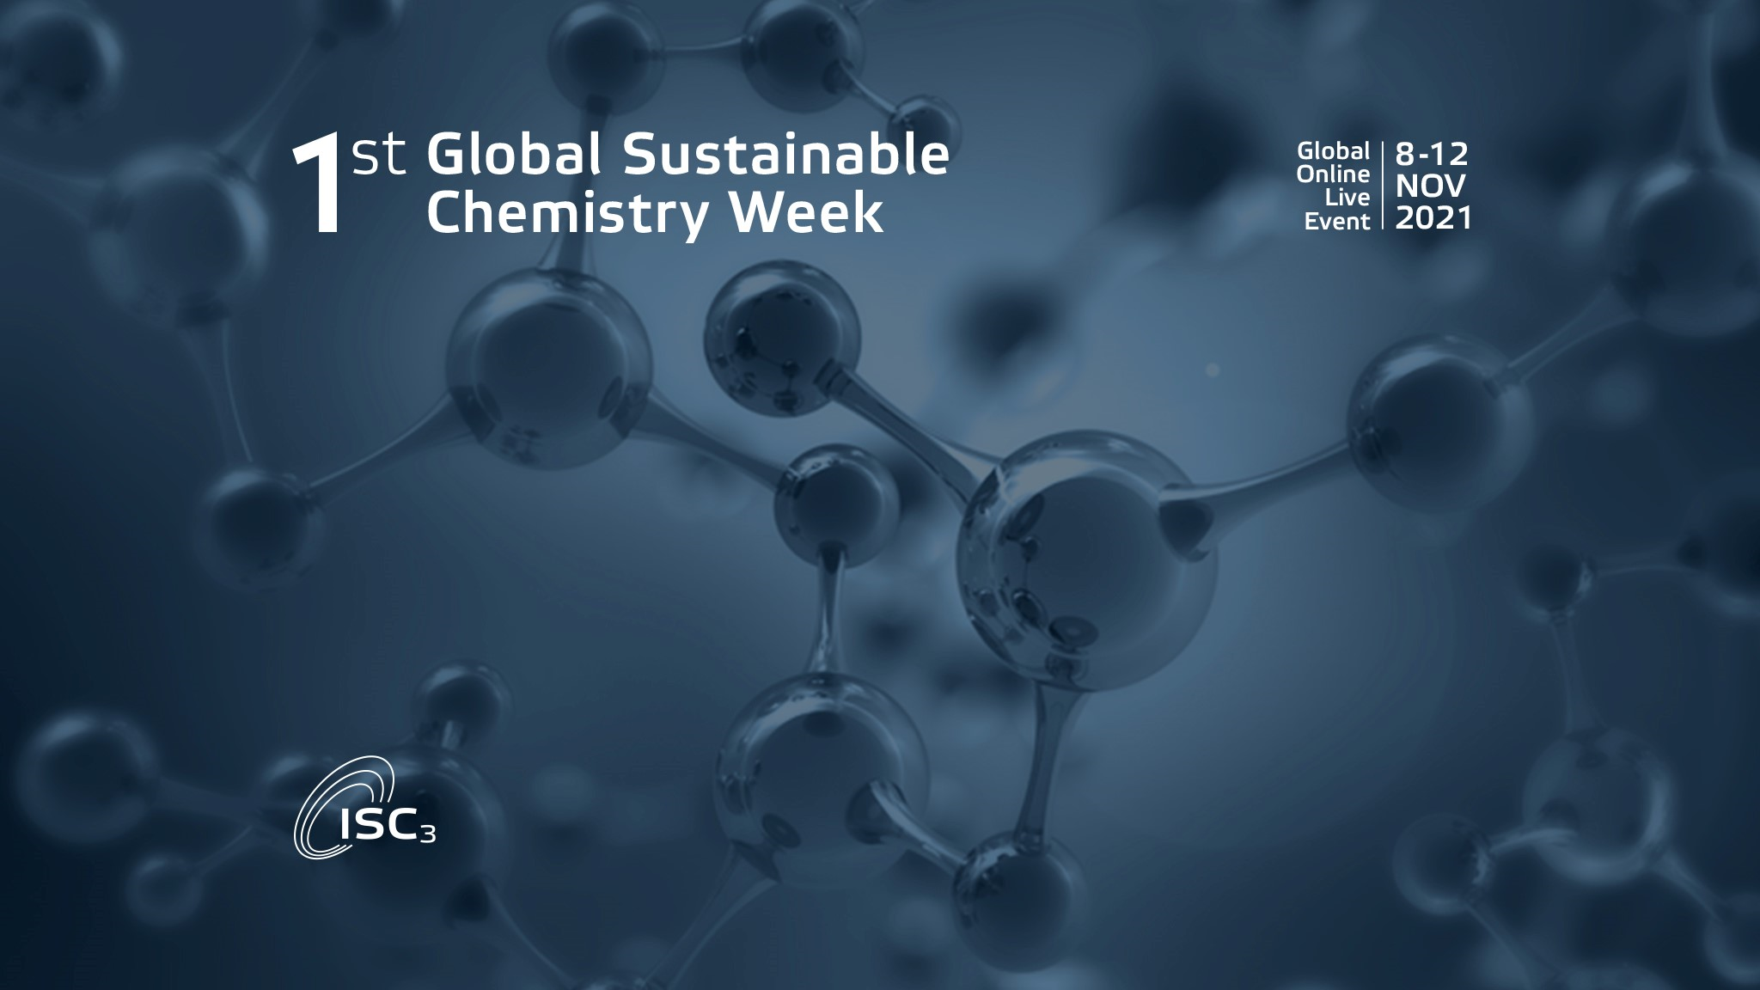
CHEMICAL PARTNERSHIP ON S3PLATFORM FOR INDUSTRIAL MODERNIZATION -TESTBED FOR INTERREGIONAL COOPERATION
Catalonia
EU Regions:
Key players in the transition to the sustainable and circular chemical sector

Slide 2
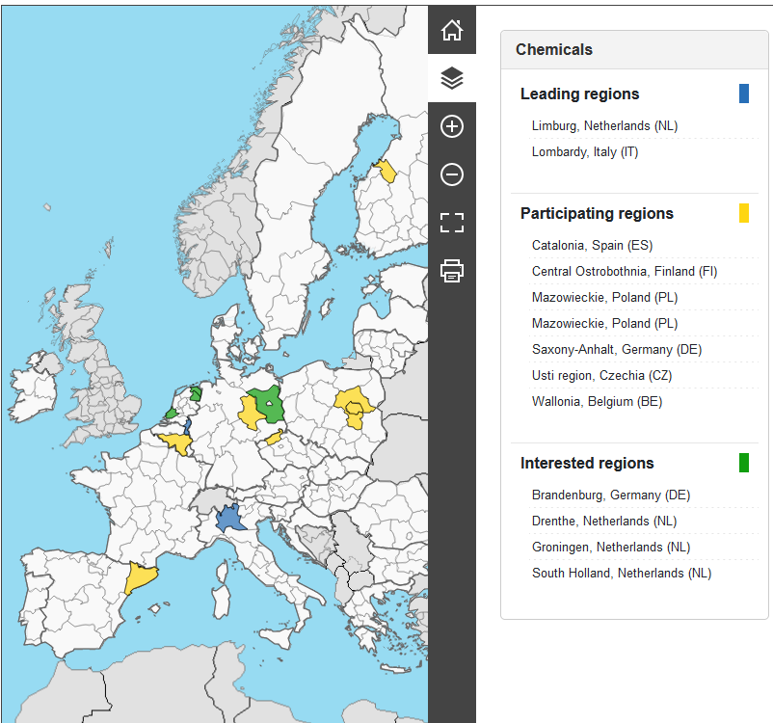
Regions & working groups
Alternative feedstock
Polymers
Chemical recycling
Sustainable process technology

Slide 3




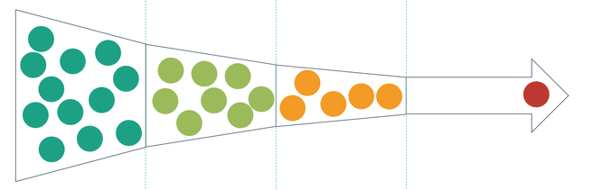











Processes with low or near zero
CO₂ generation
Catalysis and Biocatalysis
Chemistry 4.0.
Flow Chemistry
Creation of a network
of singular infrastructures.
Green Solvents,
New purification and separation processes
Improvement of the energy efficiency
of chemical processes

Slide 4

FLOW CHEMISTRY
Innovative technology
Paradigm shift in the production of chemical products
Increased safety and flexibility in production
Faster and more efficient
Business access to new technologies
Application in emerging fields, such as personalized medicine, nanomaterials.
This technology can facilitate the reindustrialization and relocation of companies and chemical processes in Europe.
  Flow chemistry is the development and study of chemical reactions whereby reactants are combined by pumping fluids, including solutions of reagents, though tubes at known rates and a controlled temperature.

Slide 5
Flow Chemical Interregional Hub (FCIH)
The proposal for the Flow Chemical Interregional Hub (FCIH) is based on 4 axes distributed in several geographical nodes
1
Pilot plant for process developments (not GMP)
2
GMP plant as a demonstrator of processes
3
Resource center, management, financial aspects, promotion, legal and regulatory framework, accreditation of qualified technology providers in flow chemistry and complementary technologies, training, contact with investors, etc.
4
Business Accelerator.
6

Slide 6
Main bottlenecks
Identification of the business model
Financing problems
Legal aspects and intellectual property
Interregional dimension
How to involve private companies.
6

Slide 7






Chemical Sector Challenges
Covid-19
Decarbonization
Volatility of raw materials
2020 has been a year of disruption for the chemical industry, in general, and particularly for Catalonia. It has played an important role in the fight against coronavirus, and the production of disinfectants, diagnostic reagents, etc. It has increased, but it has also been exposed to global and complex supply chain breaks, and the decline in markets such as automobiles, construction, among others, coupled with rising energy prices.
Acceleration of processes of decarbonization of the economy. The chemical industry must find opportunities in these areas and diversify technologies and products, with better efficiency in the use of resources, new raw materials, reuse of resources, water and waste treatment, the transformation of waste and by-products into new raw materials.
Can provide an opportunity for chemical recycling technologies, circular and bio economy and the use of secondary raw materials.
Value chains
Digital transformation
Talent
Bring value chains closer together to make them more resistant and resilient.
This may be "deglobalization", but an opportunity for reindustrialization.
Redefinition of processes, and introduction of new technologies
Attraction of young people to this science, and maintenance of chemical knowledge.
6

Slide 8





The chemical industry in Catalonia
1.053 companies
€18,502 M
43.3% of the turnover of the chemical sector in Spain
Nº of chemical companies grew a 9% since 2016.
36,459 employees
Degree of internationalisation
First export sector in Catalonia
48.2% of Spanish chemical product exports were Catalan
12.5% of industrial GVA
3rd largest manufacturing sector of the Catalan economy behind Food and Automotive
Source: ACCIÓ (latest available figures)
Notes:
Lletres fora del finger

Slide 9






















































































Value chain of the chemical industry in Catalonia
RAW MATERIALS
PETRO-CHEMICALS
BASIC CHEMICAL COMPANIES
SPECIALTY CHEMICAL COMPANIES
SPECIALISED LOGISTICS
PRODUCT SALES TO CONSUMER
CHANNELS
SOAPS, PERFUMES, DETERGENTS AND COSMETICS
OTHER CHEMICAL PRODUCTS AND MAN-MADE FIBERS
Other Channels
Agricultural
Automotive
Construction
Food
Pharmaceutical
Other chemical manufactures
PAINTS, VARNISHES AND SIMILAR COATINGS
PESTICIDES AND OTHER AGROCHEMICAL PRODUCTS
Big and medium distribution channels
Supermarkets
Perfumeries
DIY Stores
Source: ACCIÓ

Slide 10

NEXT GENERATION CATALONIA
Hydrogen Valley of Catalonia
The Battery Hub
Carbon recovery project

Slide 11
Thank you!

