Slide 1

The growth accelerator towards a circular environment.
Lia Voermans
Brightlands Chemelot Campus
ECRN 11.10.2021

Slide 2
In South Limburg we are developing the first large-scale Circular Hub in Europe

Slide 3
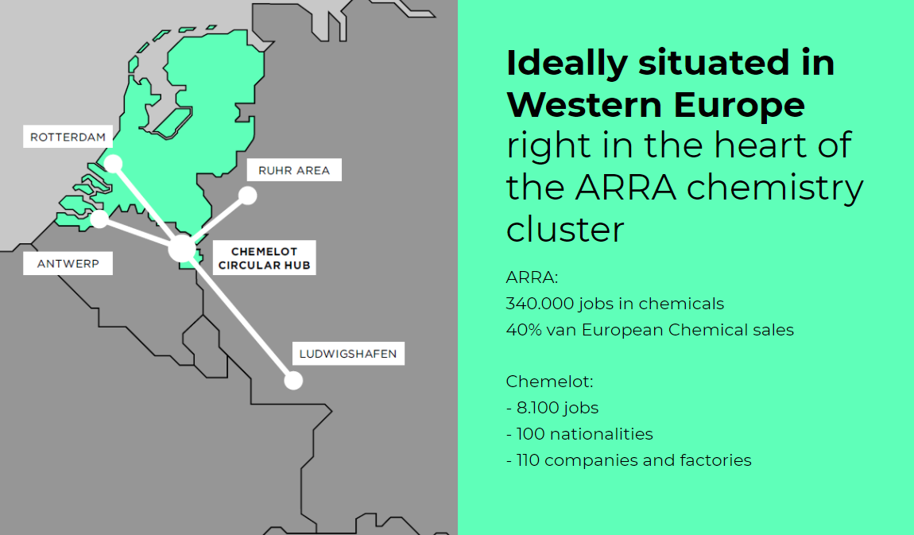

Slide 4
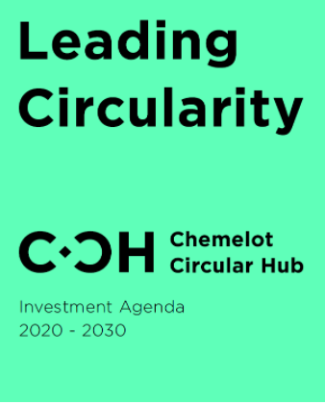
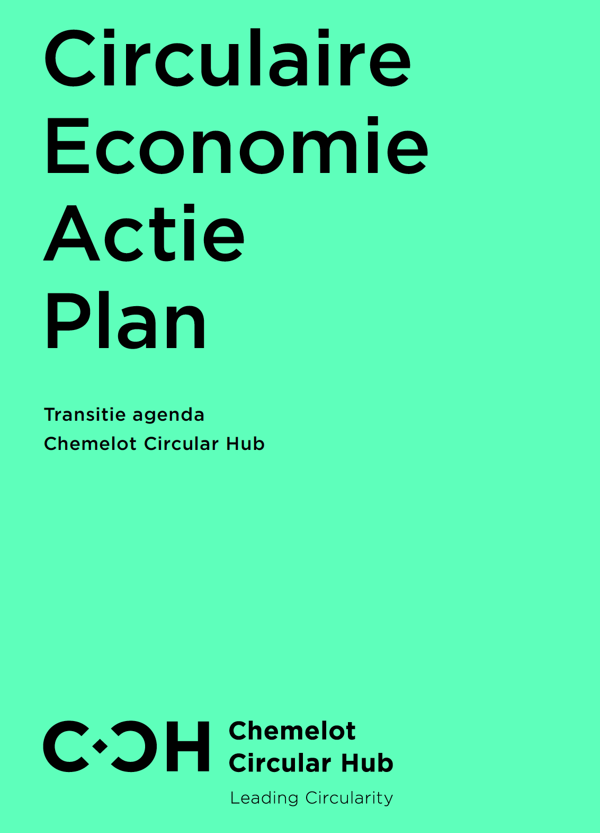
+

Slide 5
Our goal:
Securing the future of the region and NL (preventing mine closure 2.0)
Developing a new economic branch for the Netherlands and Europe:
Circular Chemistry and Materials
Our way:
“Connecting Minds, Creating the Future”
New Ecosystems- new Business models
System-integrated value chain transition (push-pull)
Using al lot of creativity/ learning communities
In cooperation with other relevant parties/ regions in NL and Europe
Notes:
De indirecte effecten van ons handelen zijn vaak nog veel groter dan de directe effecten

Slide 6
Crucial for transition = Creative- innovative Ecosystem (‘disruptives’)
Such as Brightlands Chemelot Campus
Notes:
Wij zijn de place to be om het verschiil te kunnen maken

Slide 7
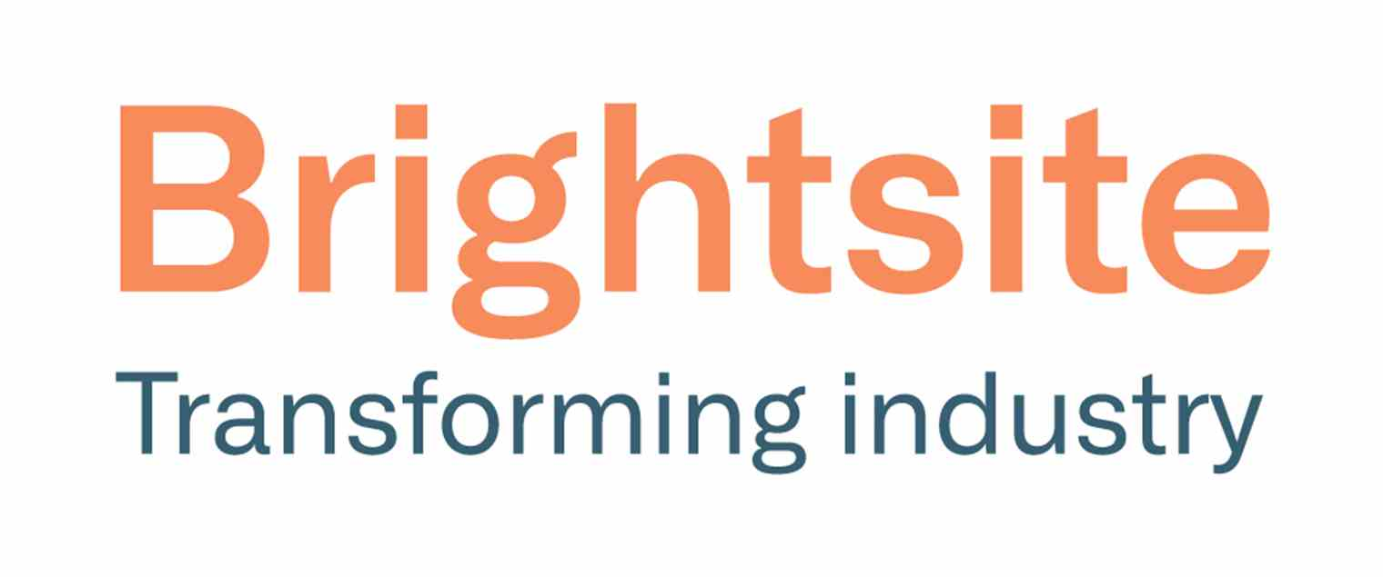
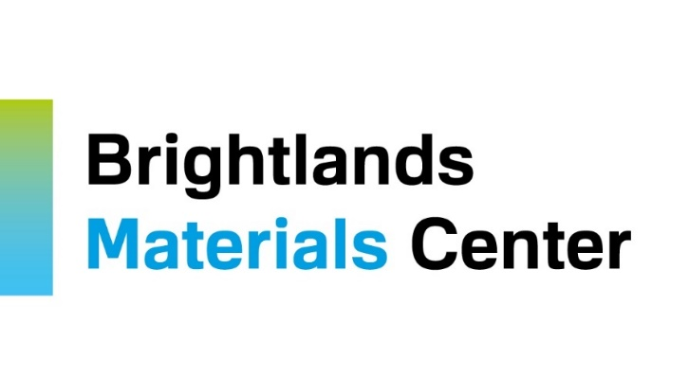
Brightlands Innovation Program
Sustainable Chemical Processes
Sustainable carbon and hydrogen
Waste streams as new feedstock
Biobased
Electrification
Circular Materials and Products
Designed-from and to-recycle
Longevity and Functionality
1. Acquisition of breakthrough technologies at Chemelot Industrial Park - First in kind factory
2. Acquisition of breakthrough technologies at Chemelot Campus – Pilots & Demonstrators
3. Scaling breakthrough ideas in development centres

Slide 9
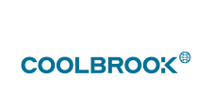

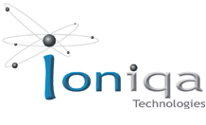
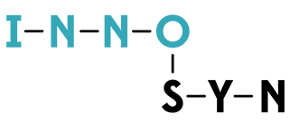


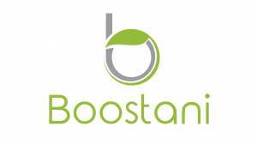

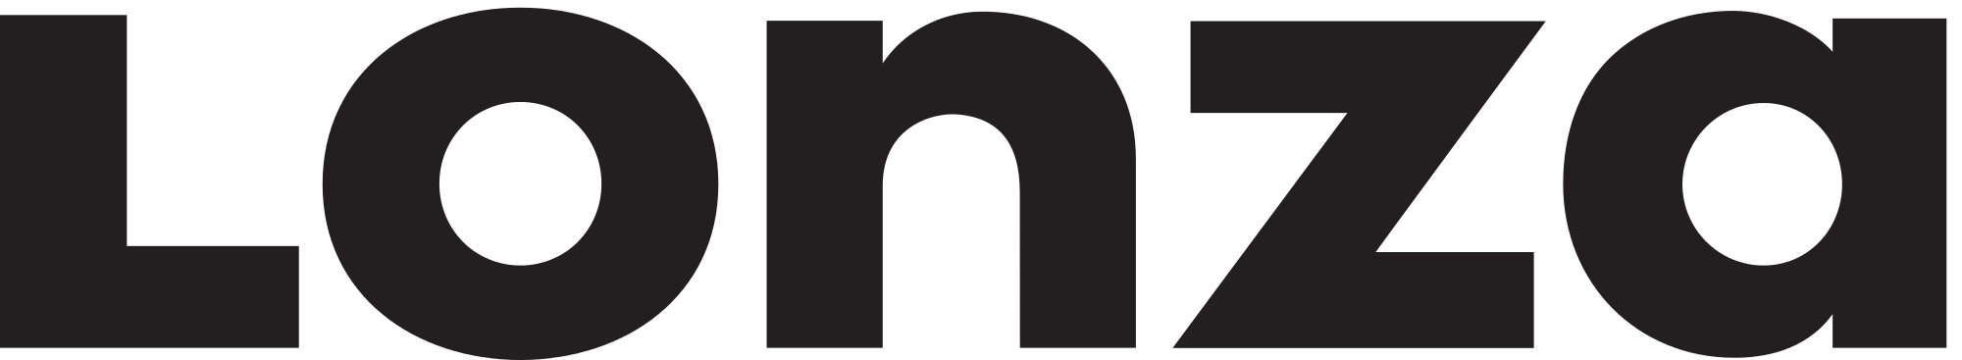
Innovative Process Technology Raw Materials/Energy Transition
home of
many disruptives

Slide 10
All these elements
come together in:
SyschemiQ

Slide 11
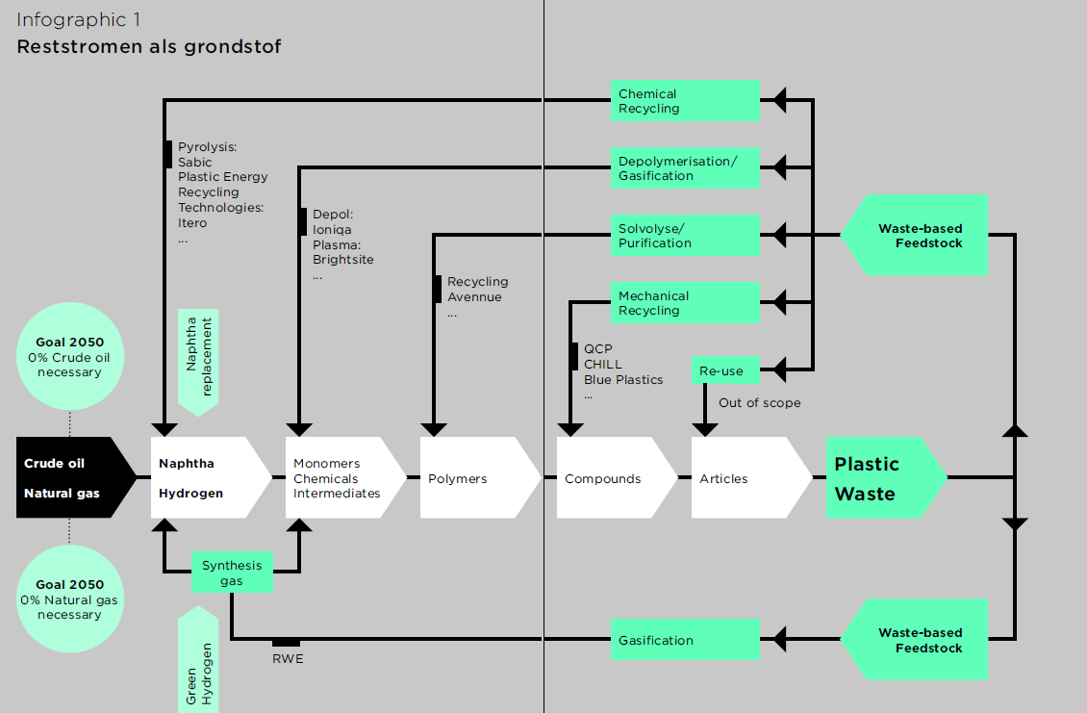
New circular Feedstock

Slide 12
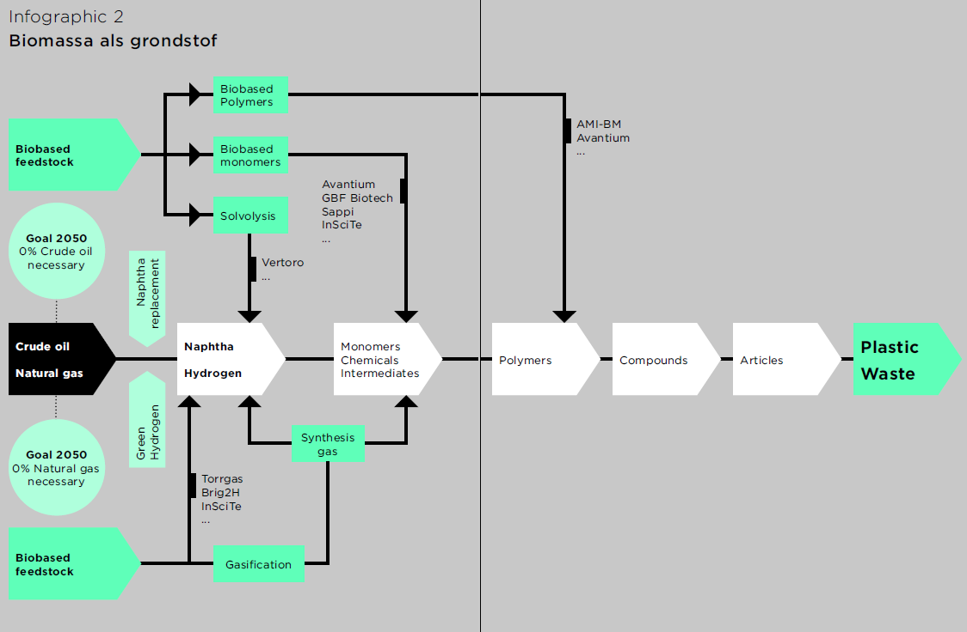
New Circular Feedstock

Slide 13
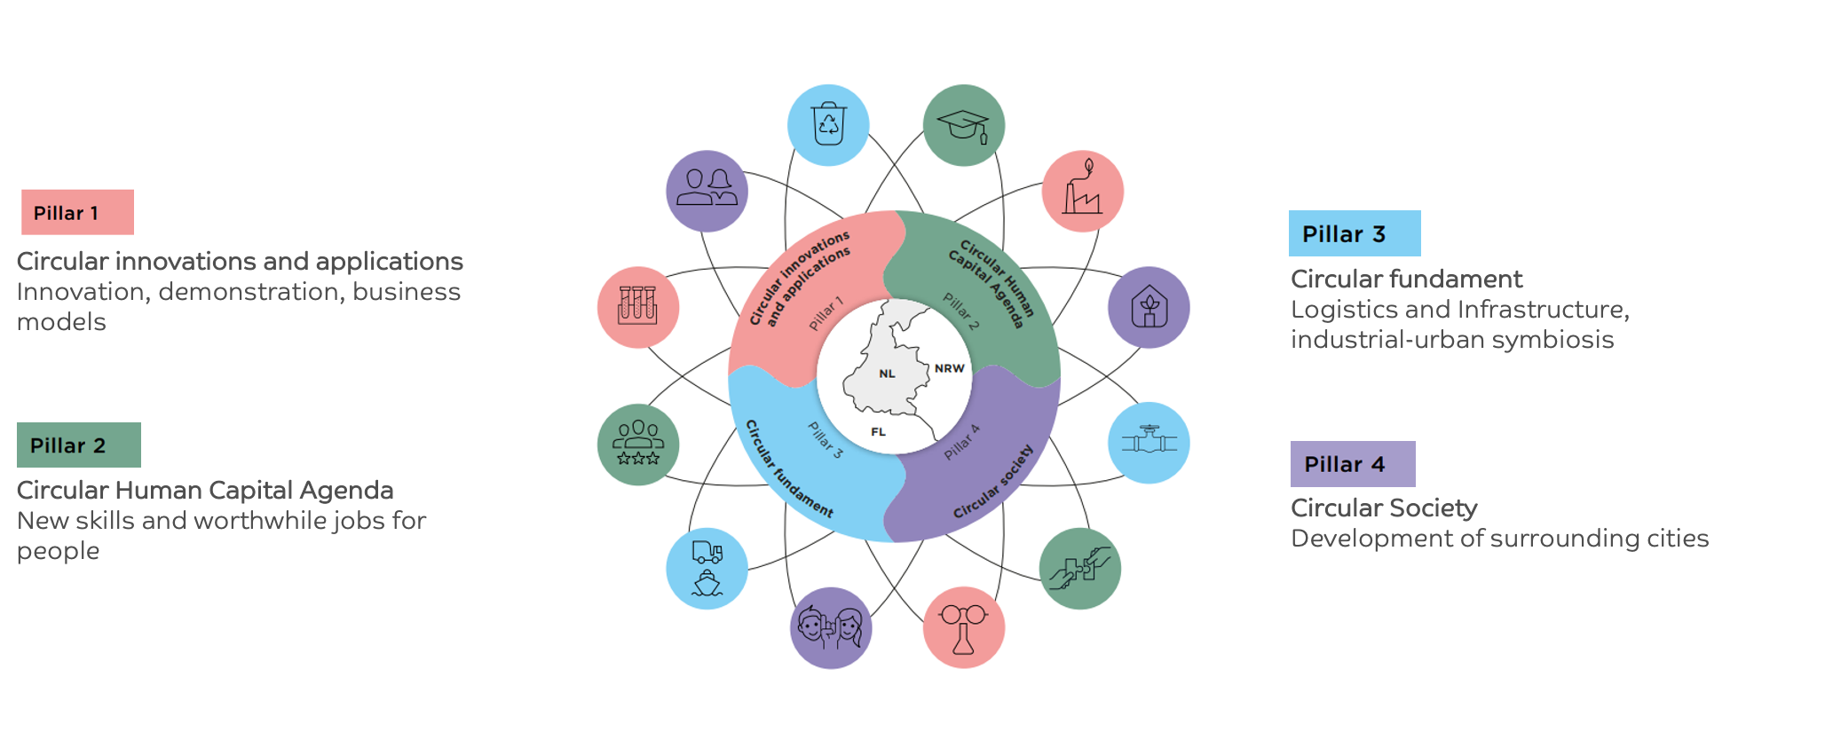
Integral approach cooperation across 4 pillars

Slide 14
SYSCHEMIQ- Closed Loop on Plastic Recycling

Slide 15
Thank you for your attention
Lia.Voermans@Brightlands.com

