Slide 1
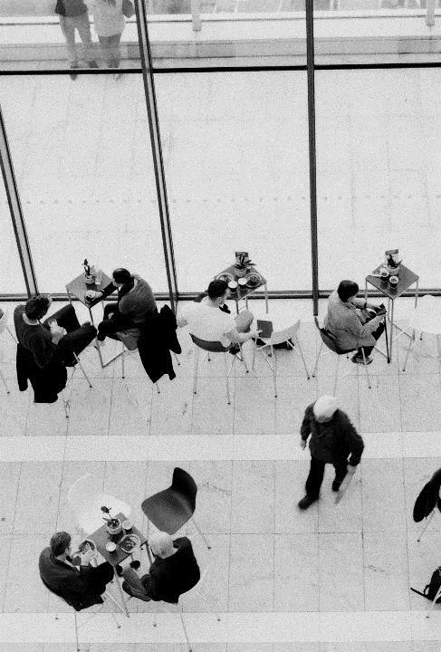
EUROPEAN REGIONS RESEARCH AND INNOVATION NETWORK
Angèle Liaigre
Policy Officer, Pays de la Loire Region

Slide 2
Brussels-based network of regional and local representations focusing on research and innovation policy and programmes
Support the development of regional and local innovation ecosystems and enhance research and innovation capacities
Working Groups
Project development
Policy
Cooperation
Notes:
And ultimately finding funding opportunities for members!

Slide 3
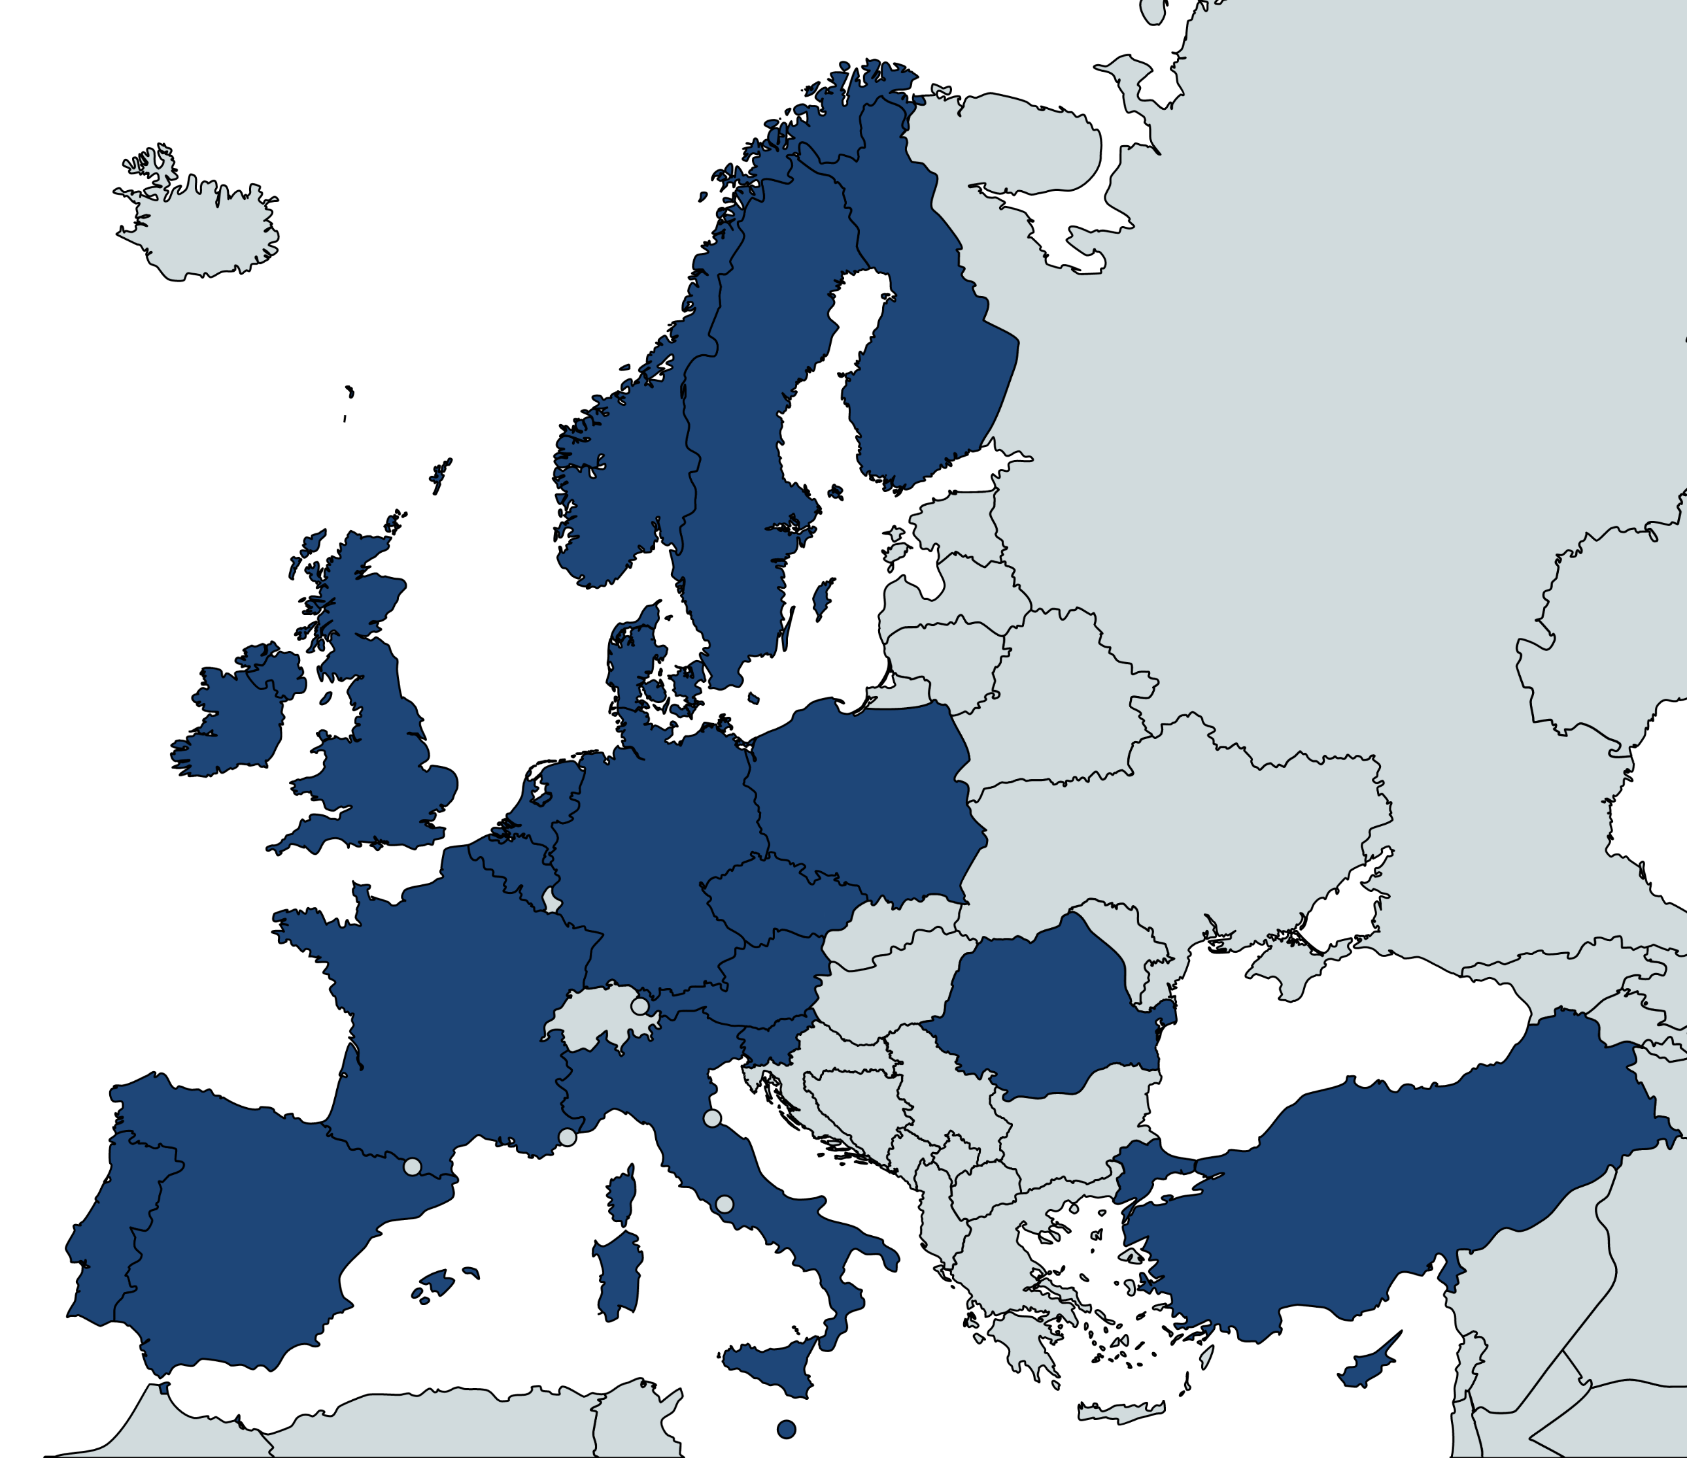
MEMBERS
120 members
-
20+ countries
Regional and local authorities
-
Universities
-
Chambers of commerce

Slide 4
RESEARCH & INNOVATION POLICY
PLACE-BASED
ECOSYSTEM
GOVERNANCE
Coordination and complementarities between EU, national, and regional agendas and funding
Specific local conditions
make R&I ecosystems flourish
Multi-actor and cross-sector collaboration for increased impact

Slide 5
BIOECONOMY WORKING GROUP
Focus
Circular bioeconomy
Ecological sustainability of solutions
=> Aligned with the Green Deal dynamic
Co-leaders
Navarra (ES), Pays de la Loire (FR), Småland Blekinge Halland (SE)
Annual Work Plan
WG priorities, key topics and planned activities
Type of activities
Information sessions
Sharing of best practices
Project development
Position papers to influence EU policy initiatives
Notes:
Our objectives
=> Increase the influence of regions and their stakeholders in shaping the European circular bioeconomy including food systems, forests, bioenergy, biowaste, bio-based products etc.
•Increase cooperation and develop projects between members of the WG
•Information sharing
Programmes
•Horizon Europe -cluster on natural resources and food + Missions + partnerships (BBI and its successor)
•LIFE programme: not much of a focus until now but it is increasing
•Interreg
•
Policy/strategies
•The European Green Deal: “From farm to fork” strategy, Action plan on circular economy, mitigation and adaption plan, EU Forest Strategy
•Food 2030 agenda
•Bioeconomy Strategy + action plan

Slide 6
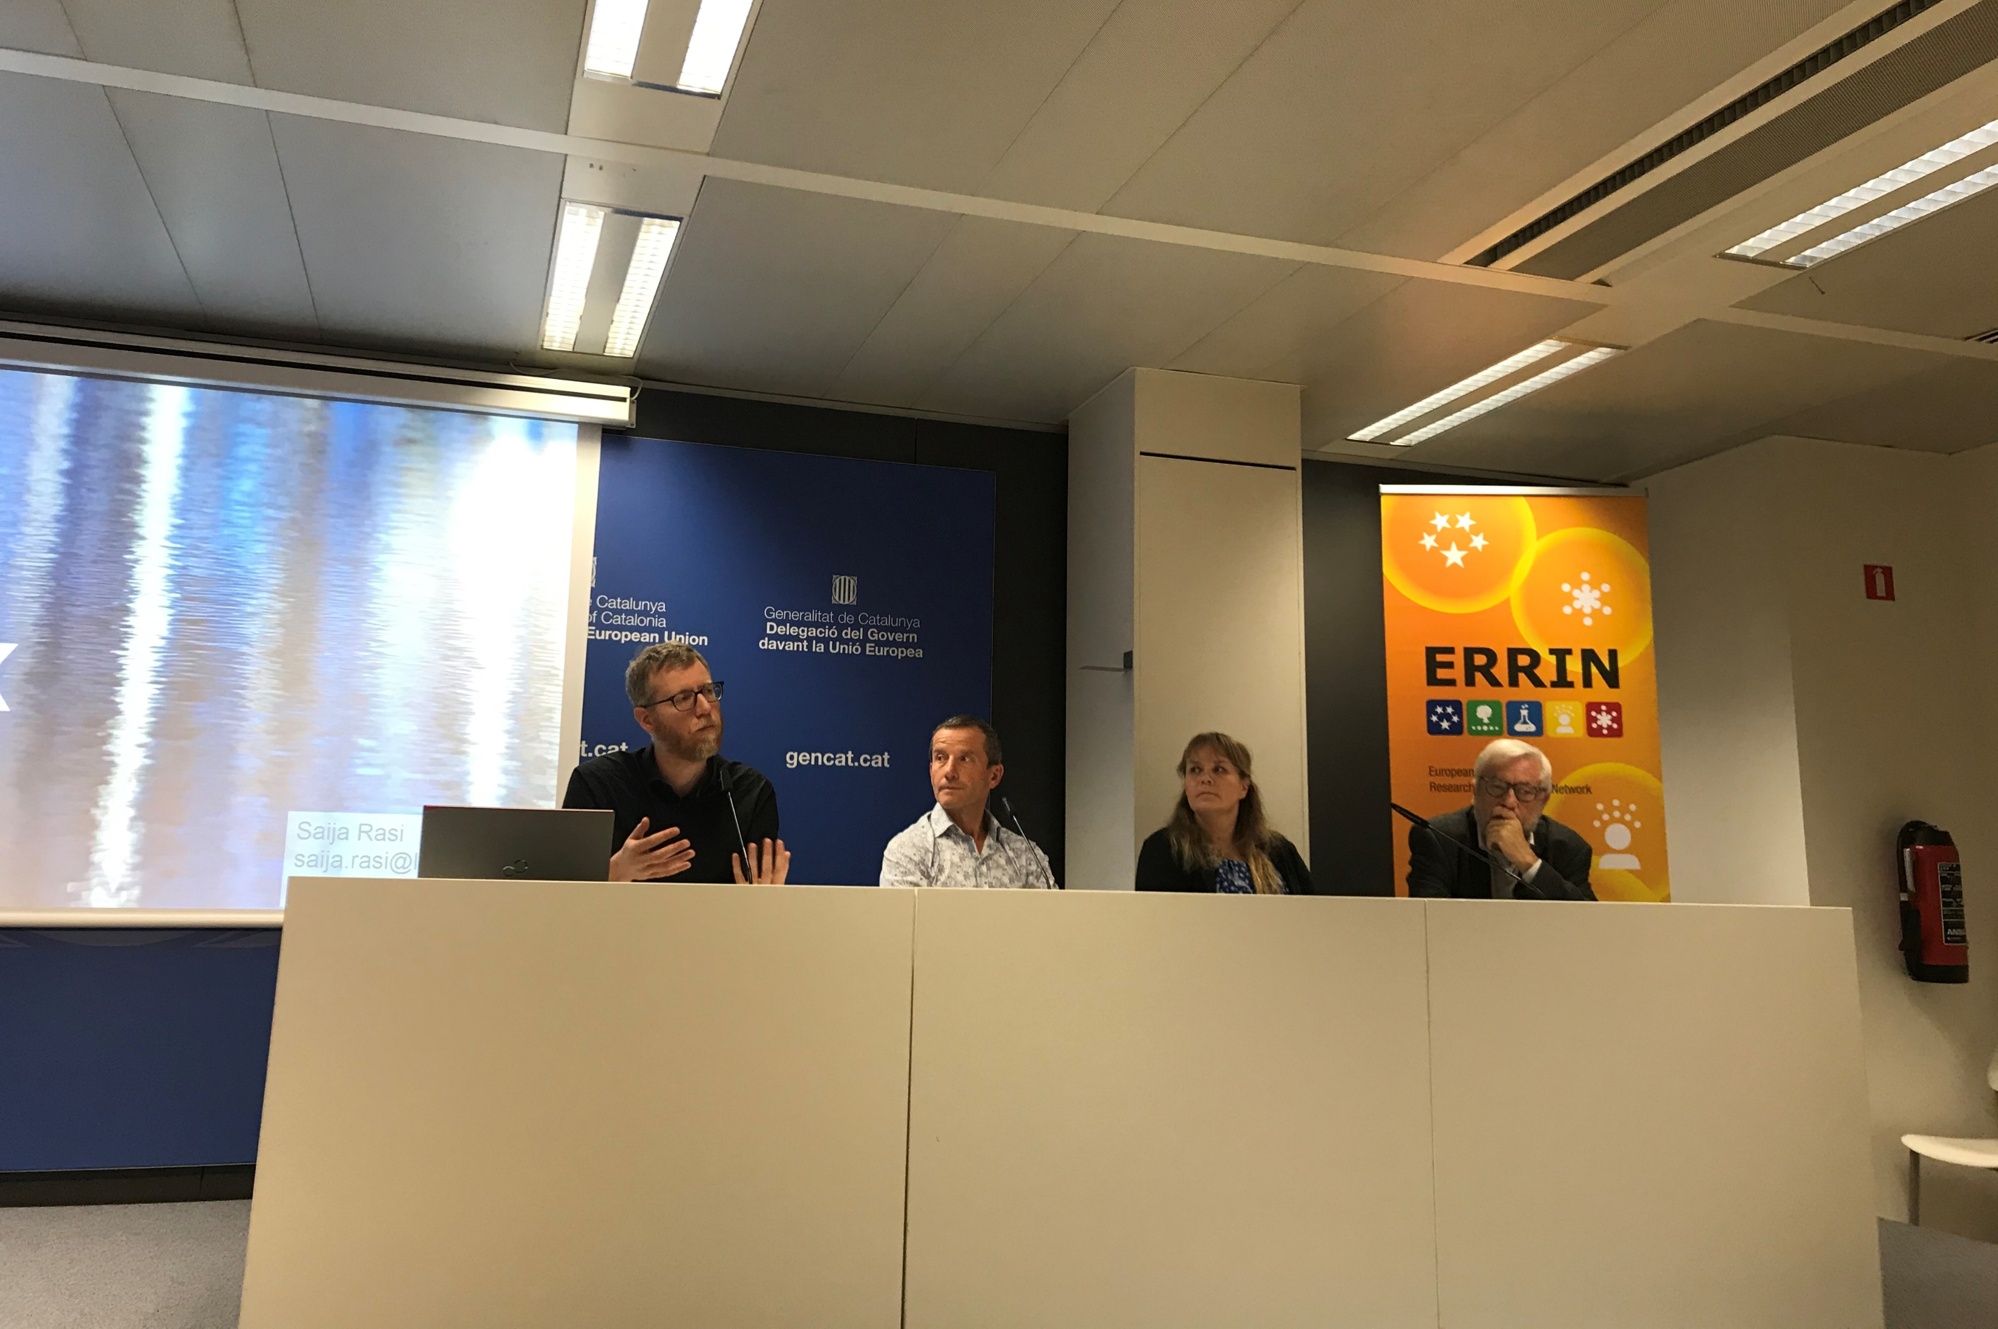
WORKING GROUP MEETINGS
Bioeconomy WG meetings
Information sessions with institutional representatives
February 2021: State of play of the Mission on Soil Health and Food
Sharing of best practices from member regions
November 2020: Regional strategies related to the circular bioeconomy
Topics for 2021
Mission on Soil Health and Food
Bio-based materials for buildings
Innovations for food waste
Green Digital Innovation Hubs

Slide 7
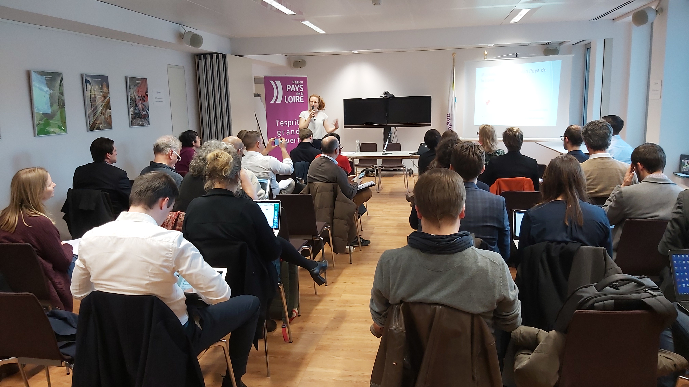
WORKING GROUP MEETINGS - Example
6th February 2020: “Future prospects of Algae cultivation: for a greener and more sustainable society”
Rich agenda, with interventions from DG MARE and the EABA
Best practices from Pays de la Loire, Saxony-Anhalt and Flanders
In brief: opportunity to network, state-of-play on the European vision, great inputs from regional actors and identification of interests among participants
Notes:
Physical event at the time, o joy ! ☺
Mostly meant for brussels representatives at the time, even if we had sometimes external speakers coming from abroad. One good thing with covid: the digital meetings became much more accessible to representatives and actors based in the whole of Europe. Something to continue for the future ?

Slide 8
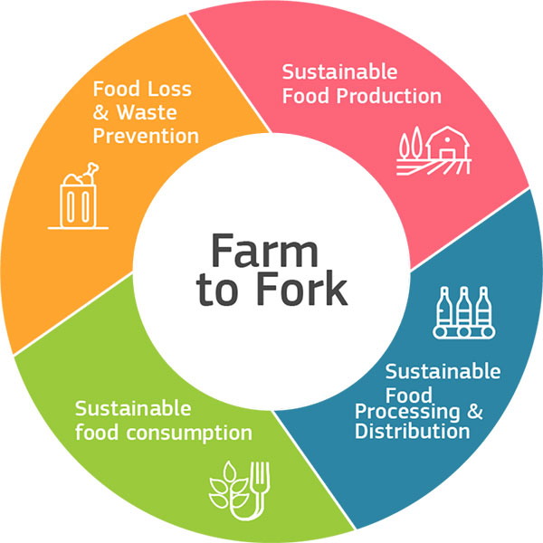
PROJECT DEVELOPMENT
BBI JU project development workshop – June 2020
5 project ideas
More than 30 participants
Farm to Fork project development workshop (Green Deal calls )– September 2020
12 project ideas
More than 60 participants
Upcoming: Project development around the Horizon Europe Cluster 5 & 6 calls
Notes:
More details on the Farm to fork project development: it was quite ambitious, and we got the full support from the ERRIN network, which was great. We focused on the sub-topic « F2F » of the Green Deal call and launched a call for interest to gather project ideas. 12 were received in total, and each got its own roundtable where they would be presented and where interested partners/regional actors could interact. The workshop was actually divided into two sessions: a morning one to present the European vision on F2F (policy and project wise), with some best practices coming from several regions (Mid-Norway, Lower Silesia and the University of Turku).

Slide 9
POLICY WORK
Position paper “A regional and local perspective on a future EU Algae Strategy”
Produced by a drafting group of six people with input from the wider ERRIN membership
Jointly led by the Bioeconomy and Blue Growth Working Groups
Basis for ERRIN’s response to the EU roadmap consultation “Blue bioeconomy – towards a strong and sustainable EU algae sector”
Under consideration: collaboration with the CofR for the “European Bioeconomy Policy Forum”

Slide 10
www.errin.eu
ERRIN
@ERRINNetwork

