Slide 1
The Biobased Transition in Groningen/Northern Netherlands
André Heeres, Hanze University of Applied Sciences, January 2020

Slide 2
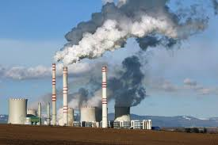
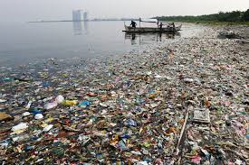
Drivers
Environmental aspects
Demographic trends
Growth world population
Increasing prosperity (middle class)
Economic opportunities!

Slide 3
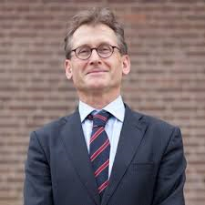
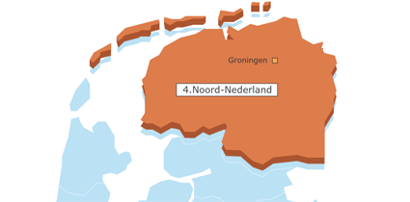
“Agro/Energy meets Chemistry”
Chemical cluster
Eemsdelta
Chemical cluster
Emmen

Slide 4
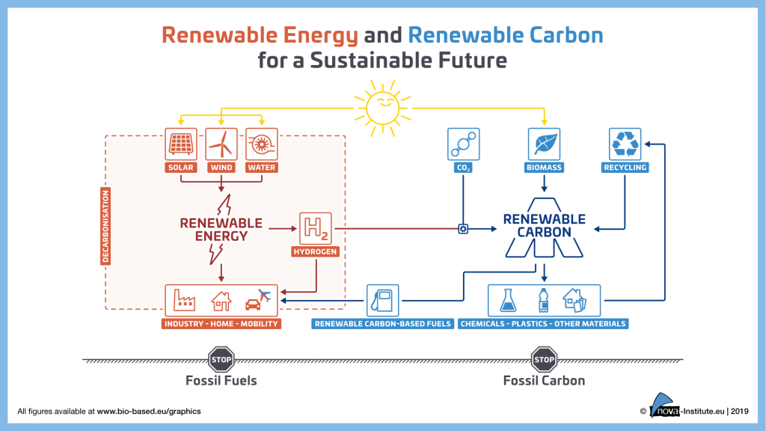
The ambition…..

Slide 5
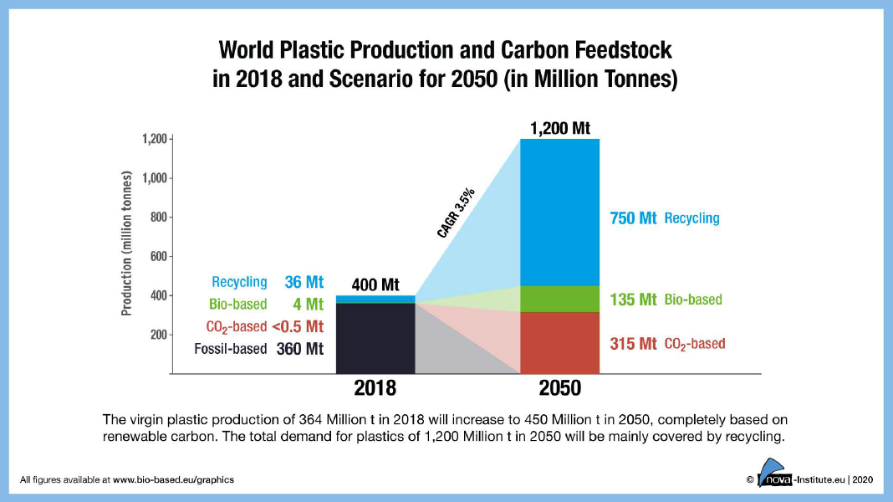
Future scenario

Slide 6
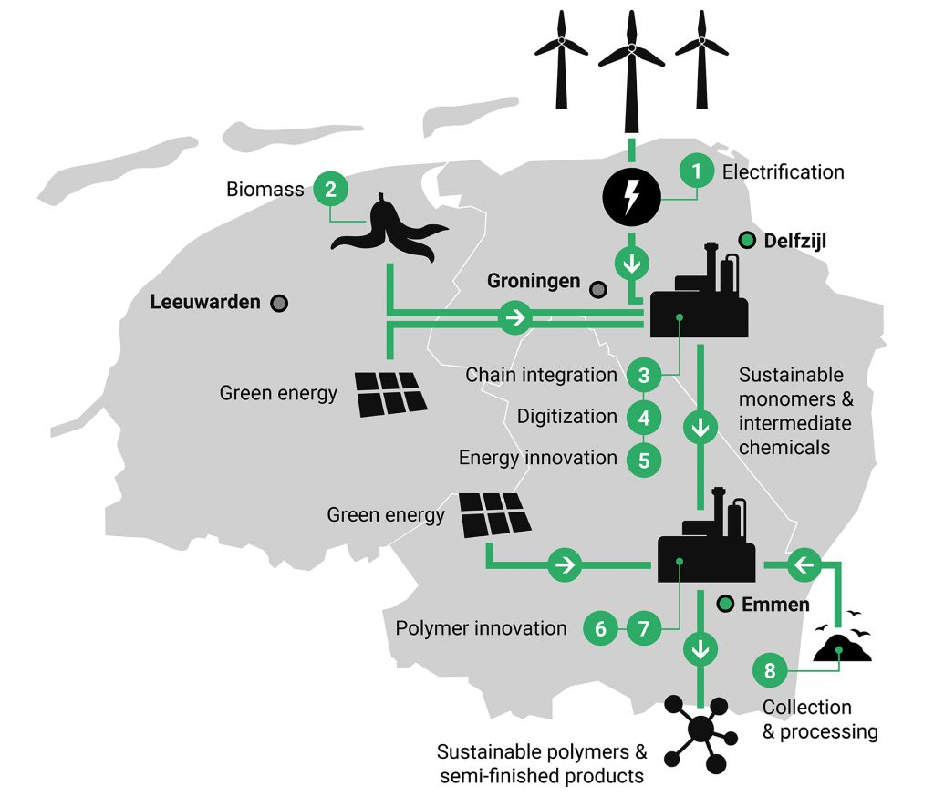
Requirements “agro/energy-chemistry coupling”
Renewable energy
Hydrogen
Biomass (agriculture) (CO2)
Agricultural processing
Biorefinery
Expertise in chemistry
Chemical clusters/companies
Human Capital
Subsidies, investment funding
and ........
Collaboration between all partners!

Slide 7
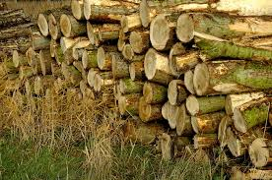
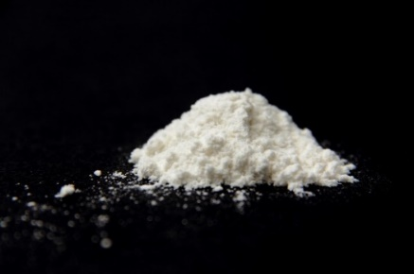
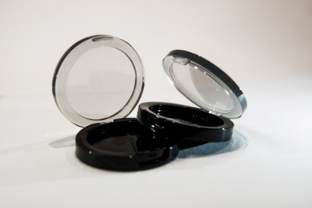
Downstream towards BioPET100

Slide 8
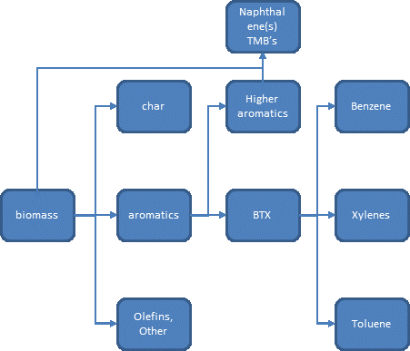
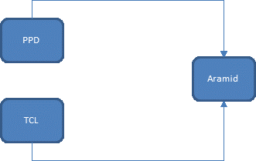
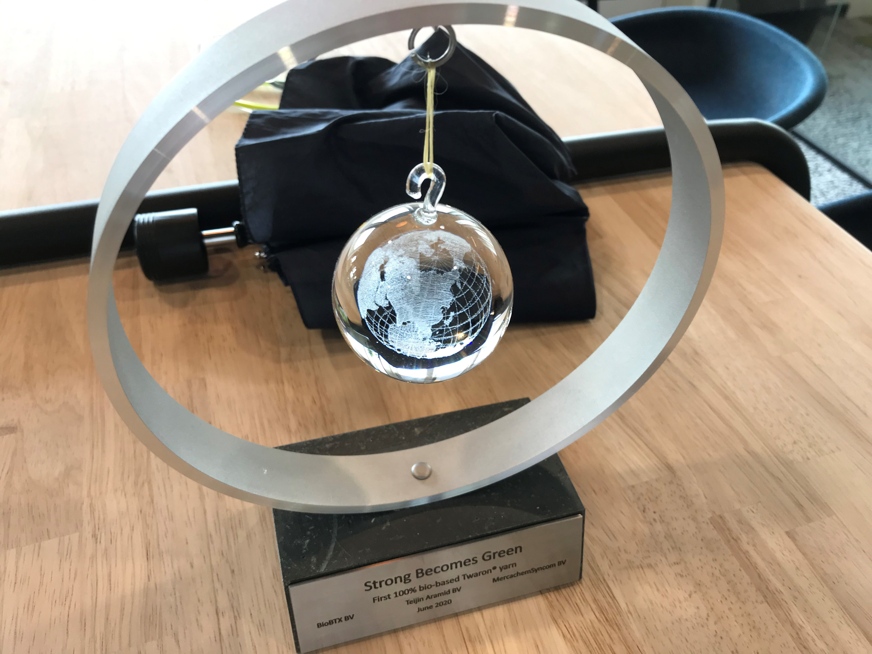
…..and bioaramids (Twaron)

Slide 9
Biobased PEF

Slide 10
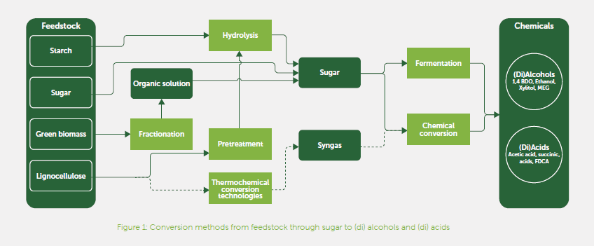
The Chemport saccharide agenda
Webinar Chemport saccharide agenda: January 28th, 9.30 - 11.00

Slide 11
Conclusions
“Greenification” of the chemical industry is essential to reach the climate goals set.
The Northern Netherlands (Groningen) is perfectly equipped to be a frontrunner in the biobased/circular transition.
Excellent Public-Private-Partnerships increase the chances of succes!

