Slide 1
Have your process scaled up at BPF, a reliable and experienced pilot scale partner.
Shared Pilot Facilities & Lessons learned about Interregional cooperation
ECRN workshop
21 JAN 2021
Raimo van der Linden

Slide 2
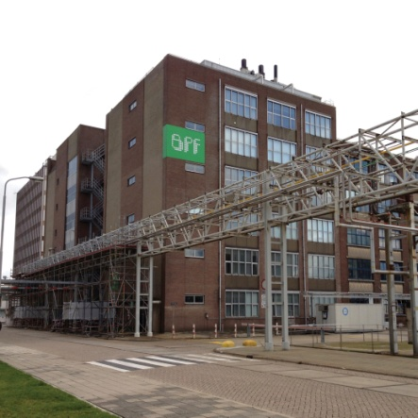
Bioprocess Pilot Facility (BPF)
A Shared Pilot Facility
Located in Delft, Netherlands (close to Rotterdam / The Hague)
Accessible to everyone
Able to perform almost any biobased process at pilot scale
Non-profit
IP remains with the client (i.e. not a knowledge institute)
Equipment (>200 pieces) already operational
Experienced operators and engineers (35 FTE total BPF)

Slide 3
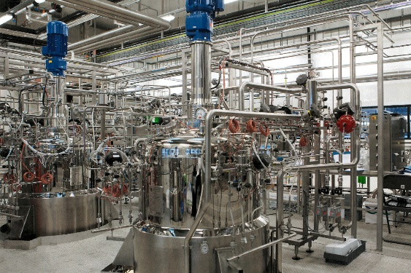
Piloting
When and why to use a pilot?
Pilot: De-risk your scale up
Scale up of lab
High-risk changes to commercial process
Every pilot run is a consideration:
Costs of the pilot
vs.
Risks if you don’t

Slide 4

SMART Pilots (Interreg Europe project)
SMART Pilots recommendations for policy makers
Invest wisely and focus on maintaining and further developing existing facilities to keep their state-of-the art equipment up-to-date.
Create mechanisms to encourage usage of already existing shared pilot facilities, even if these are located outside their own region.
Increase coordination and collaboration between pilot facilities, improve users’ awareness of the available facilities and avoid overlapping investments in Europe.
Encourage companies to work together with SPFs from an early stage on, for example by offering small and medium-sized companies vouchers for such collaborations.
Project website:
https://www.interregeurope.eu/smartpilots/
Youtube, 3 minutes:
https://www.youtube.com/watch?v=PMR6HG_MEi8

Slide 5
European bottlenecks in piloting
The Big Picture
The smaller the company, the bigger the challenge
Large Multinational:
  Piloting costs very small compared to investment of commercial process
  Good investment to de-risk
Small start-up:
  Costs are very significant compared to annual turnover of start-up
  Piloting is unaffordable without subsidies

Slide 6
Subsidies
Allow subcontracting via vouchers
Plenty subsidies (e.g. H2020, Interreg, etc.) at TRL 4-8…
  But subcontracting often discouraged
  Subsidies not designed for financial break-even
  Participation as partner is financially not interesting (if you want no IP)
How can a start-up get access to a Shared Pilot Facility?
Answer: subsidies where subcontracting is allowed
  E.g. voucher schemes

Slide 7

Vouchers
Budget still available
Simple application
  Simple forms + signed quotation from BPF
First-come-first-serve system
Three vouchers:
  15 k€ voucher at 0% co-funding for pre-pilot (lab) work
  50 k€ voucher at 50% co-funding for the pilot work
  15 k€ voucher at 50% co-funding for use of BPF or Planet B.io lab/office space (Delft)
Open to any SME from the EU-27 (!)
Link (scroll down for English): https://www.kansenvoorwest2.nl/nl/subsidie/openstelling-vouchers-biobased-industries/

Slide 8
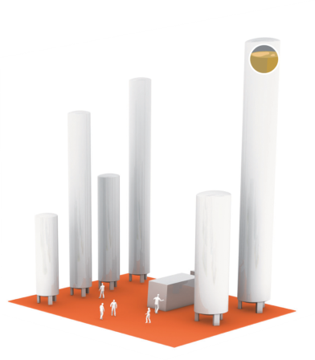
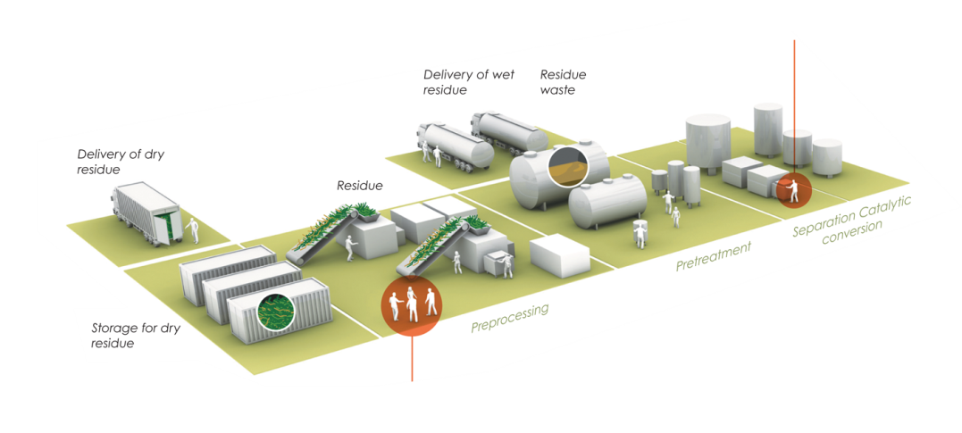
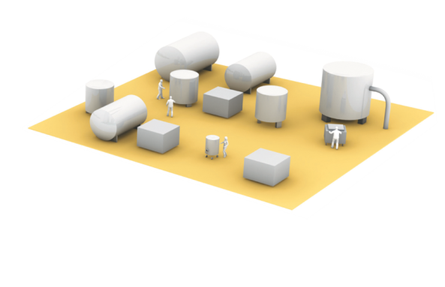
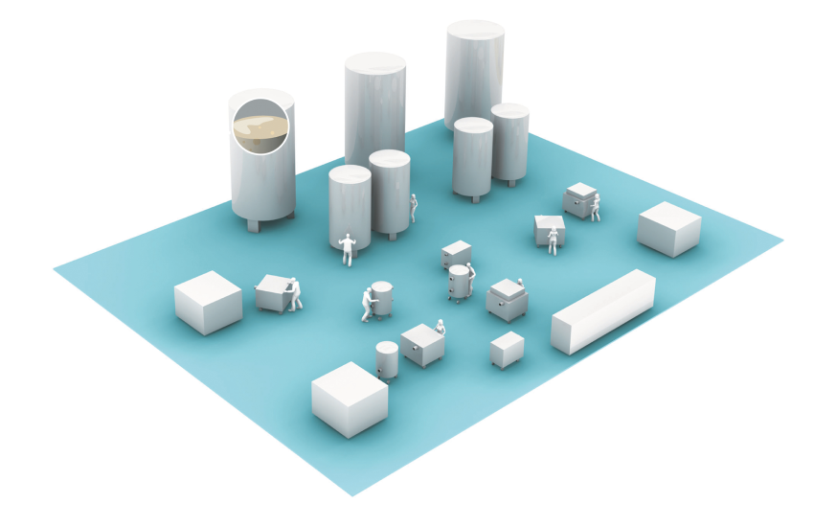
BPF facilities
An entire value chain at pilot scale
Pretreatment
Fermentation
Bench Scale Pretreatment
Pilot Scale Pretreatment
Hydrolysis
Stirred 10 L - 4 m³
Separations
Experienced Crew
Training
Downstream Processing
Food grade
Dryers, Solid-Liquid Separations
Extractions, Membranes, Chemical reactors, etc.
Fermentation
Downstream Processing
FSSC 22000

Slide 9
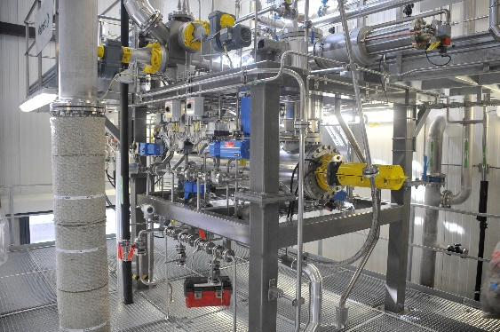
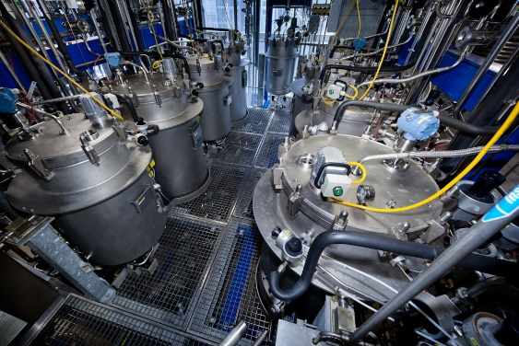
BPF equipment
Extensive and flexible
Continuous pre-treatment equipment
  Steam explosion & mild acid/alkaline pretreatment
  40 kg/h
Fermentation capacity up to 4,000 liter
Extensive downstream processing (DSP) equipment
Food-grade (certified) fermentation & DSP
Continuous Steam Explosion reactor
Feed vessels of fermentation department

Slide 10








Eco-system at Biotech Campus Delft
Over 10 companies, and growing
The vibrant, south-west part of the Netherlands with plenty of talent and economic activity
Educational programs and network from Delft University of Technology and Yes!Delft incubator
A vibrant ecosystem with common workspaces, restaurant, gym and events to facilitate collaboration
High-end competences in genetics, analysis, process development and food application
3000 m² office and lab space (ML1/ML2) for rent
on site (also at BPF)
>9 hectares greenfield location for new buildings
or production facilities

Slide 11

BPF is a truly multi-purpose pilot facility
Raimo van der Linden
Raimo.linden-van-der@bpf.eu
M: +31 6 42 48 07 54
www.bpf.eu

