Slide 1
Trilateral Hydrogen Action Plan Marc van Doorn Program Manager

Slide 2
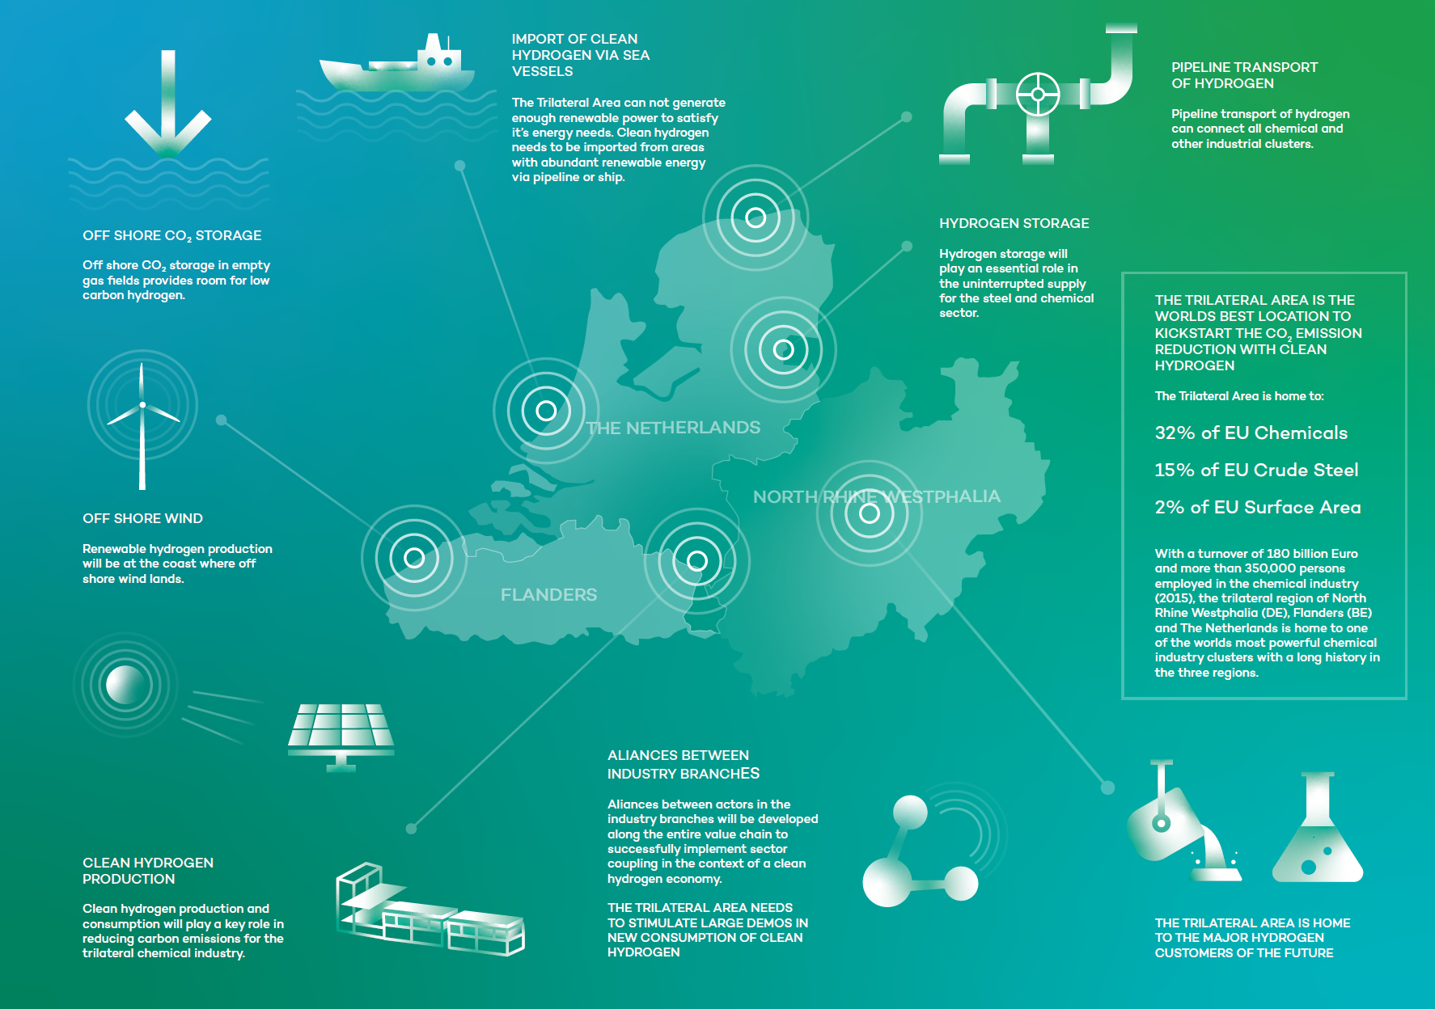

Slide 3
Build cross border alliances over the whole supply chain, starting from : -> Hydrogen use as a feedstock -> Import, Transport and Storage -> Hydrogen production -> Renewable Energy production Close the funding gap

