Slide 1
Fuel of the Future: The Role of Hydrogen for a carbon free Europe
Dr. Jürgen Ude
State Secretary
Ministry of Economy, Science and Digitalisation Saxony-Anhalt

Slide 2
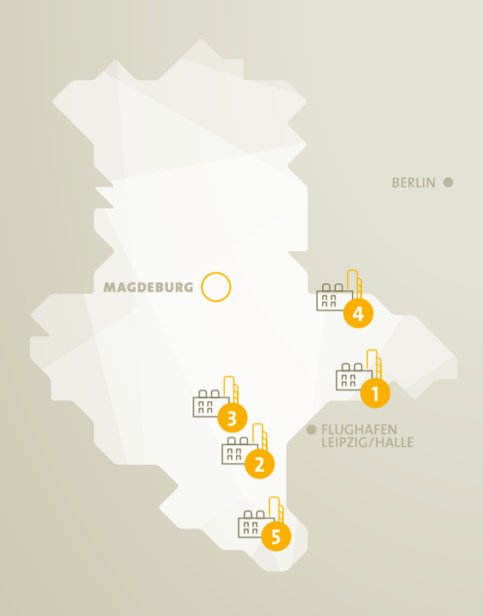
Chemical Parks in Saxony-Anhalt
CHEMIEPARK BITTERFELD-WOLFEN
Founded: 1893 | Size: 1.200 hectare | Companies: 350
CHEMIESTANDORT LEUNA
Founded: 1916 | Size: 1.300 hectare | Companies: 100
DOW VALUE PARK SCHKOPAU/ BÖHLEN
Founded: 1998 | Size: 150 hectare | Companies: 20
AGRO-CHEMIE PARK PIESTERITZ
Founded: 2005 | Size: 220 hectare | Companies: 30
CHEMIE- UND INDUSTRIEPARK ZEITZ
Founded: 1936 | Size: 230 hectare | Companies: 50
1
1
2
3
4
5
Source: Investment and Marketing Corporation Saxony-Anhalt

Slide 3
Hydrogen potentials in Saxony-Anhalt
Wind and PV potential for green electricity
Electrolysis test platform
Industry with high H₂ demand
Know-how in H₂ plant technology
Second longest H₂ pipeline in Germany
Salt Caravans for large-scale storage
Universities and research institutions
Hydrogen Network HYPOS
Source: Fraunhofer Institute for Microstructure of Materials and Systems IMWS

Slide 4
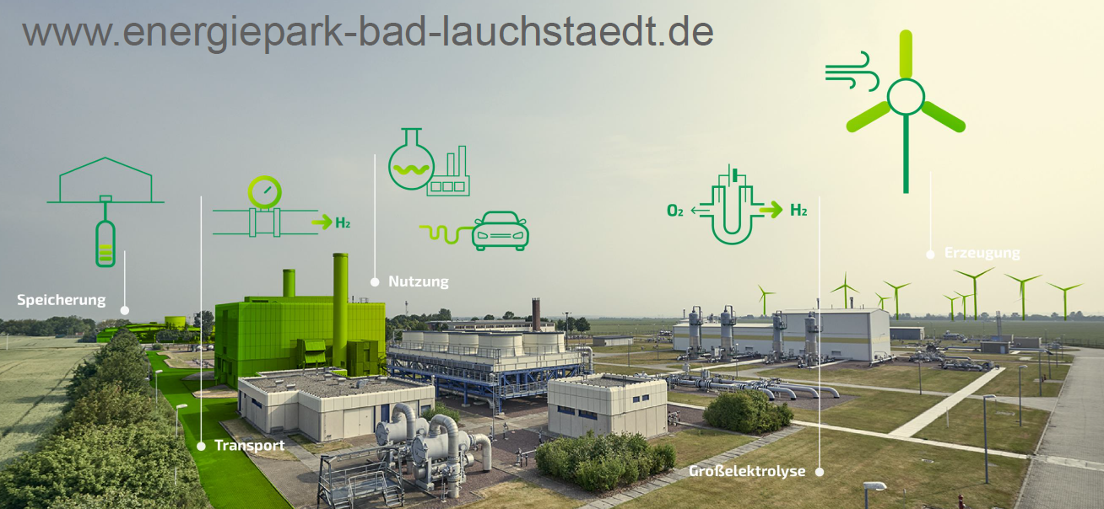
Projects: Hydrogen Real Laboratories
Energy Park Bad Lauchstädt
Source: Fraunhofer Institute for Microstructure of Materials and Systems IMWS
GreenHydroChem Leuna
Source: VNG Gasspeicher

Slide 5
Thank you for your attention!

