Slide 1
European Chemicals Network Conference
26 October 2020
Jürgen TIEDJE, Head of Unit “Sustainable Industrial Systems”
DG Research & Innovation
European Commission

Slide 2
My key words
Relevance of Horizon Europe to the debate today
European partnerships in Horizon Europe – the potential candidate
Processes4Planet
The idea of circularity hubs
The role of regions

Slide 3
Digital, Industry & Space
Civil Security for Society
Health
Food, Bioeconomy, Natural Resources, Agriculture & Environment
Culture, Creativity and Inclusive Societies
Climate, Energy and Mobility
Notes:
The second pillar focuses on Global Challenges and European Industrial Competiveness (named Global Challenges and Industrial Competiveness in the Commission Proposal). With a proposed budget of € 52.7 billion, it's designed to fund research and innovation tackling societal challenges and reinforce technological and industrial capacities.
This pillar contains six clusters that address the full spectrum of global challenges, as seen on the slide. The integration in clusters is designed to incentivise a systemic approach with cross-disciplinary, cross-sectoral, cross-policy and international collaboration, thereby achieving higher impact and better seizing the innovation potential that is often greatest at the intersection of disciplines and sectors.
Particularly relevant for CO2 utilisation activities are the clusters: ‘Digital, Industry and Space’ and ‘Climate, Energy and Mobility’.

Slide 4
What do we discuss now with industry under Horizon Europe? An example
Processes4Planet KPIs
CLIMATE KPIs
100% of total CO2eq emission reduction potential by integration of renewable energy & energy efficiency demonstrated through R&I projects at TRL7
100% of total CO2eq emission reduction potential through CO2 Capture and Use demonstrated through R&I projects at TRL7
Increasing EU’s Climate ambition for 2030 & 2050
A zero pollution ambition for a toxic-free environment
Supplying clean, affordable & secure energy
Preserving and restoring ecosystems and biodiversity
CIRCULARITY KPIs
100% (TBD) of waste reduction potential demonstrated through R&I projects at TRL7
90% (TBD) secondary materials re-use potential demonstrated through R&I projects at TRL7
90% (TBD) of wastewater re-use/recycling potential demonstrated through R&I projects at TRL7
15+ H4Cs launched into the process of development
Mobilising industry for a clean and circular economy
From farm to fork: healthy, environmental food system
Building & renovating in an energy and resource efficient way
Accelerating the shift to sustainable and smart mobility
COMPETITIVENESS & CROSS-CUTTING KPIs
Launch 15+ marbles integrating solutions developed through Processes4Planet portfolio towards the 100% target+
Leverage factor 5 to 10
60 significant innovations TRL 7-8
CAPEX & OPEX reduction through the innovations
Impact on SMEs through projects & H4Cs
20 new types of skills and jobs (10 integrated into academia and company programmes)
Financing the transition
Leave no one behind
(Just Transition)

Slide 5
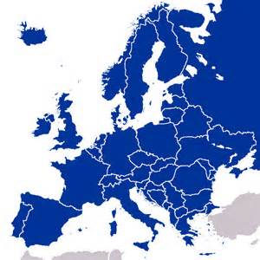
business to territory
Hubs for circularity (H4C)
knowledge platform
- data
- best practices
value loops
decarbonised energy sources
First of a kind, lighthouse demonstrator plants of commercial size
carbon neutrality
waste as a resource
zero-waste-to-landfill
breakthrough technology and processes
social innovation
global competitiveness
new business models
SMEs
process industry
public waste associations
Global challenges
civil society
RTOs
private waste management
local authorities
energy industry
regional authorities
local proximity
manufacturing industry

Slide 6
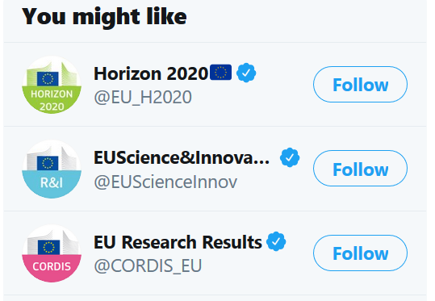
Want to know more?
Industrial Research and innovation website
Success stories
Horizon magazine articles
Key Enabling technology projects on YouTube
Horizon Results Platform
Jurgen.tiedje@ec.europa.eu

Slide 7
Thank you for your attention!
Jürgen Tiedje

