Slide 1
CuRe Technology
Regulatory challenges in creating a closed loop for polyester
European Chemical Regions Network Conference
Building the Sustainable Chemical Industry of Tomorrow
Regional Response to Common European Challenges
Josse Kunst
Chief Commercial Officer
October 23, 2020

Slide 2
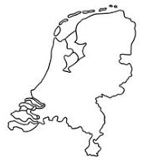
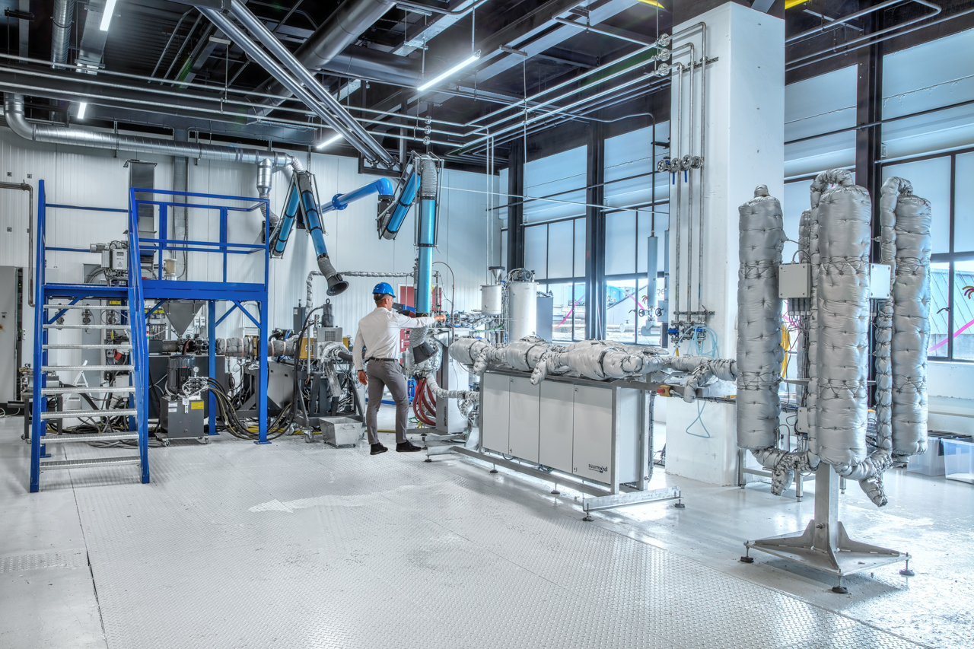
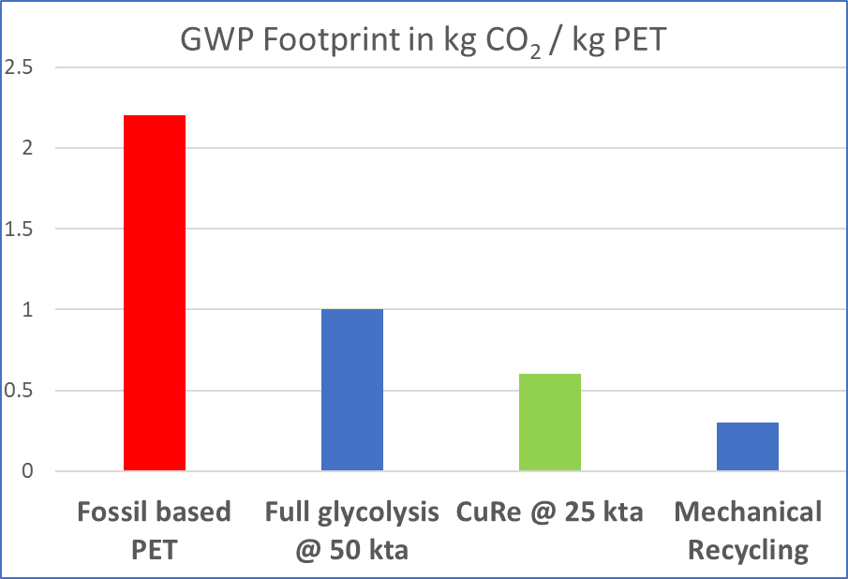
CuRe Technology is the least energy consuming route to close the loop on polyester

Slide 3
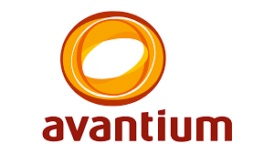
Northern Netherlands is Europe’s Polyester Valley
Delfzijl
Know-how
Groningen
Leeuwarden
Mechanical Recycling
Meppen
Chemical Recycling
Heerenveen
Emmen
Zwolle
Design for recycling
Chemical Production

Slide 4
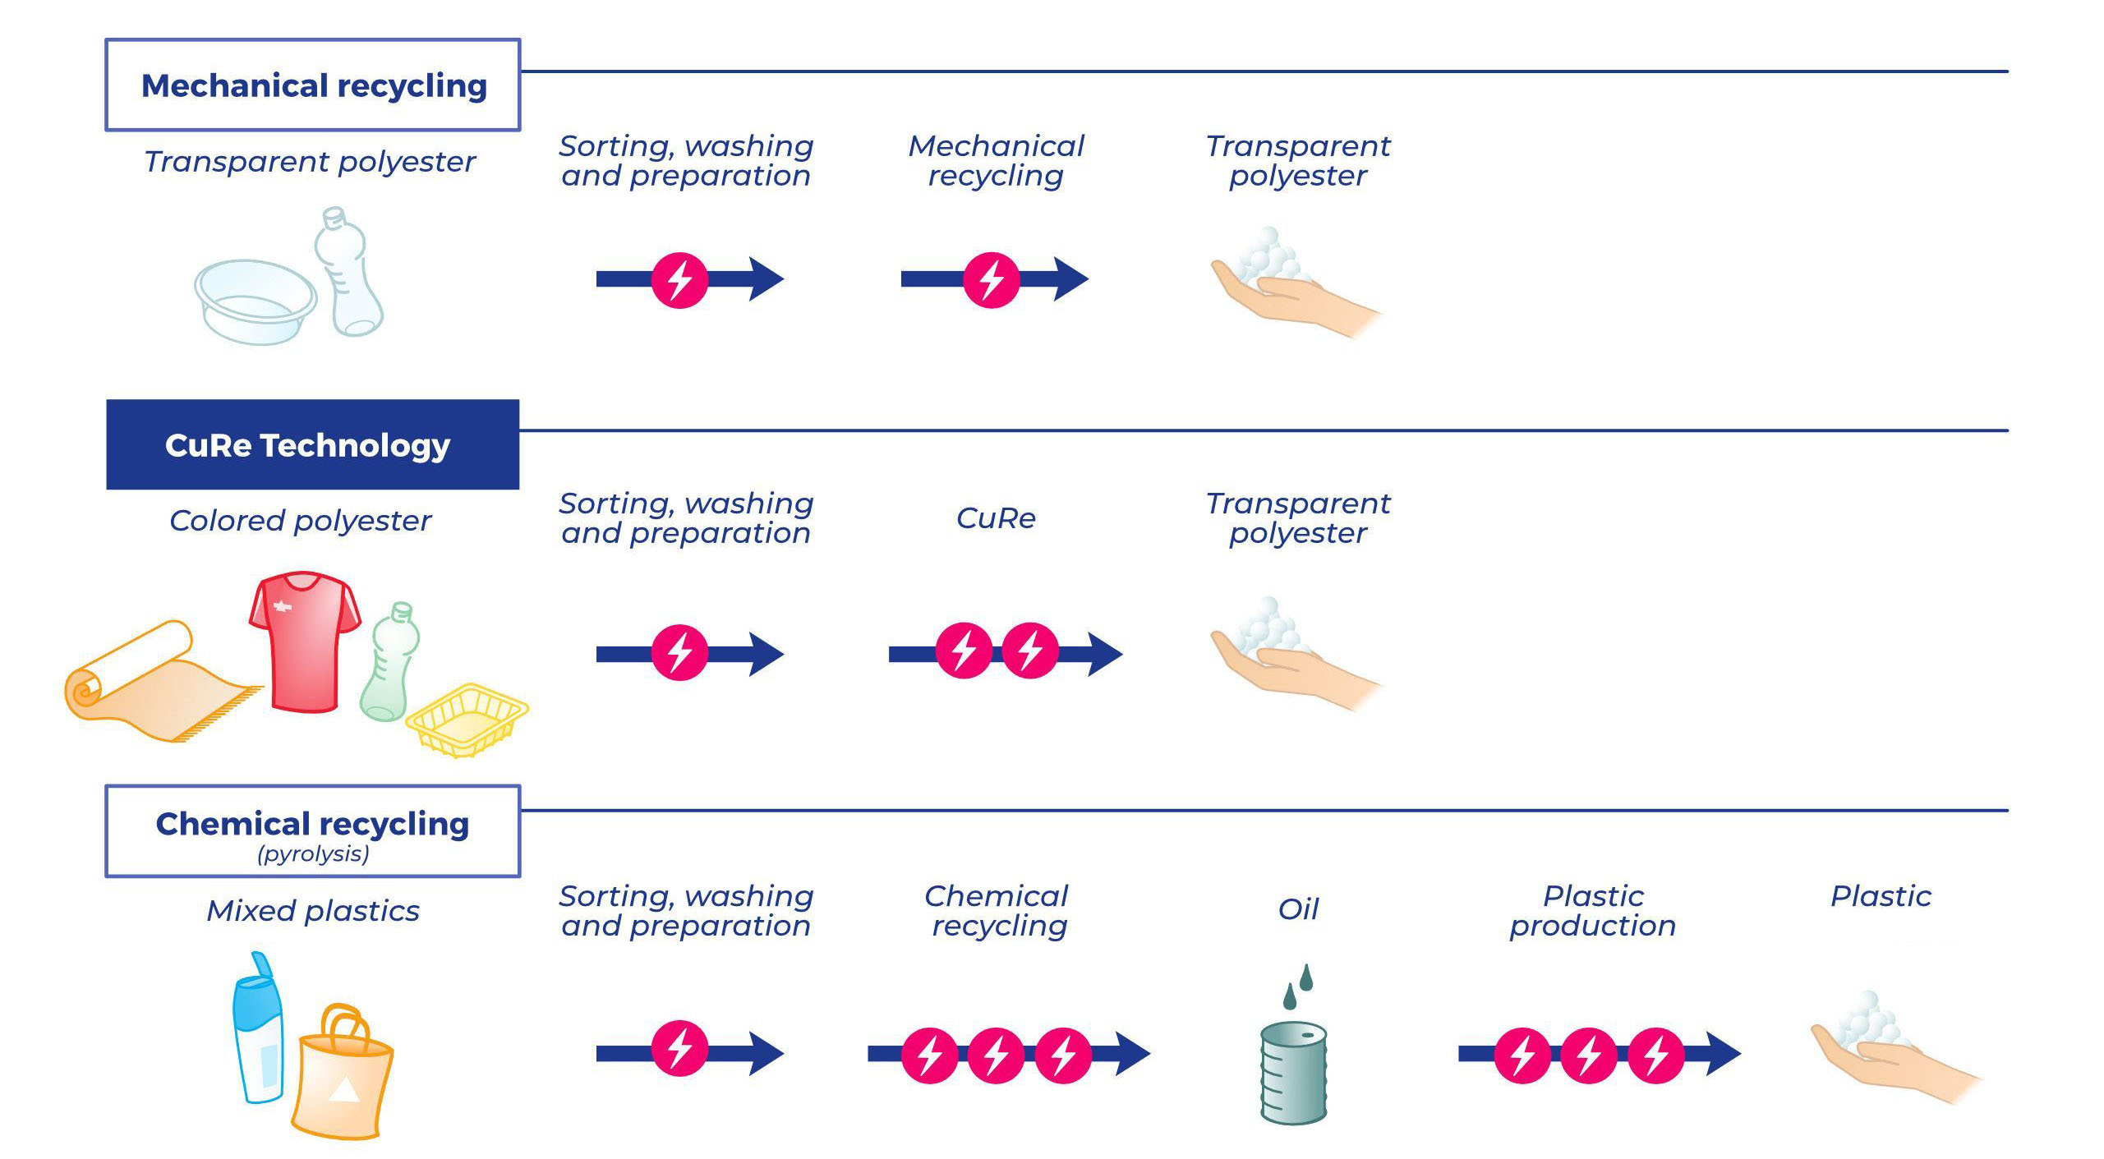
Ambitious EU climate and recycling targets cannot be met with current regulatory unclarity wrt food contact approval
Existing regulations
95 % food grade waste as input
Strict testing of rPET quality
Chemical recycling excluded
Chemical recycling from waste to rPET not covered by mechanical recycling legislation nor by ‘back to monomer’ recycling
Regulations under discussion
Focus on back to monomer technologies

Slide 5
CuRe Technology position to meet EU ambition level
I. Food Contact Approval
Safety for food contact in packaging for consumers is leading.
Stimulate development of new recycling technologies that are safe and competitive.
Approvals on the basis of proven end quality and safety of the recycled plastics using well-defined tests and procedures.
Proposed are challenge tests, NIAS testing, working as per GMP practices and guaranteed traceability in combination with carefully selected raw materials.
II. Meet Climate Targets & Recycling Rates
EU directives on use of recycled content in packaging bog success to drive the industry to new technologies, capacity expansion and economic recycling infrastructure.
But…. Packaging is only 1/3 of all polyester used, 2/3 is textile and/or carpet.
Accelerate waste collection and sorting by extending the EU directives on recycled content for non packaging applications.
Combine with obligatory transparency on ingredients (material passports) to make recycling possible

Slide 6
n
We are grateful for the funding from:

