Slide 1
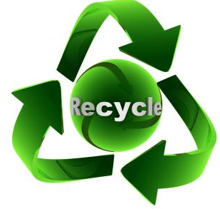
INNOVATIVE SOLUTIONS TO HALT PLASTIC WASTE chemical recycling and modern recycling
Tomasz KLEPKA, PhD, DSc (Eng) Associate profesor
Head of Departament: Technology and Polymer Processing
Faculty of Mechanical Engineering
Lublin University of Technology

Slide 2
Contents
Introduction, West Pomeranian Chemical Cluster „Green Chemistry”
The lifecycle of polymers.
Plastic chemical recycling (advantages and disadvantages)?
Conclusion about chemical recycling.
Other ways of recycling plastics.

Slide 3
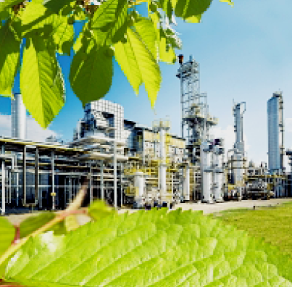
The Association West Pomeranian Chemical Cluster
„Green Chemistry”
.

Slide 4
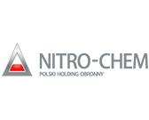
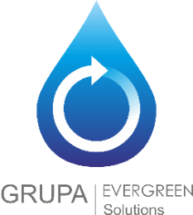
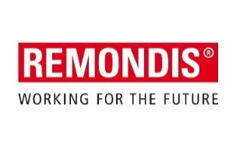
„Green Chemistry” Cluster Poland
Established in 2007
167 Members
32 large enterprises
106 sMEs
Scientific institutions
Local government units
Business support institutions

Slide 5
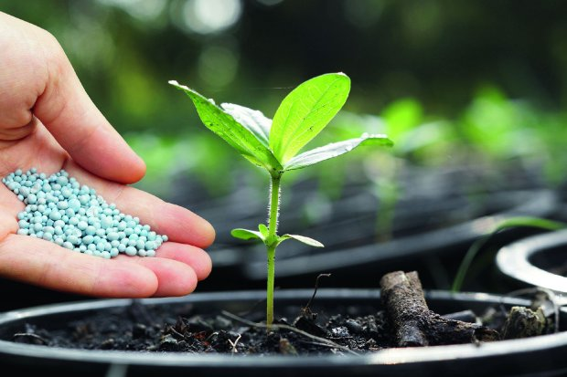
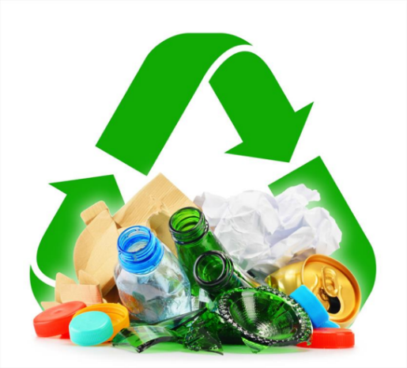
Potential:
Biotechnology
Packaging
Energy and material recovery
Projects (International -14, National – 24)
Foto. Źródło:
http://info.e-ogrody.pl
http://polkarton.com
https://www.pkt.pl

Slide 6
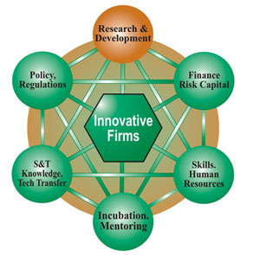
Development needs of the Cluster
Obtaining funding for the Cluster activities related to: bilateral meetings, economic missions, exchanges of experience between science and industry, participation in international conferences and symposia for enterpreneurs or industry fairs
Consistent provisions of law for associations working on the rules and standards of business activity (exclusion of the participation of associations in some tender procedures as e.g. micro-entrepreneurs - no clear provisions on NGOs)
Raising the competences of the Cluster employees and animators (various types of training)
Foto. Źródło: http://apitco.org/development_industry_clusters.html

Slide 7
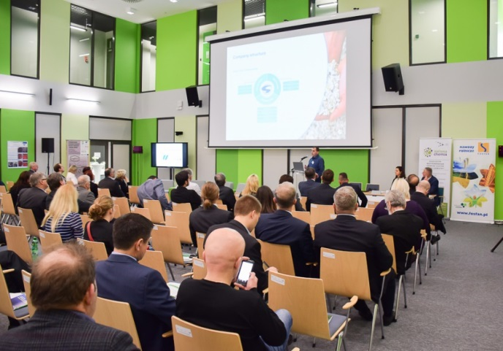
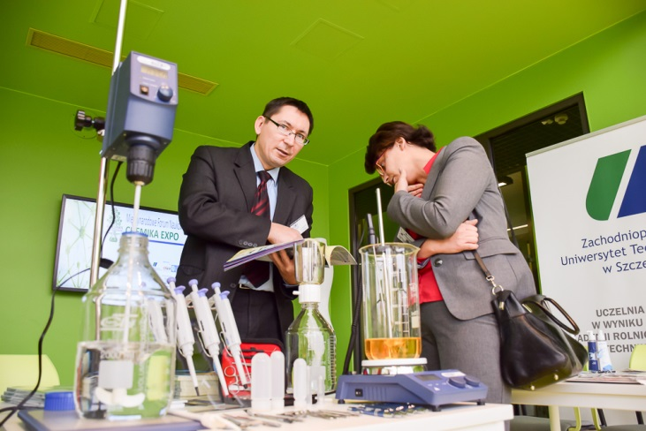
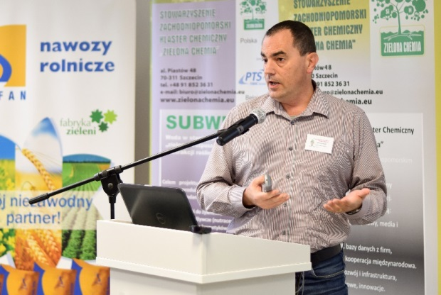
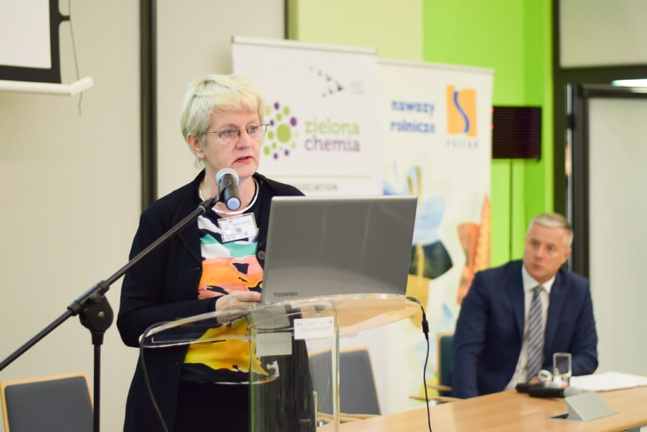
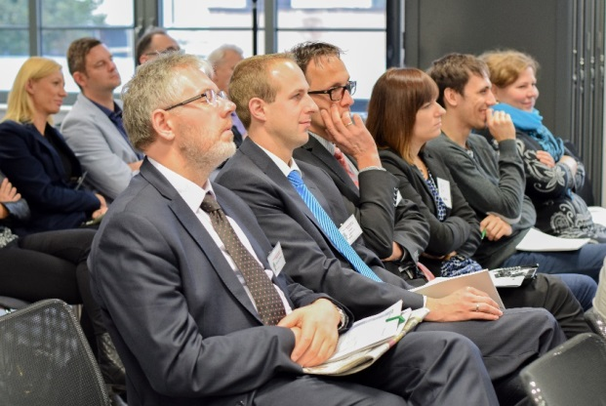
International Scientific and Economic Forums
Cluster product recognizable on the national and international arena – 10+ editions
Conference, Workshops, Cooperation Exchange and mini-fair

Slide 8
Plastic chemical recycling
The number of technologies comprised in what is commonly referred to as chemical recycling can
be divided into three different categories depending on the level of decomposition that the plastic
waste will be subject to (see figure 1):
Solvent-based purification, which decomposes plastics back to the polymer stage.
Chemical depolymerization, which turns the plastics back into their monomers via a Chemical reaction.
Thermal depolymerization (pyrolysis and gasification) which in some cases can be
considered as chemical recycling by cracking the polymers back into monomers and further
down into hydrocarbons. Thermal depolymerization technology can also produce fuels
although in that case it can no longer be considered a form of recycling.

Slide 9
The lifecycle of polymers
Fig. 1. Lifecycle of polymer materials. Depending on the chosen route, polymers will end up in recycling, energy recovery or landfill. Icons adapted from (PlasticsEurope et al., 2015).

Slide 10
Fig. 1. Diagram of different chemical recycling processes
Source: Zero Waste Europe: www.zerowasteeurope.eu

Slide 12
Advantages of chemical recycling
Currently approximately 50 percent of plastic packaging waste from households and businesses is recycled mechanically. Current techniques and installations are not capable of recycling all types of plastic packaging. Chemical recycling can help prevent plastic waste from ending up in incinerators or landfills when it is not suitable for mechanical recycling. Examples of advantages of chemical recycling over mechanical recycling are:
Additives, fragrances and dyes can be separated from the packaging material.
Combined materials and plastics in one packaging can be separated from each other.
It offers more possibilities for the application of recyclate in packaging in the food sector.

Slide 13
Disadvantages of chemical recycling
Chemical recycling installations are a very expensive investment. Barriers and specific regulations on the protection of the natural environment do not encourage municipalities and industrial regions to opt for this type of recycling.
For example, recycling only takes place when the output product is reused as a raw material in the manufacturing industry and not when the product from chemical processing is used as energy or fuel.

Slide 14
Disadvantages of chemical recycling
Another disadvantage is that the waste flows required for chemical recycling must be cleaner than previously thought. Especially the techniques with a high CO2 reduction also place higher demands on the quality of the waste. Many new chemical recycling initiatives work perfectly on a laboratory scale with clean materials as input. However, practical tests with contaminated and difficult to mechanically recycle waste streams aren’t always successful. And the desirable cleaner input streams already effortlessly manage to find their sales channel elsewhere.
Furthermore, chemical recycling is often cost-intensive due to the pre-treatment, the amount of energy required and the chemicals / catalysts needed.

Slide 15
Conclusion about chemical recycling
Chemical recycling can help reduce the proportion of plastic waste which ends up in landfill or incineration. With chemical recycling, fossil resources for chemical production can be replaced with recycled material from plastic waste. Plastic waste is transformed into secondary raw materials, such as pyrolysis oil or monomers, The recycled raw materials can be used in the production of new plastics.
Chemical recycling complements the current approach to recycling and has the potential to change the environmental situation by processing polymer waste that is currently difficult to recycle. Investments in the development of chemical recycling technologies and infrastructure are expected to create new jobs and protect the environment by reducing CO2 emissions and increasing the EU's overall recycling capacity.

Slide 16
Other ways of recycling plastics - case study
Currently, mechanical recycling plays an indisputable role in the recovery of polymeric materials from waste. The quality of polymer regranulate obtained as a result of mechanical recycling is closely related to the precision of the segregation of plastic waste. Its effectiveness varies drastically in different countries, which is related to the applicable laws and regulations.
In Poland, the percentage of recycled plastics increases every year, but the situation is not as good as in the case of other countries. PET bottles can only be returned in a few shops, and additionally, you must show the proof of purchase. The inconvenience of the procedure and the lack of direct benefits translate into low social motivation, and the current regulations are limited only to the separation of plastic from other materials, which is ultimately thrown into one bag together with metal articles.

Slide 17
Thank you for your attention
t.klepka@pollub.pl

