Slide 1
26 October 2020
“Building the Sustainable Chemical Industry of Tomorrow: Regional Response to common European Challenges”
Jorgo Chatzimarkakis, Secretary General

Slide 2
HISTORICAL QUESTION

Slide 3
HISTORICAL SITUATION DUE TO COVID-19
Source: IEA April 2020

Slide 4
HISTORICAL APPROACH?
Green Hydrogen for a European Green Deal
A 2x40 GW Initiative
Prof. Dr. Ad van Wijk
Jorgo Chatzimarkakis

Slide 5
HISTORICAL DAY: 3 IMPORTANT EU INITIATIVES
8th JULY
ENERGY SYSTEM INTEGRATION
EU CLEAN HYDROGEN ALLIANCE
EU HYDROGEN STRATEGY

Slide 6
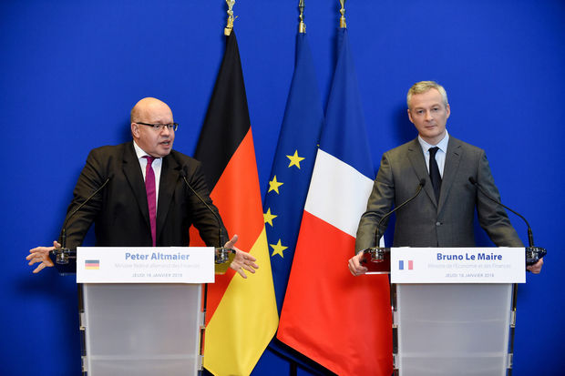
HISTORICAL MOMENTUM
16 Billion € only by the Franco-German Couple!

Slide 7
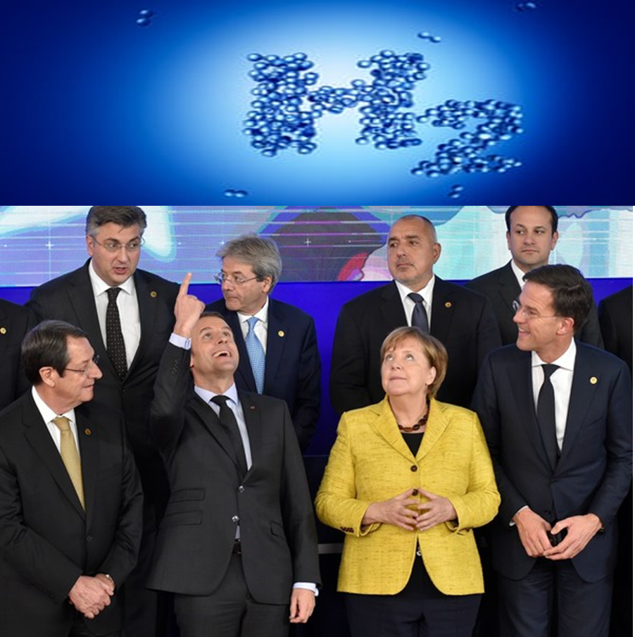
HISTORICAL POSITION FOR H2 IN EU POLITICS

Slide 8
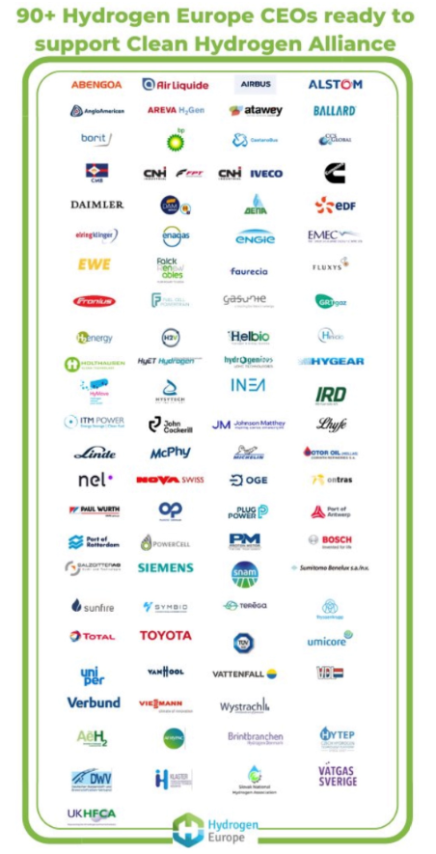
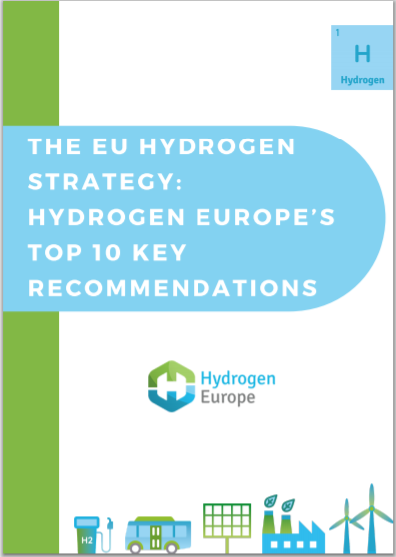
COHERENT STRATEGY
VISION
COST
COMMITMENT
RECOMMENDATIONS
Produce 40GW in Europe and 40GW in neighbouring countries by 2030.
€430bn in funds are needed to kick start the hydrogen economy.
Input to the Hydrogen Strategy: providing an enabling regulatory framework at EU level.

Slide 9
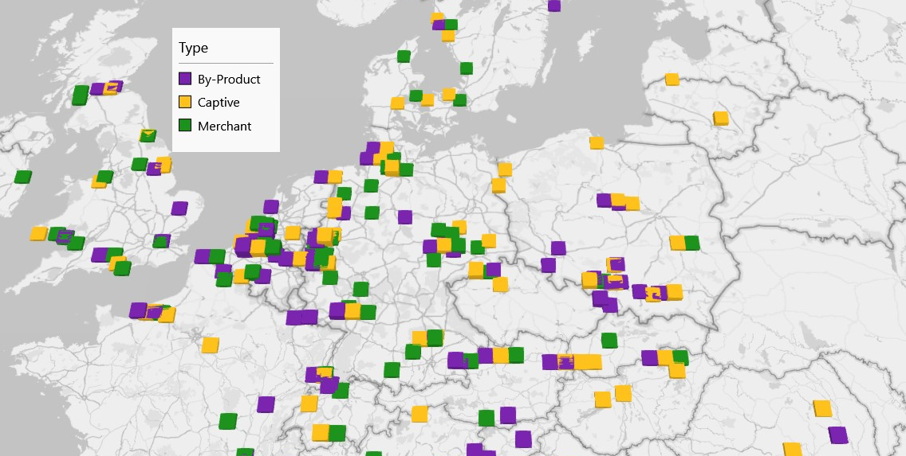
Hydrogen demand
Germany and the Netherlands are by far the biggest H2 consumers with large demand centers in the Ruhr Valley, Leuna industrial area, and North Sea maritime ports

Slide 10
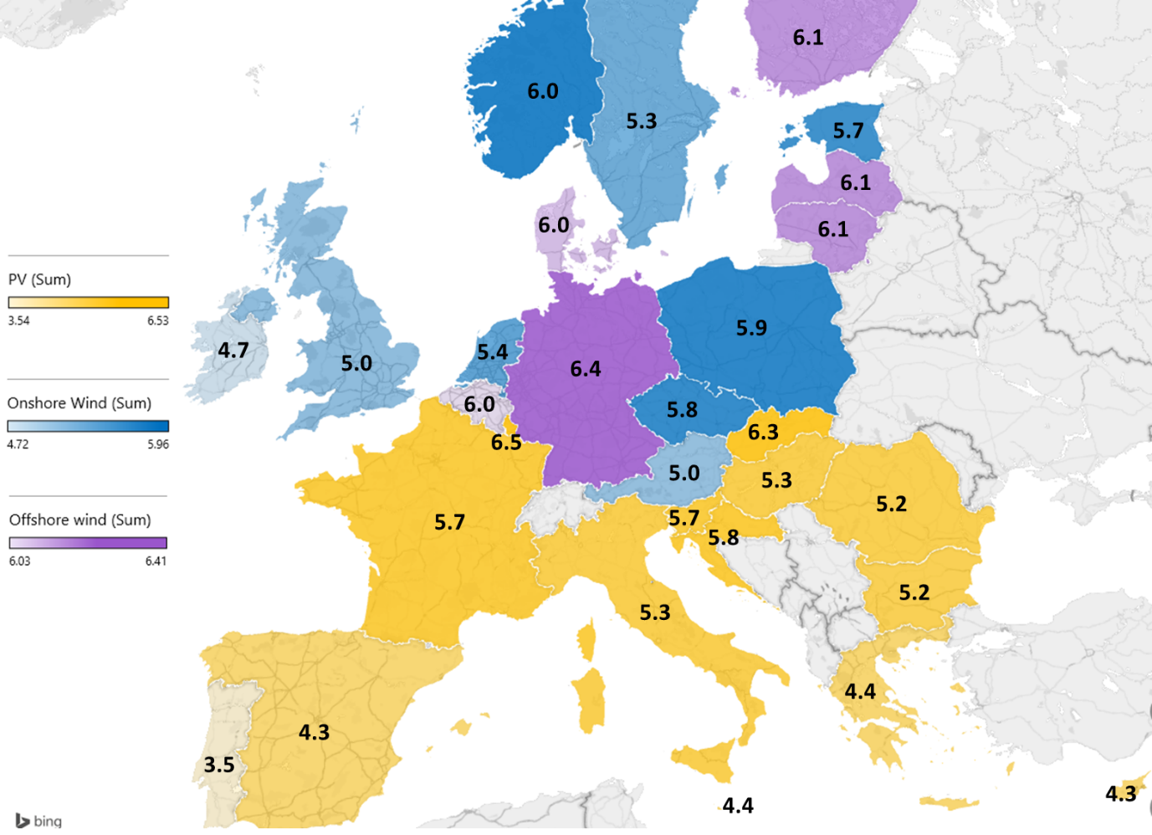
Renewable hydrogen production costs
The cheapest renewable hydrogen production costs today is PV solar + electrolysis
Yet neither Germany nor the Netherlands have great PV solar resources
Until offshore wind becomes more cost competitive, in the short to medium term, renewable H2 production costs in the south of Europe will be 2-3 EUR/kg lower.
Source: Hydrogen Europe

Slide 11
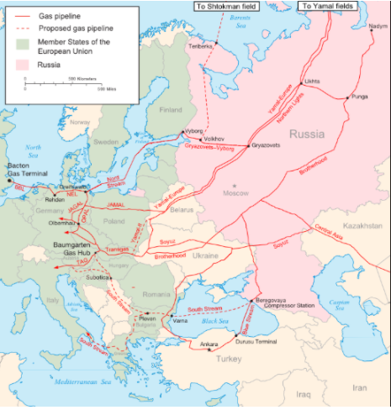
A single 48-inch pipeline has a maximum capacity of 13 GW (LHV) of hydrogen, which enables to transport around 2 million tonnes of hydrogen per year (almost all current H2 consumption in Germany)
Pipeline are by far the cheapest way of hydrogen transportation with around 0.2 EUR/kg/1,000 km
This can be further reduced (0.11 EUR/kg/1,000 km) by retrofitting existing natural gas pipelines

Slide 12
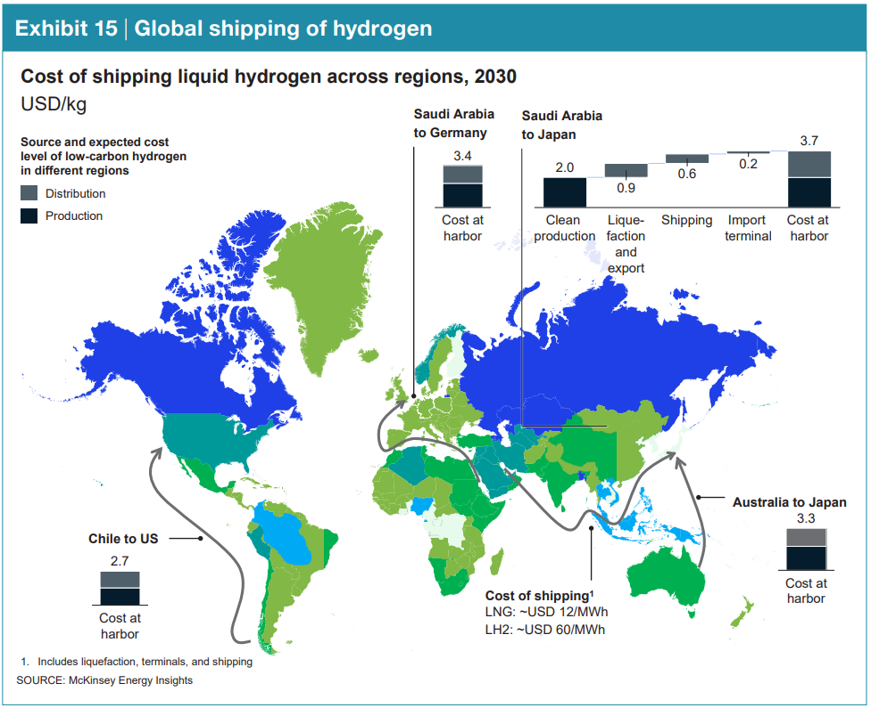
Renewable hydrogen import - ships
Cost of shipping Hydrogen in liquid form are higher than pipelines but still lower than north – south production costs difference
Alternatives include using Liquid Organic Hydrogen Carriers or ammonia / methanol as energy carriers
Source: Hydrogen Council

Slide 13
How might the markets develop?
STAGE 1
Local hydrogen valleys
STAGE 2
Imports / exports via marine ports
Pipeline connections between H2 valleys and H2 production centers
STAGE 3
STAGE 4
Integrated H2 market?
Stage 4

Slide 14
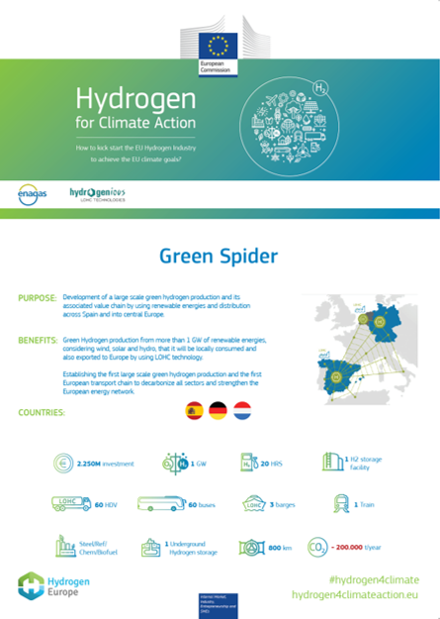
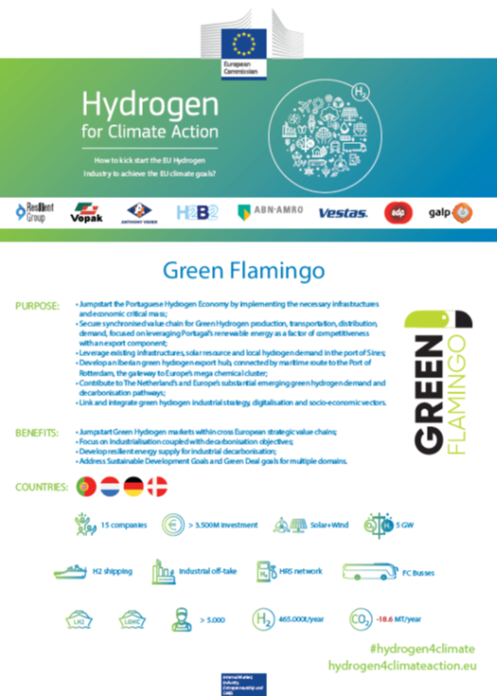
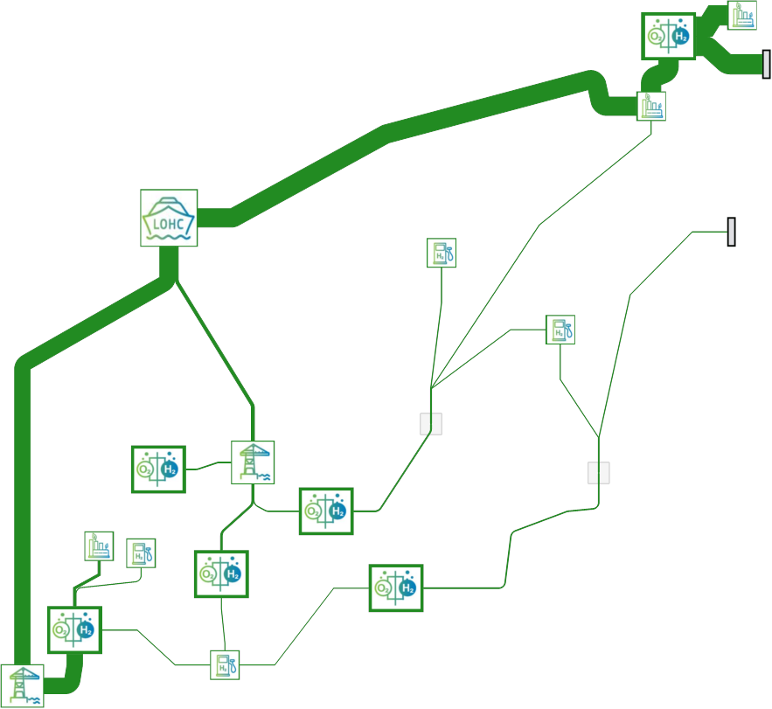
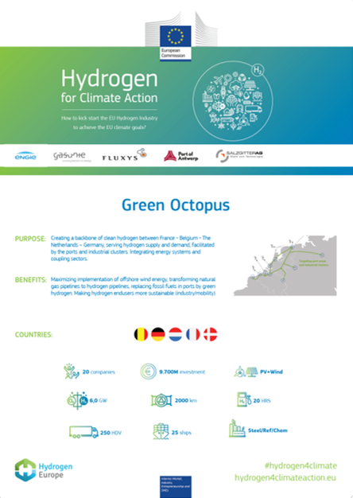
Could IPCEI accelarate this process?

Slide 15
FINANCIAL ENGINEERING
ETS FUND
FCH JU
TEN-E / TEN-T / CEF
Next Generation EU
Just Transition Fund
Next Gen EU
IPCEI

Slide 16
HISTORICAL CHANGE OF STATE AID RULES
Carbon Border Adjustment Mechanism

Slide 17
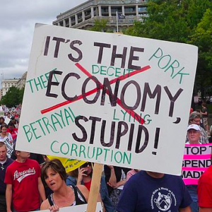
SLIDE TITLE
NEW PRIORITIES FOR A SYSTEMIC CHANGE
It’s the carbon content, stupid!

Slide 18
EXAMPLE OFFSHORE INITIATIVE
Communication on Offshore Renewable Strategy
“HydroGenewables”

Slide 19
EU NEEDS A HYDROGEN ACT
EU Hydrogen Act
Hydrogen Infrastructure
Hydrogen Market

Slide 20
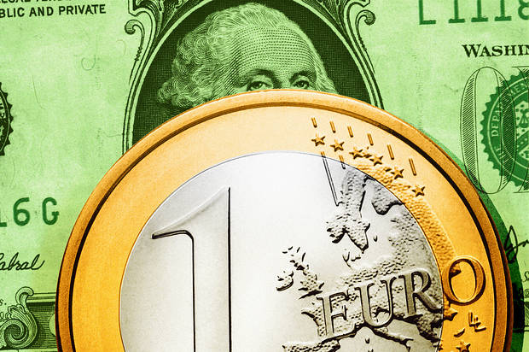
EUROPE’S HISTORICAL ROLE
Create the world’s leading market for Clean Hydrogen

Slide 21
Our mission – zero emission!
HYDROGEN EUROPE SECRETARIAT
Avenue de la Toison d’Or 56-60
BE-1060 Brussels
secretariat@hydrogeneurope.eu
+32 (0) 2 540 87 75
www.hydrogeneurope.eu

