Slide 1
The use of hydrogen in the industry
IJzebrand Rijzebol
Regional Minister for Economic Affairs

Slide 2
The chemical clusters in the Northern Netherlands

Slide 3
2 Chemical Clusters
More than 50 companies
5 knowledge institutions
14 R&D facilities
Ambition:
Become the first cluster with zero CO2 emissions and minimum environmental impact.
The entire Chemport Europe industry cluster will only use renewable energy and feedstocks by 2050.
Notes:
Chemport Europe is an ecosystem in the Northern Netherlands in which companies committed to the development of a greener chemical sector flourish.
These companies, together with knowledge institutions and government are in the process of transforming of the chemical industry. The ambition is green growth.
By 2050, only renewable energy and raw materials will be used.

Slide 4
Closing the loop

Slide 5
CO2 reduction
Absolute reduction: 35%
Relative reduction: 55%
Production increased by 50%
The CO2 emission is still decreasing!

Slide 6
Ways to reduce the CO2 emission
CO2 neutral
Energy efficiency
Circularity
Change energy source
Biobased feedstock
Process innovation
CCS
CCU
Balance between reducing the emission while keeping the competitive position in the highly competitive global market
Notes:
Vanuit technisch perspectief zijn er voldoende mogelijkheden voorhanden om deze doelstelling te behalen. De industrie opereert in een zeer competitieve omgeving op een wereldwijd speelveld.
Voor het behoud van de internationale concurrentiepositie van de industrie dient daarom uitvoerig gekeken te worden naar eventuele nadelige effecten van kostenverhoging door duurzaamheidsverbeteringen. Projecten voor de reductie van emissies zullen ook in dit kader beoordeeld moeten worden. Het instrumentarium van de overheid dat ontwikkeld zal worden, zal mede bepalen welke projecten en oplossingsrichtingen financieel haalbaar zijn.

Slide 7
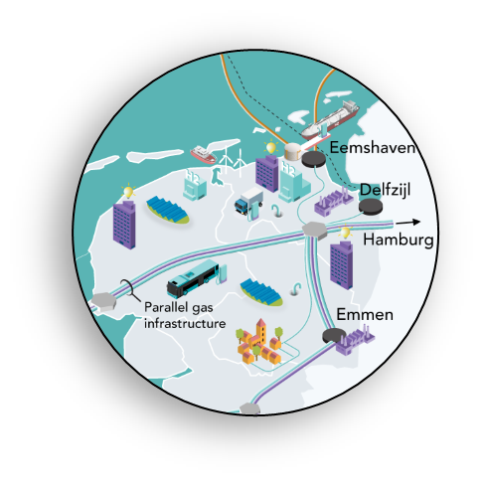
Hydrogen as a sustainable source for feedstock and energy
The Northern Netherlands has access to the following critical assets required for a competitive hydrogen ecosystem:
hydrogen offtake markets
offshore wind potential
strategic locations for hydrogen production
available and dense infrastructure (pipelines, storage, ports)
gas and hydrogen knowledge.

Slide 8
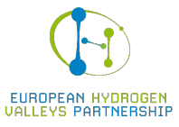
Hydrogen Valley
Development of a fully functional green hydrogen chain in the Northern Netherlands
Production
Feedstock for the industry
Storage
Transportation
Energy source for the industry
S3 platform: European Hydrogen Valleys Partnership
Northern Netherlands Hydrogen Investment Agenda
Notes:
90 miljoen euro
20 miljoen van de EC ontvangen (Horizon2020 programma)
70 miljoen publieke en private investeringen
Project duurt 6 jaar
Dit is een overkoepelend project waaronder vele kleinere projecten hangen.
Goed borgen dat deze projecten in samenhang worden opgezet en uitgevoerd.

Slide 9
Hydrogen in the industrial cluster
Companies at the Chemical Parc Delfzijl already exchange residual hydrogen
This is a residual product of the chlorine production
Combining hydrogen with carbon for the production of (for example) methanol
Carbon from waste streams or CCU methods
Using hydrogen for the production of polymers (for example aramid fibers)
Notes:
Waterstof als een restproduct: van zoutwinning → zuivering (15% zout) → elektrolyse: waterstof, natronloog en chloor

Slide 10
We are interested in European cooperation for greening the industry!
Thank you for your attention!

