Slide 1


Chemical Recycling and Circular Economy
Henk Pool, Innovation Manager, Cefic
European Chemicals Regions Network Conference
26 October 2020

Slide 2
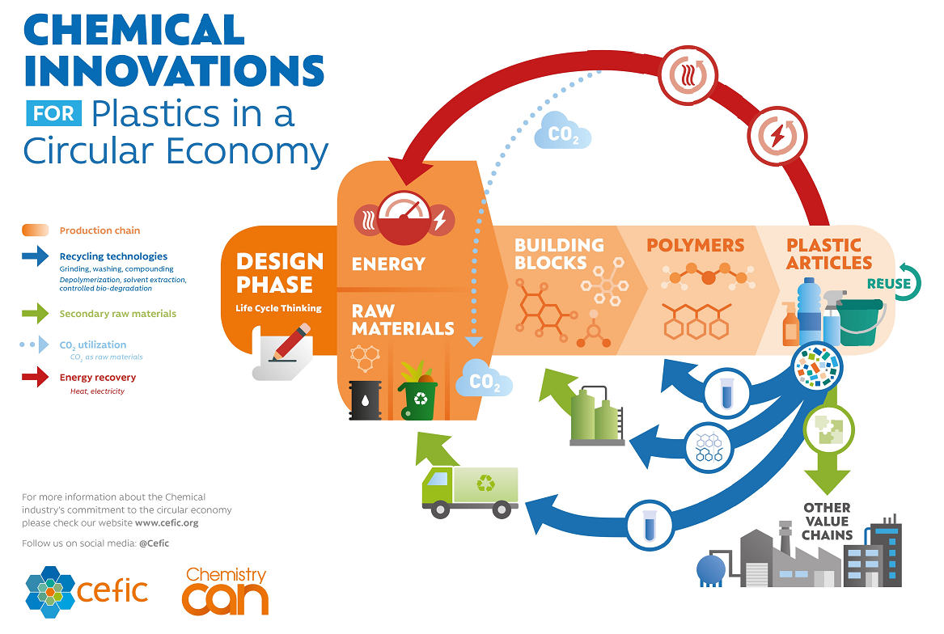
Creating a Circular Economy for Plastics
“Every year, Europeans generate 25 million tonnes of plastic waste, but less than 30% is collected for recycling” states the 2018 European Plastics Strategy.
15% of the plastic waste collected today finds its way back to the market
Mechanical Recycling + Sorting
85% is currently incinerated or landfilled
Opportunity for Chemical Recycling
Mixed + Contaminated Plastics
European Chemicals Regions Network Conference, 26 October 2020

Slide 3
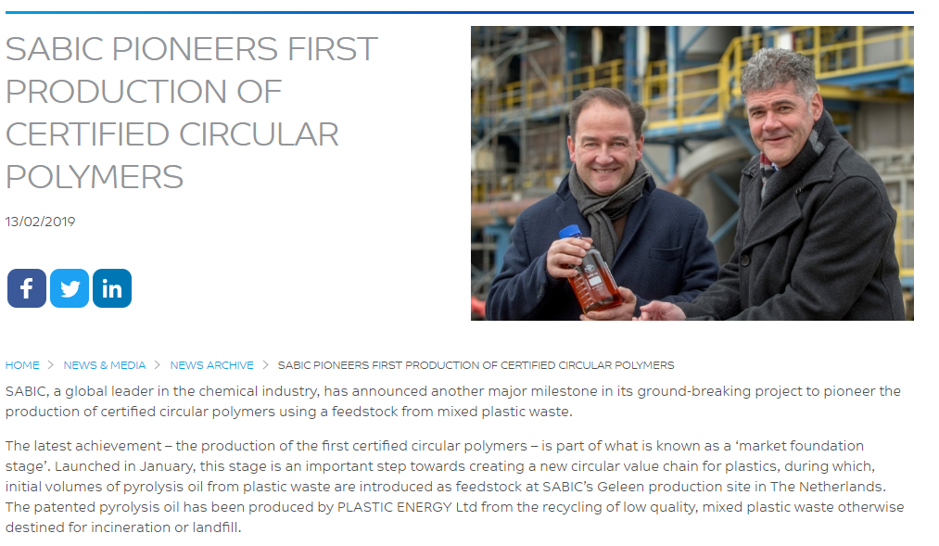

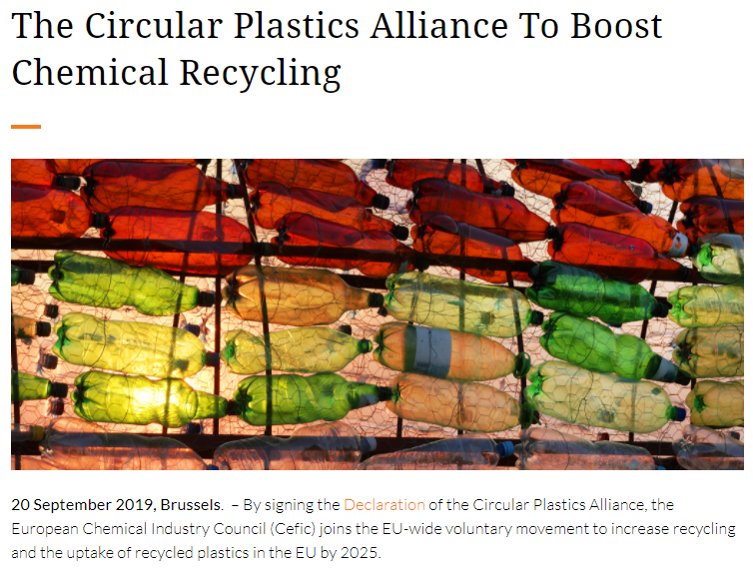

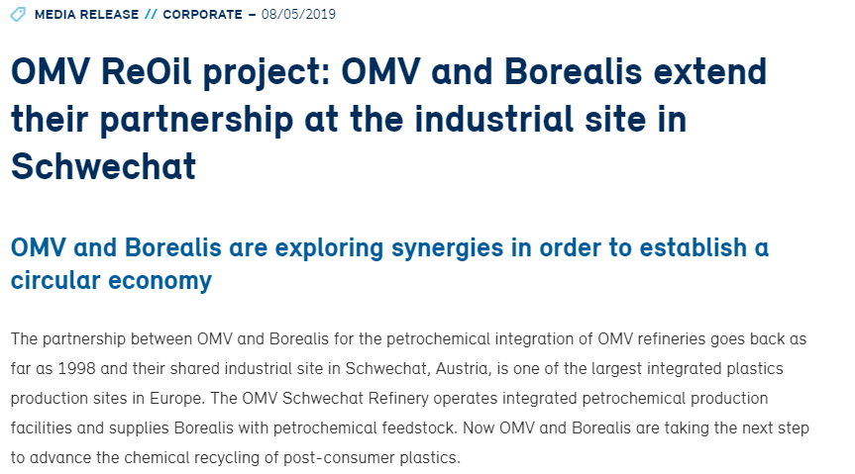


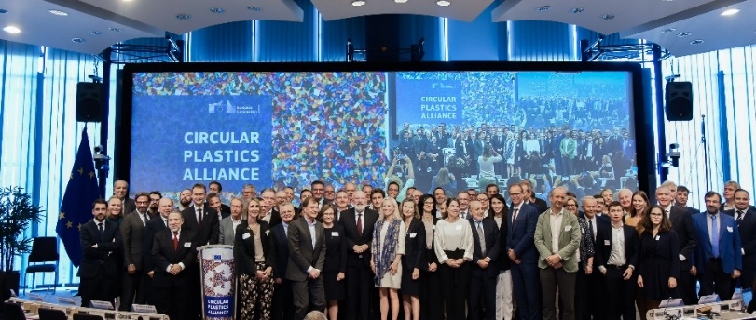
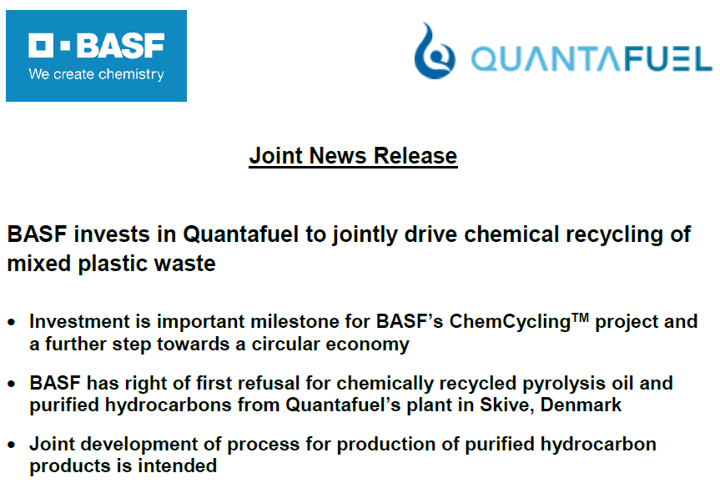


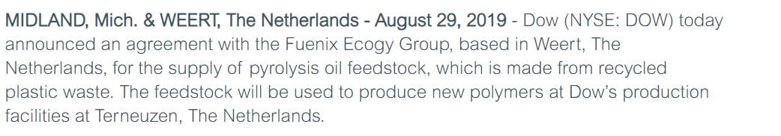

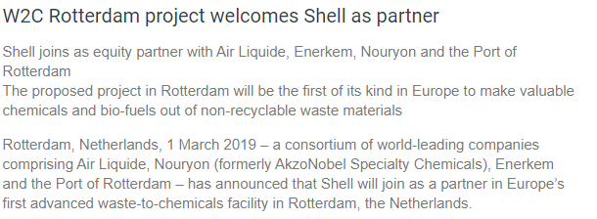

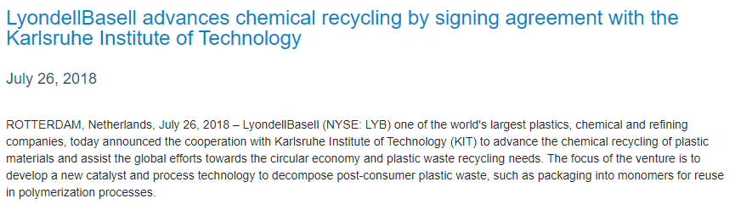




Chemical Recycling: What is the Chemical Industry Doing?
Partnerships: Technology Development & Business Case
European Chemicals Regions Network Conference, 26 October 2020

Slide 4
Chemical Recycling: Answering some Questions
Competing with mechanical recycling Cefic position Complementing + needing both
Chemical “Recycling” producing fuel Cefic position not Recycling
GHG footprint Cefic LCA study Publishing soon
Recycled content (Qualitative & Quantitative) Chain of Custody Segregating or
Attributing using Mass Balance
Not proven at full scale Technology Ready & Demonstrating
Can not compete in market Business case Partnerships & Testing in market
European Chemicals Regions Network Conference, 26 October 2020

Slide 5
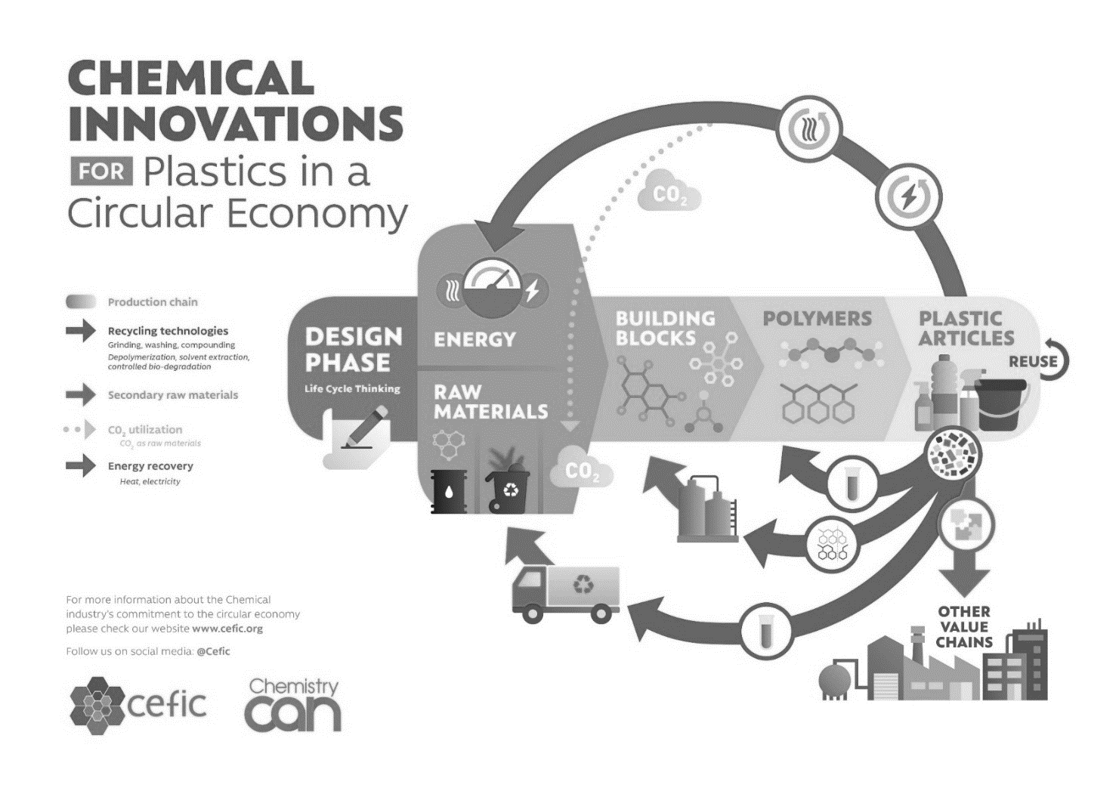
Can we achieve a Circular Economy for Plastics without Chemical Recycling?
Resources:
Middle East: oil + gas
US: shale gas
Europe: end of life materials = products and secondary raw materials
Europe can take a leadership role in the development of the circular economy
(Chemical) Recycling is an integral part of a circular economy
Shift from a “waste orientation” to a “resource orientation”
& Create a single market for secondary raw materials
European Chemicals Regions Network Conference, 26 October 2020

Slide 6
Thank you

