Slide 1
Regional solutions to upscale the Bio-based chemical production in Europe
Dirk Carrez Executive Director, Biobased Industries Consortium
BUILDING THE SUSTAINABLE CHEMICAL INDUSTRY OF TOMORROW (ECRN, 26 October 2020)

Slide 2
Mission
Build new bio-based value chains (develop new technologies, products and applications, optimise feedstock)
Create favourable business and policy climate to accelerate market uptake of bio-based products

Slide 3
BIC membership in figures
> 240 industry members (large enterprises, SMEs and SMEs in clusters), includes brand owners/market actors
Sector represented: Agriculture, food & feed, Aquaculture and marine, Chemicals and materials, Forestry and pulp & paper, Market actors, Technology providers, Waste management & treatment
> 200 associate members i.e. universities, RTOs, associations, etc.

Slide 4
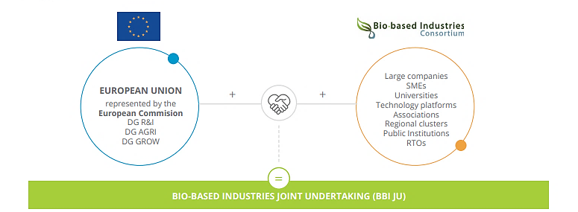
BBI JU: Partnership between industry (BIC) and EC

Slide 5
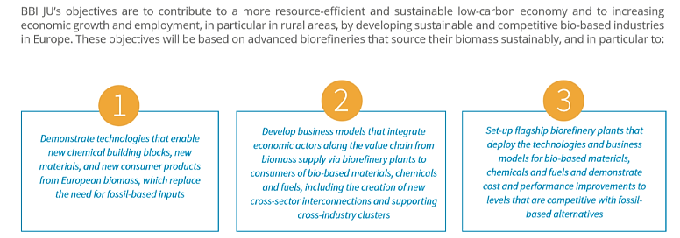
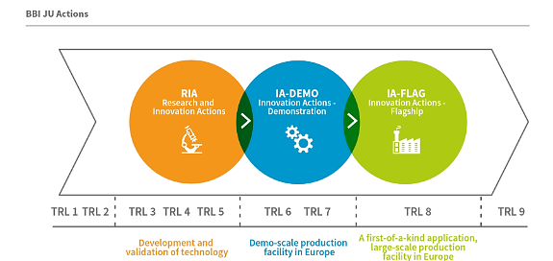
BBI: Objectives & actions

Slide 6
Impact of BBI JU (2014-today)
Mobilisation of private investment in Europe: keeping knowledge and innovation, and investments in innovative production processes in Europe. Attract companies from outside EU to invest in innovation in Europe!
Growing interest for BBI grants, including growing number of demo and flagship proposals
Development of new innovative value chains: e.g. food industry collaborating with the chemical industry, the forestry and pulp & paper sector collaborating with chemical and textile industry, etc.
New industrial sectors are joining e.g. by creating value from waste and side streams (food processing sector, aquatic/marine sectors, bio-waste, …). As a result we also observe a wider geographical spread throughout Europe.
Linking the industry to policies and initiatives such as the Circular Economy Package and COP21.
Increased market focus: participation of brand owners is key as they help to develop new applications and create new markets. Their involvement also shortens time to market for innovative bio-based products.
Growing involvement of the regions: BIC and BBI JU have strengthened their collaboration with the EU regions to exchange information and explore synergies and opportunities for joint financing, and deployment of new local value chains.
Growing awareness from EU-13 of the opportunities.

Slide 7
BBI JU projects and regional/rural development
Project types
Rural development & Green Deal
DEMO
Demonstrating the proof of concept that setting up innovative value chains in rural areas is feasible
2. FLAGSHIP
First-of-their-kind and state-of-the-art bio-based projects i.e. projects that have the potential to upscale the circular bioeconomy in Europe
Deploying R&D & building value chains
at regional level
ECONOMIC & SOCIAL
The BBI project is implemented in a rural area i.e. supporting regional/rural development by creating jobs and green growth (linked to regional development, green recovery, …)
2. ENVIRONMENT
Sustainability building investments, can be linked with (future) CAP and Pillar II (support for rural development).

Slide 8
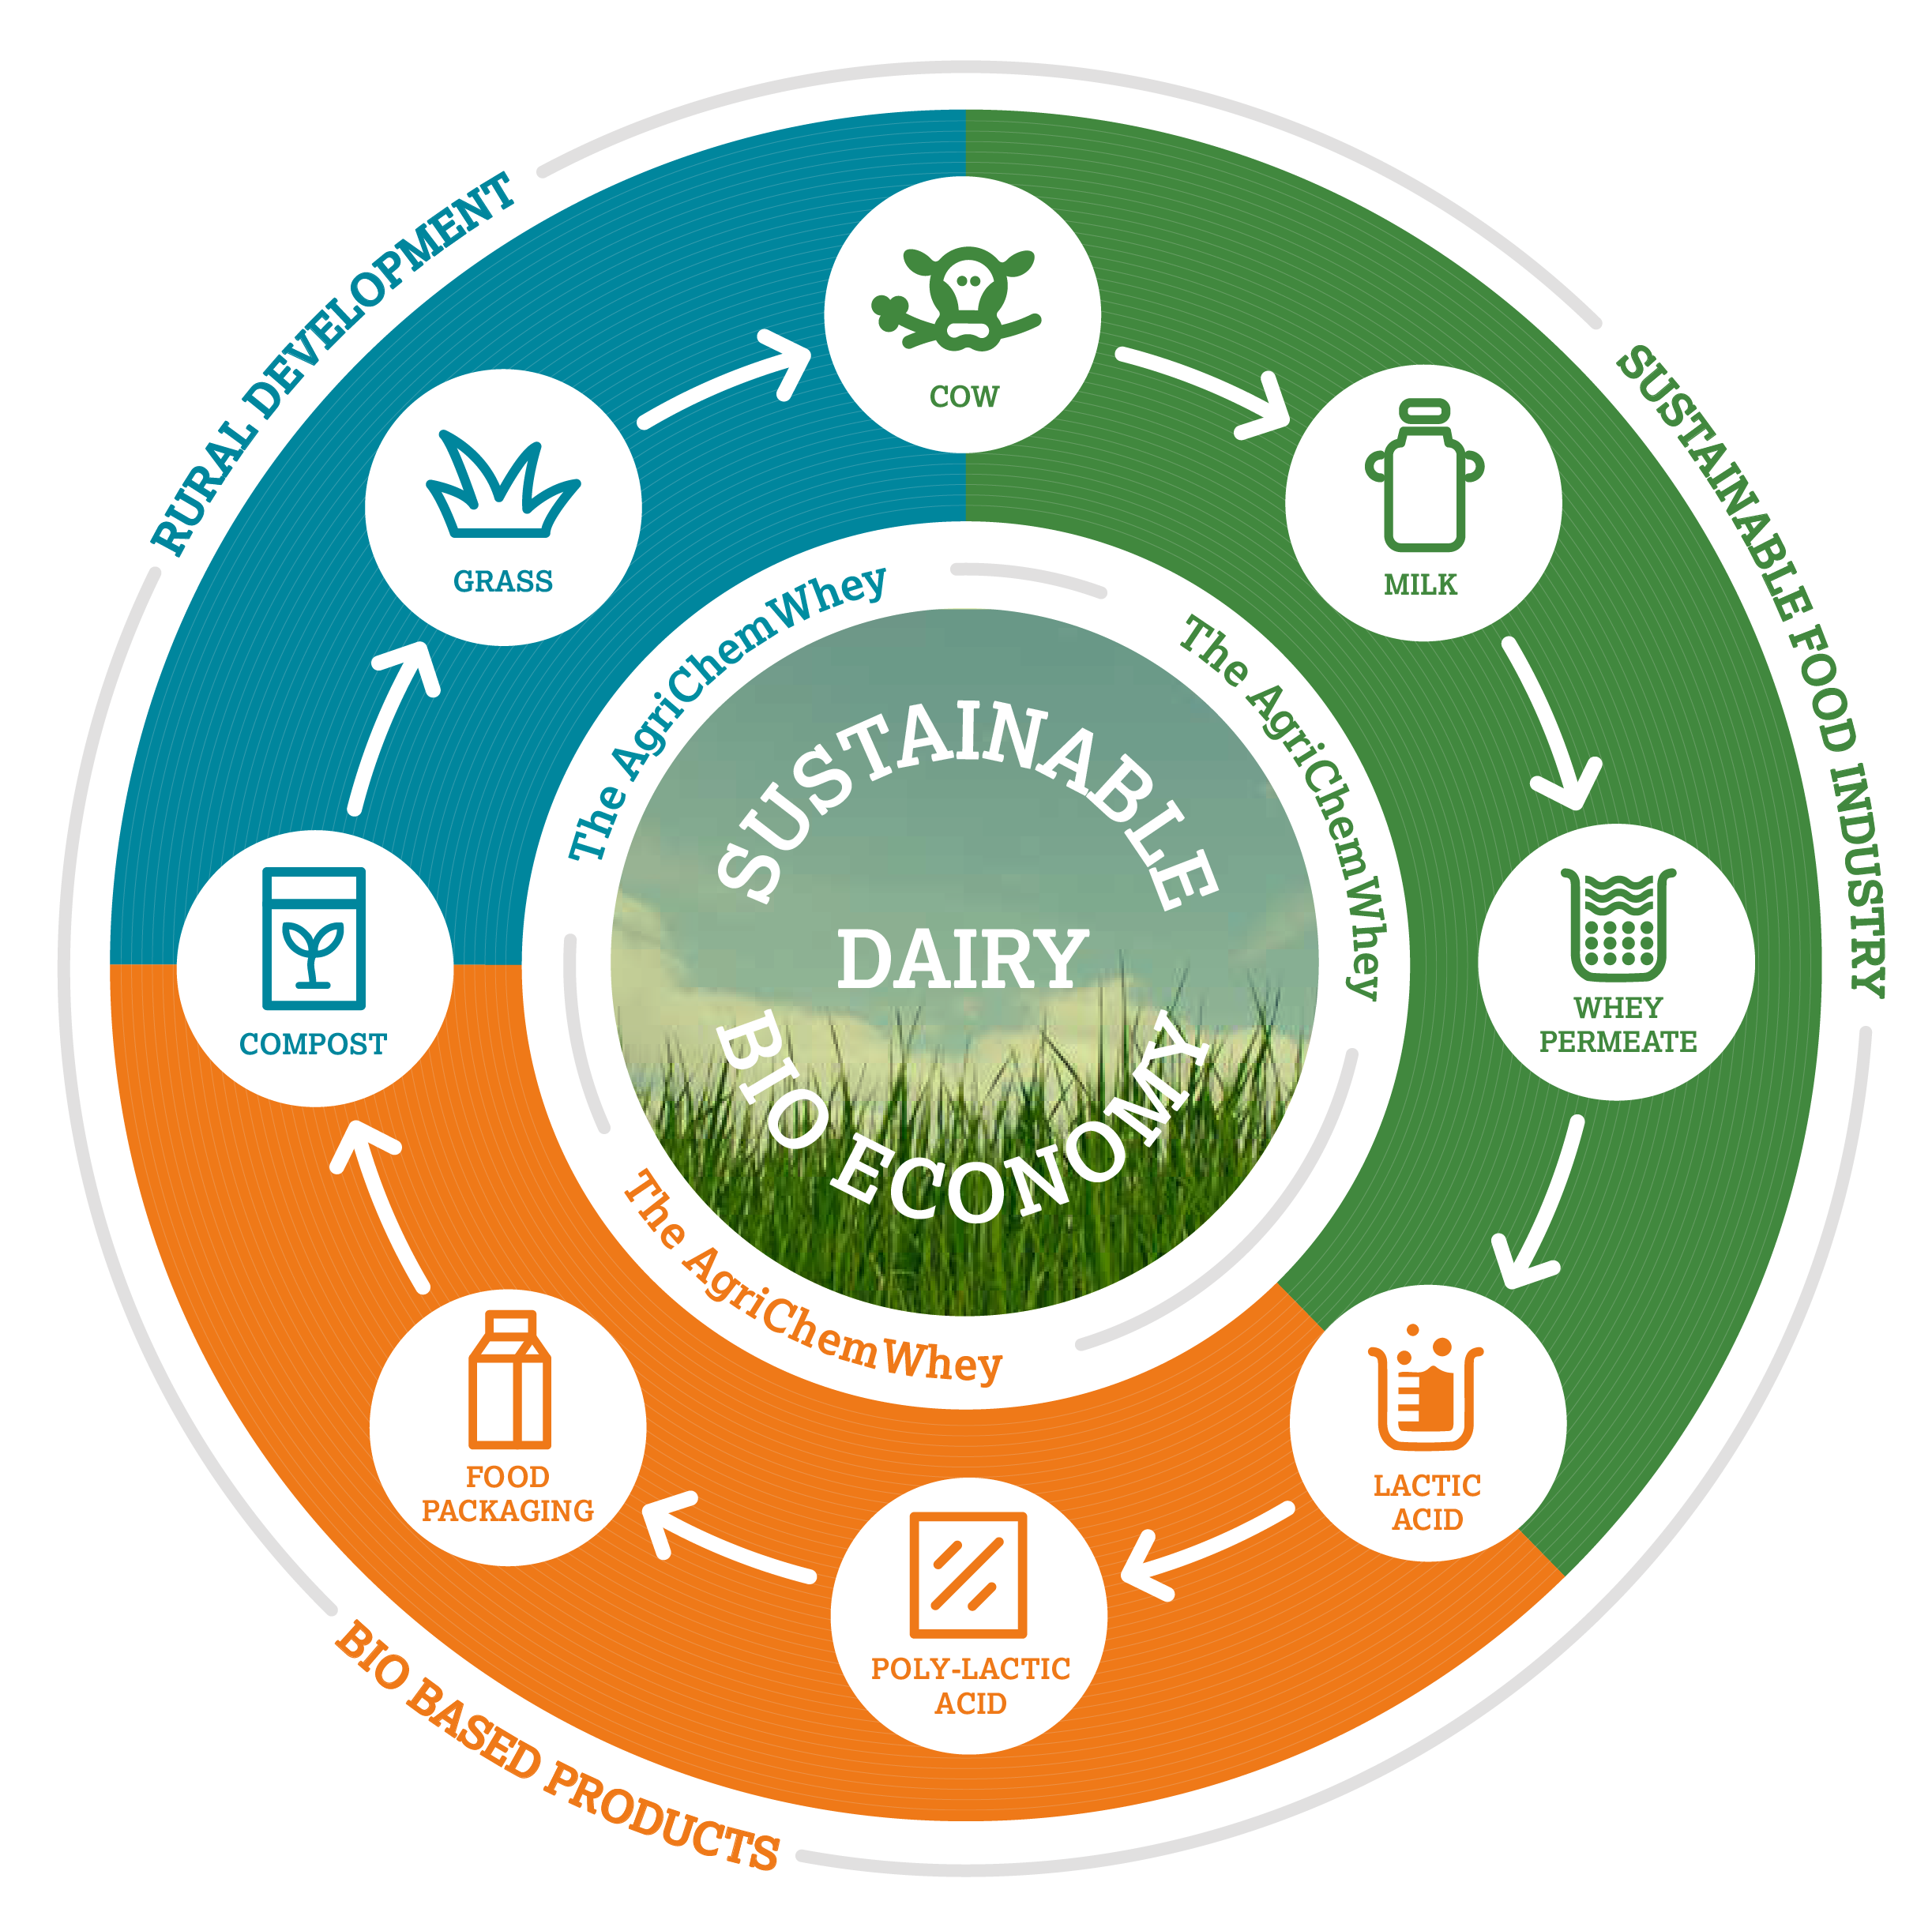
1. AgriChemWhey
Valorising dairy by-products and creating new opportunities for EU farmers
RURAL INVESTMENT
Flagship investment in rural area Lisheen, Ireland
RURAL DEVELOPMENT
OBJECTIVE
Converting dairy by-products to high-value
bio-based chemicals
SUSTAINABILITY CHALLENGE
Aid farmers to comply with EU Water Framework
Directive for sustainable milk expansion in the EU
RURAL DEVELOPMENT
NEW SUSTAINABLE PRODUCTS
L-Lactic acid, polylactic acid, minerals for human
nutrition and bio-based fertiliser
RURAL DEVELOPMENT
Zinc mine replaced by National Bioeconomy
Campus & AgriChemWhey model replicated in
other regions
GREEN GROWTH
New EU products meeting global demand for
whey protein for human and animal nutrition

Slide 9
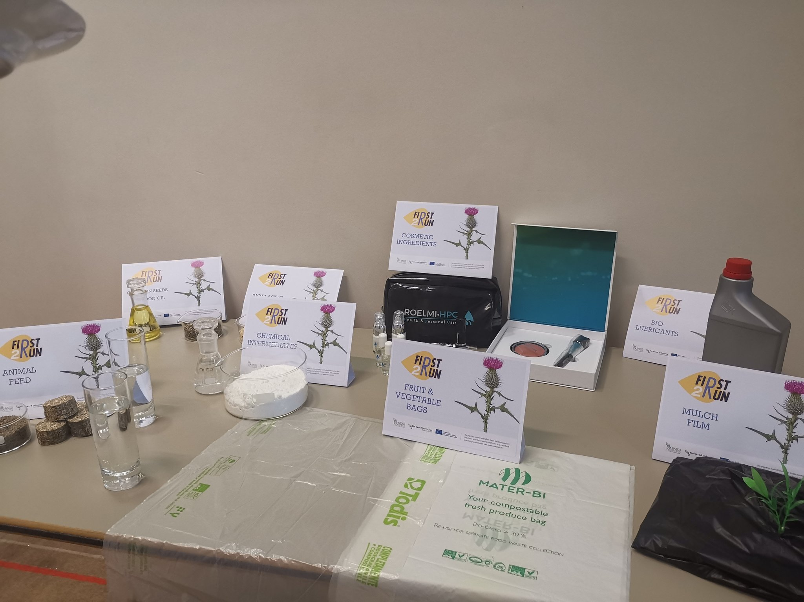
2. First2Run
First-ever BBI flagship produces high value bio-based products from marginal lands
RURAL INVESTMENT
Flagship investment in rural area of Sardinia, Italy
RURAL DEVELOPMENT
OBJECTIVE
Converting underutilised oil crops grown in arid
and/or marginal lands into bio-based products
SUSTAINABILITY CHALLENGE
New bio-based product alternatives which reduce
GHG emissions by 35%
NEW SUSTAINABLE PRODUCTS
Cultivation of indigenous cardoon crops to
produce bioplastics, cosmetics, lubricants,
fertilisers, herbicides and animal feed
a
RURAL DEVELOPMENT
established a new local value chain involving
farmers as biomass suppliers and as end-users of
fertilisers, herbicides and animal feed
GREEN GROWTH
600 jobs directly created in an area with a high
unemployment due to shutdown of a local
petrochemical plant

Slide 10
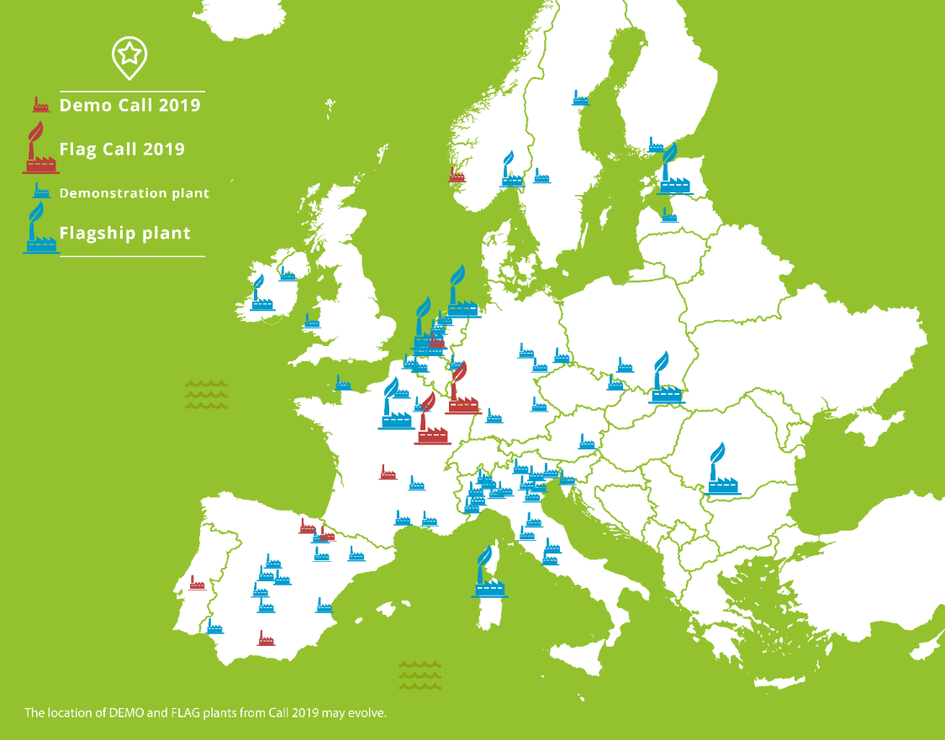
Geographical coverage of DEMOs and FLAGs
2014-2019

Slide 11
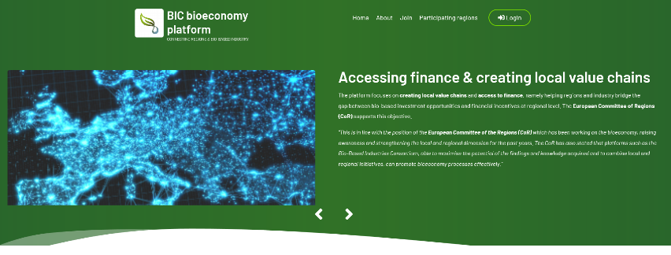
Regional dimension of the biobased industry
Challenges & opportunities
Why?
Opportunities to “valorise” local feedstock: municipal waste, agricultural crops or forestry, waste from food industry, aquatic & marine feedstock, ….
Regions can help setting up local value chains, so their local industry (including primary sector) benefits from it.
Often this will need a collaboration with surrounding regions → Interregional collaboration or innovation programmes could certainly help.
Not all partners for a local value chain can be found within the region → Search for a partner from outside the region will often be needed.
Regions can use regional and rural development funds and other finances to support and attract investments, and as such create new jobs and opportunities (including for the primary sector).
Mobilising effect: Regions are “closer” to their stakeholders, including SMEs, universities & research institutes, local investors, farmers & foresters, …
Actions:
Better involvement of the regional / local authorities, actors and investors in a possible new PPP for the biobased economy: mobilizing the local actors, engage in information, communication, exploitation and dissemination activities, support regional deployment, ...
Launch of a digital platform with industry and regions https://www.bioeconomy-regions.eu

Slide 12
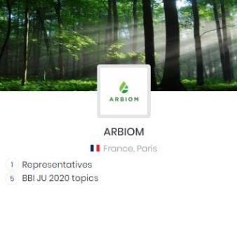
BIC’s new bioeconomy platform
Partnering based on profiles with key data
100 + Bio-based industry
> 50 Regions
Sector(s)
Offer to regions e.g. feedstock to commercialise, pilot plants to develop etc.
Target market sectors
Feedstocks currently in use
Feedstocks looking to use
BBI JU project participation
BBI JU calls applied for
Biorefineries in Europe, etc…
Primary/secondary contact
General introduction of region
Bio-based investment priorities/Smart Specialisation
Regional bioeconomy strategy
Feedstocks
Financial incentives for bio-based investment
Industry sectors you are seeking investment from
Skills & competencies, etc…

Slide 13
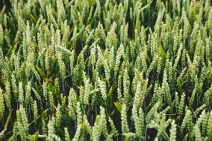
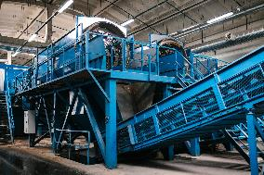
BIC’s new bioeconomy platform
What are the benefits?
Regions
Bio-based industry
Attract investments from the bio-based industry in new, local value chains
Highlight your region’s bio-based priorities, feedstocks, incentives for investment etc. & link up with S3 strategies
Use the platform’s search and filter functions to identify the right bio-based industry actors for a BBI or other bio-based investment project
Access alternative sources of finance for highly ranked, but unsuccessful funding proposals e.g. flagship & demo
Highlight the types of markets sectors, feedstock use etc. you are targeting and attract the right regions for a BBI project or other bio-based investment project
Use the platform’s search and filter functions to identify regions’ financial incentives for investment

Slide 14
BIC’s new bioeconomy platform
Who are the 50 + regions involved?
Northern Europe
Western Europe
Southern Europe
Central & Eastern Europe
Denmark (1)
Aarhus (business region)
Iceland (1)
Þingeyjarsýsla (North Iceland)
Finland (3)
Kainuu
North Karelia
Southwest Finland
Sweden (4)
Kalmar County
Gävleborg
Östergötland
Värmland
Greece (2)
Central Macedonia
Western Macedonia
Italy (8)
Emilia-Romagna
Friuli Venezia Giulia
Lombardy
Marche*
Piemonte
Puglia*
Trentino*
Veneto
Croatia (1)
Istria*
Hungary (1)
Dél-Alföld (Southern Great Plain)
Latvia (1)
Vidzeme
Lithuania (1)
Klaipeda
Poland (2)
Pomorskie
Zachodniopomorskie
Romania (2)
• Centru
• Nord-Est
Slovenia (1) (unitary state)
Belgium (2)
Flanders
Wallonia*
France (2)
Hauts-de-France
Pays de la Loire
Germany (2)
Baden-Württemberg
North Rhine-Westphalia
Ireland (3)
South-East
South West
North & Western (regional assembly)
Netherlands (5)
Limburg
North Brabant
Groningen, Drenthe and Fryslan*
United Kingdom (3)
Northern Ireland
Yorkshire & the Humber
Wales
Portugal (2)
Algarve*
Lisbon*
Spain (6)
Andalusia
Aragón
Basque country
Catalonia
Extremadura
Navarra
* Yet to complete profile

Slide 15
Thanks !!! Dirk Carrez dirk.carrez@biconsortium.eu www.biconsortium.eu

