Slide 1
Lia Voermans, Director Chemelot Circular Hub
ECRN conference Europe
26.10.2020

Slide 2
In the Limburg region (NL), we are developing Europe's first large-scale Circular Hub
Notes:
We are an self- sustaining industrial ecosystem since years working on full scale industrial symbioses and circular economy
We’re Closing the feedstock- , energy and data loops and have brought togethter all relevant stakeholders, technologies, infrastructures,, tools & Instruments necessary for the incubation, implementation, evoluation and management

Slide 3
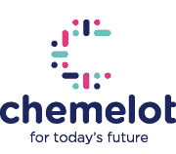
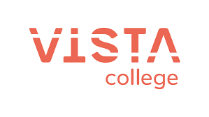
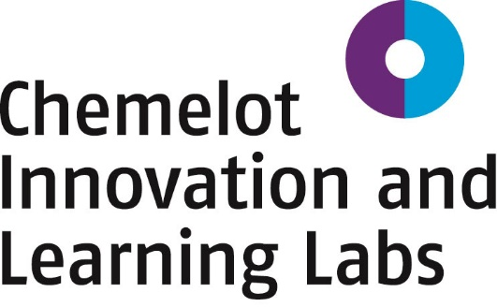
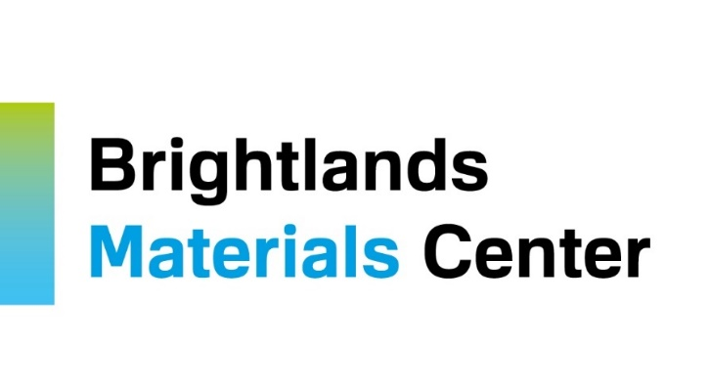
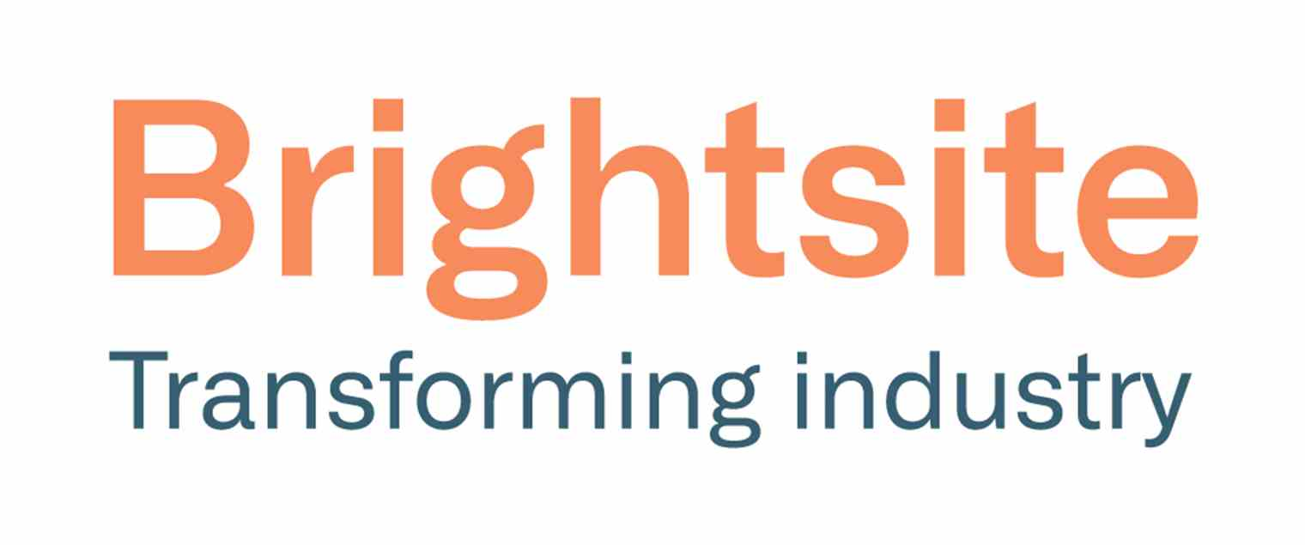
Initiators

Slide 4
Stakeholders
Government, Process Industry, Research & knowledge institutes and citizens invest together in:
CHEMELOT CIRCULAR HUB
Chemelot Industrial Parc as the epicenter of the circular chemical industry
Brightlands Chemelot Campus as a hotspot for circular innovations
Human Capital Agenda as vehicle that captivates, attract and trains talent at all levels
Circular society as enabler towards a healthy living environment

Slide 5
Chemelot Circular Hub
in pole position
Notes:
We are a self-sustaining economic industrial ecosystem
for full-scale Industrial- Urban Symbiosis and Circular Economy,
closing Feedstock – (energy, resource and data) loops
bringing together all relevant stakeholders, technologies, infrastructures, tools and instruments necessary for their incubation, implementation, evolution and management.

Slide 6
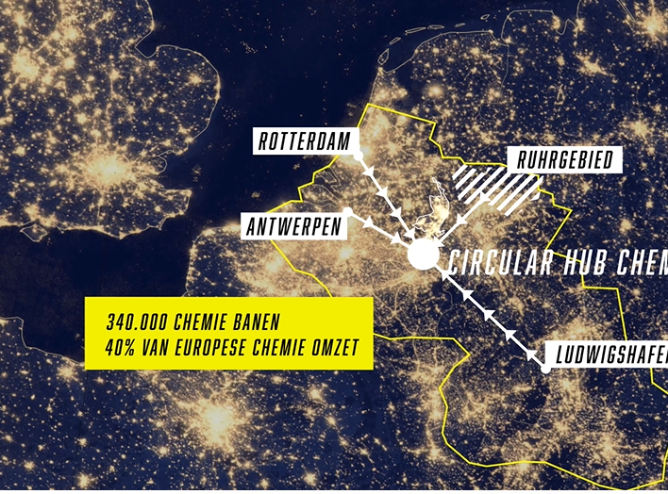
Success factors
Unique innovation ecosystem
Most productive chemical cluster in NL
Tradition in transition
Strategic location in Europe
(ARRRA cluster)
We're already on our way!
A)
Notes:
Area: Industrial Park + Innovation Campus
Capability: scaling up + debottlenecking
Knowledge: chemical, process and material engineering
Education: CHILL Labs national Best Practice
Region: without borders, Euregional, Trilateral
Governments: want to contribute and invest
The acquisition of parties with new, already scaled-up technologies that will be located directly at Chemelot Industrial Park
The acquisition of parties with still-to-scale-up technologies that will be located on the Brightlands Chemelot Campus (Pilot & Demos)
Scaling up inventions from basic research elsewhere in the application-oriented research institutes such as:
- Brightsite
- Brightlands Materials Center
- Aachen-Maastricht Institute on Biobased Materials

Slide 7
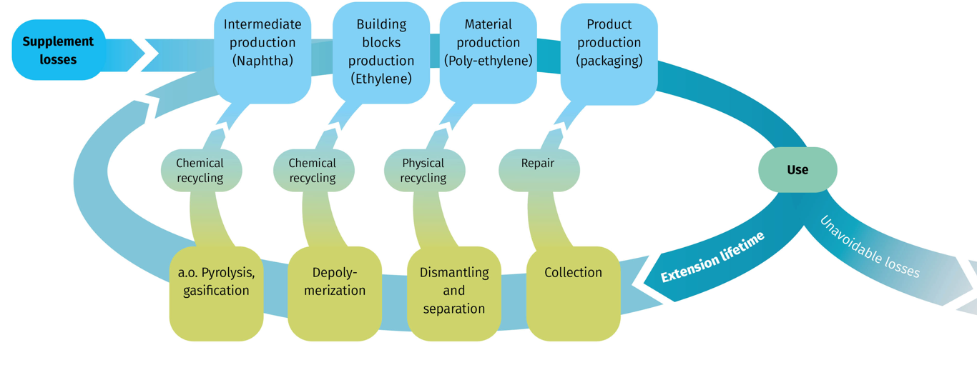
Technological–Steps
From linear to circular
Continue current revenue model
Expansion revenue model (Upstream)
Expansion revenue model(Downstream)
Broadening revenue model
Knowledge valorization
Notes:
From:
Natural gas and naphtha as a source of energy and raw material
To:
Electricity as an energy source and plastic residual streams and biomass as raw materials

Slide 8
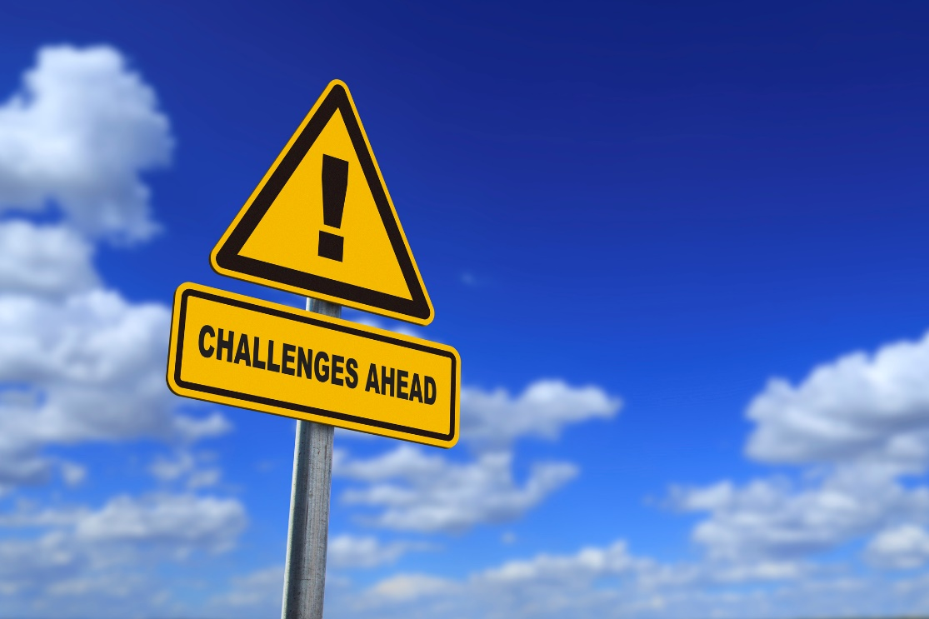
Challenges
Non-technological issues
Know how and experience exchange between H4C within Trilateral Region- Europe
De-bottleneck waste - acknowledged as a new feedstock
Current Policies block Circular Economy (scope 3)
Need for a Level playing field (Cross-border legislation)
Security of Supply Renewable Electricity
Awareness of Learning curve for new technologies

Slide 9
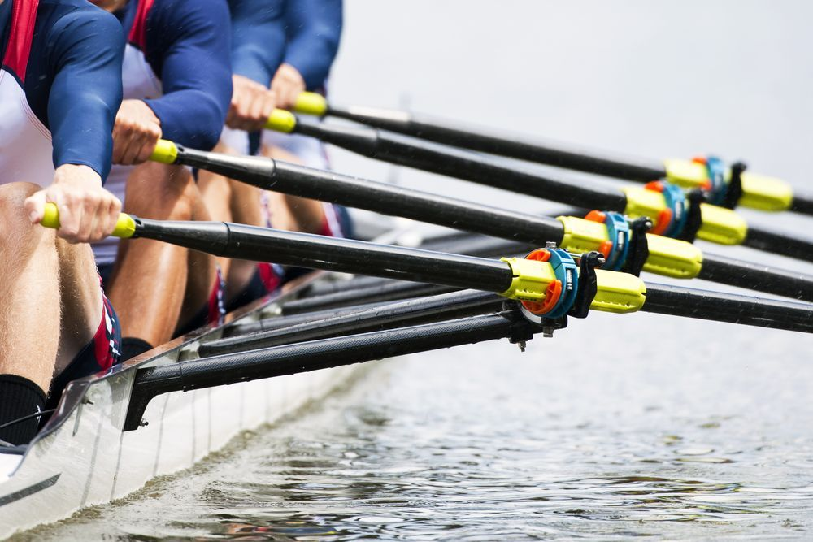
Come invest with us …
Talent development
Technology
Infrastructure
Public welfare
In a sustainable future for this region, the Netherlands and Europe

Slide 10
THANK YOU FOR YOUR ATTENTION
Lia.Voermans@Brightlands.com

